Slide 2
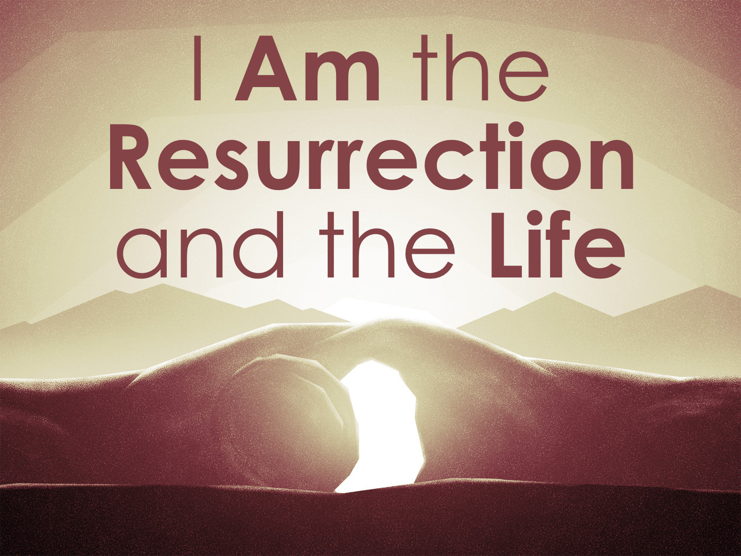

Slide 3
“I Am the Resurrection”
He is the author of the resurrection.
He is “the firstfruits of those who have fallen asleep”: 1 Cor. 15.20
He gives assurance to all who hear and believe: John 5.24, 28-29; 11.25; 1 Thess. 4.16-17

Slide 4
“I Am the Life”
He has the power to give life: John 5.21; 6.33; 10.10, 28
Where there is resurrection, there is life, but this life is spiritual: Eph. 2.1-5

Slide 5
Whoever believes in the Son of God has the testimony in himself. Whoever does not believe God has made him a liar, because he has not believed in the testimony that God has borne concerning his Son. And this is the testimony, that God gave us eternal life, and this life is in his Son. Whoever has the Son has life; whoever does not have the Son of God does not have life.
1 John 5.10-12

