Slide 2
What does your
say about you?

Slide 8
1.65 billion monthly active users
1.51 billion mobile active users
4.5 billion likes generated daily
29.7% of users are age 25 to 34
5 new profiles are created every second
Source: zephoria.com
Notes:
Source: https://zephoria.com/top-15-valuable-facebook-statistics/

Slide 9
300 million photos are uploaded per day
20 minutes average time per visit
4.75 billion pieces of content shared daily
1 in 5 page views in the U.S.
Source: zephoria.com
Notes:
Source: https://zephoria.com/top-15-valuable-facebook-statistics/

Slide 10
510 comments are posted, 293,000 statuses are updated, and 136,000 photos are uploaded every 60 seconds
Source: zephoria.com
Notes:
Source: https://zephoria.com/top-15-valuable-facebook-statistics/

Slide 11
Snapchat:
8,796 photos sent per second
10 billion videos a day
Sources: businessinsider.com | digitaltrends.com
Notes:
Sources:
http://www.businessinsider.com/snapchat-photos-sent-per-second-2015-5
http://www.digitaltrends.com/social-media/snapchat-10-billion/

Slide 12
Oxford Dictionaries 2013 Word of the Year, “selfie”
Source: oxforddictionaires.com
Notes:
http://blog.oxforddictionaries.com/2014/06/social-media-changing-language/

Slide 13
What Good Can We Do With Social Media?
Keep up with family, friends and brethren from all around the world
Our “web presence” to promote the gospel within the community/world.
Notes:
Source: https://zephoria.com/top-15-valuable-facebook-statistics/

Slide 14
What Evil Can We Do With Social Media?
Divide people
Spread lies and bitterness
Advance false doctrines
Self-glorification
Profanity
Immodesty
Pornography
Notes:
Source: https://zephoria.com/top-15-valuable-facebook-statistics/

Slide 15
Watch what you POST on

Slide 16
Watch What You Post On Facebook
Do not BROADCAST sin to the world: Eph. 4.29-32; 5.3-5; Matt. 5.14-16; 12.36-37
Corrupt words? Complaining and grumbling? Angry thoughts? Venting? Gossip? Arguing?
These things HINDER the gospel! Cf. 1 Tim. 4.12; 1 Peter 2.12; Titus 2.7-8
Notes:
Source: https://zephoria.com/top-15-valuable-facebook-statistics/

Slide 17
Watch What You Post On Facebook
THINK Before You Post:
Is it TRUTHFUL?
Is it NECESSARY?
Is it KIND?
Is it APPROPRIATE?
If it's a sin OFFLINE, it's a sin ONLINE!
Notes:
Source: https://zephoria.com/top-15-valuable-facebook-statistics/

Slide 18
Watch what you UPLOAD on

Slide 19
Watch What You Upload On Facebook
Why are we INVOLVED in the activities that would warrant such a picture or video?
We are not to LOOK like the world: Rom. 12.1-2; 1 Peter 4.3-5
Our post can be a STUMBLING block to others: Matt. 18.6
Notes:
Source: https://zephoria.com/top-15-valuable-facebook-statistics/

Slide 20
Watch what you SHARE/LIKE on

Slide 21
Watch What You Share/Like on Facebook
Are we guilty of sharing / liking SIN?
Memes sometimes include immodesty, profanity, immorality, gossip, blasting people, etc.
Notes:
Source: https://zephoria.com/top-15-valuable-facebook-statistics/

Slide 22
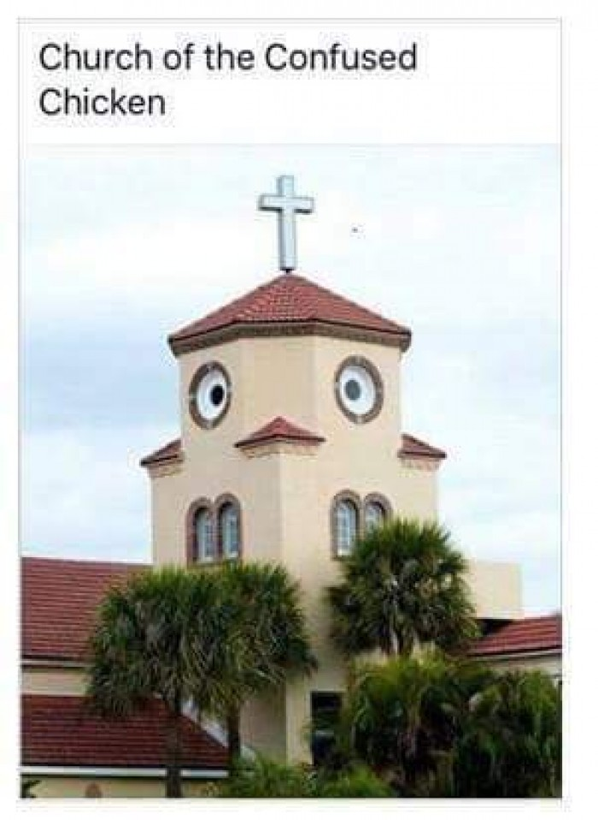
Notes:
Source: https://zephoria.com/top-15-valuable-facebook-statistics/

Slide 23
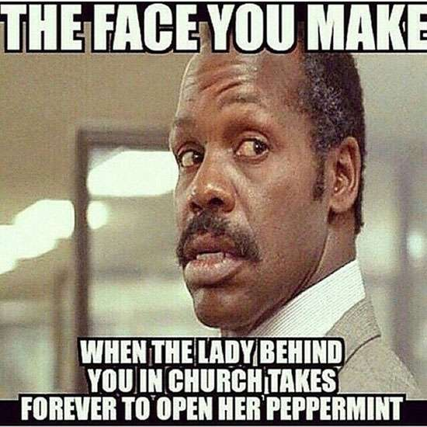
Notes:
Source: https://zephoria.com/top-15-valuable-facebook-statistics/

Slide 24
Watch What You Share/Like On Facebook
Are we guilty of sharing / liking SIN?
Memes sometimes include immodesty, profanity, immorality, gossip, blasting people, etc.
Are we spreading lies? Slander?
Are the facts truthful?
Notes:
Source: https://zephoria.com/top-15-valuable-facebook-statistics/

Slide 25
FAKE
Source: World News Daily Report
Notes:
http://worldnewsdailyreport.com/red-sea-archaeologists-discover-remains-of-egyptian-army-from-the-biblical-exodus/

Slide 26
Watch What You Share/Like On Facebook
Where is it coming from?
When we share an image/video we share the caption, the page it originated from and the comments.
Notes:
Source: https://zephoria.com/top-15-valuable-facebook-statistics/

Slide 27
Watch what you DO on

Slide 28
Watch What You Do On Facebook
Online TEMPTATIONS await you!
the people you BEFRIEND: 1 Cor. 15.33
the things you SEE: Matt. 6.22-23; Psalm 101.3
Be cautious of settling family / friend ISSUES online: Matt. 18.15-17
Notes:
Source: https://zephoria.com/top-15-valuable-facebook-statistics/

Slide 29
Watch your TIME spent on

Slide 30
Social media is checked 17 times a day
2013: 18-34 = 3.8 hours a day
35-49 = 3 hours per day
50-64 = 2.4 hours per day
2015: 8-12 = 6 hours | 12 and up = 9 hours
Sources: digitaltrends.com | marketingcharts.com | cnn.com
Notes:
http://www.digitaltrends.com/mobile/informate-report-social-media-smartphone-use/
http://www.marketingcharts.com/online/social-networking-eats-up-3-hours-per-day-for-the-average-american-user-26049/
http://www.cnn.com/2015/11/03/health/teens-tweens-media-screen-use-report/

Slide 32
Watch Your Time Spent On Facebook
Newsfeed: Updates on family and friends, etc.
Talking to people, watching videos, etc.
“Click bait”
Notes:
http://www.digitaltrends.com/mobile/informate-report-social-media-smartphone-use/
http://www.marketingcharts.com/online/social-networking-eats-up-3-hours-per-day-for-the-average-american-user-26049/
http://www.cnn.com/2015/11/03/health/teens-tweens-media-screen-use-report/

Slide 36
Social media is checked 17 times a day
2013: 18-34 = 3.8 hours a day
35-49 = 3 hours per day
50-64 = 2.4 hours per day
2015: 8-12 = 6 hours | 12 and up = 9 hours
Sources: digitaltrends.com | marketingcharts.com | cnn.com
Notes:
http://www.digitaltrends.com/mobile/informate-report-social-media-smartphone-use/
http://www.marketingcharts.com/online/social-networking-eats-up-3-hours-per-day-for-the-average-american-user-26049/
http://www.cnn.com/2015/11/03/health/teens-tweens-media-screen-use-report/

Slide 37
Watch Your Time Spent On Facebook
What if we checked our Bible 17 times a day?
What if we prayed 17 times a day?
What if we invited 17 people to a Bible study?
Notes:
http://www.digitaltrends.com/mobile/informate-report-social-media-smartphone-use/
http://www.marketingcharts.com/online/social-networking-eats-up-3-hours-per-day-for-the-average-american-user-26049/
http://www.cnn.com/2015/11/03/health/teens-tweens-media-screen-use-report/

Slide 38
What does your
say about you?

