Slide 2
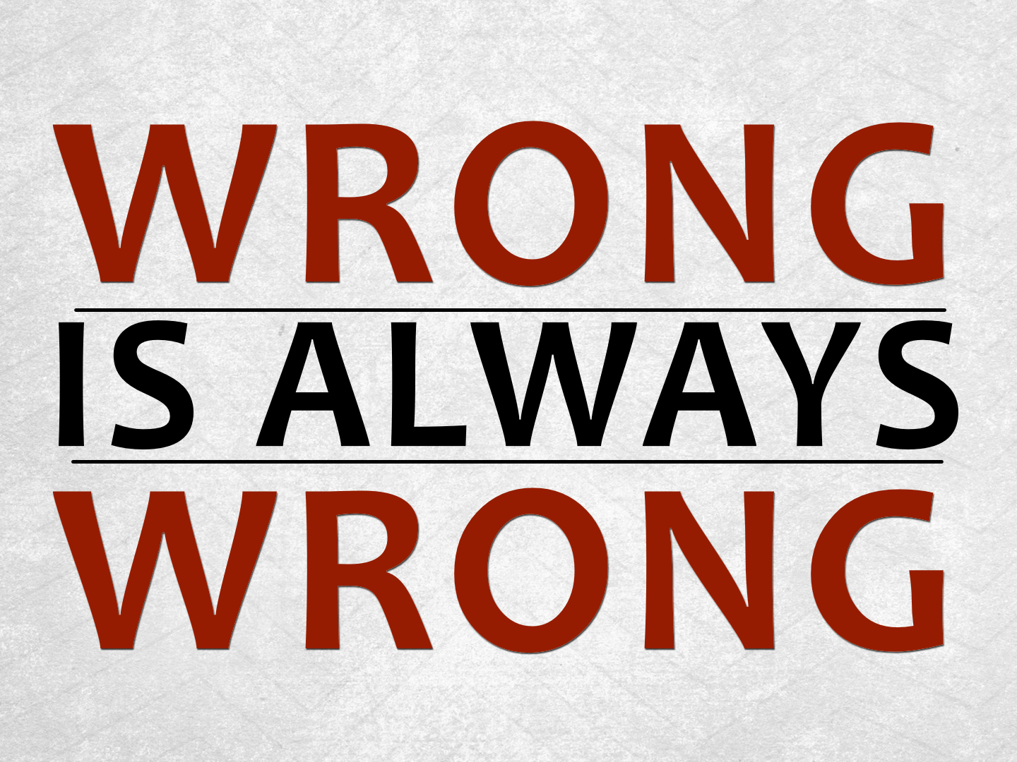

Slide 3
Colossians 3.25
For the wrongdoer will be paid back for the wrong he has done, and there is no partiality.

Slide 4
No Matter WHO Does It
The rich & powerful: Job 34.19
Jews or Gentiles: Rom. 2.11-12
The majority: Exo. 23.2; Matt. 7.13-14
Preachers: Gal. 2.11-14
Family: Matt. 10.37

Slide 5
Even If It Is LEGAL
Just because something is legal does not make it right: John 12.48
Just because something is unlawful doesn’t make it wrong: Acts 5.29
Man will always try to make sin legal!

Slide 6
Even If We Don’t Get CAUGHT
The eyes of the Lord are everywhere: Prov. 15.3
“be sure your sin will find you out” Num. 32.23
Some men’s sins are clearly evident, preceding them to judgment, but those of some men follow later. 1 Tim. 5.24
God will judge the secrets of men: Rom. 2.16

Slide 7
Even If It Is Done for a GOOD CAUSE
“The end justifies the means” rational:
  gambling to help education, churches, etc.
  church giveaways, etc.
We cannot do evil for good to come: Rom. 3.8; cf. 1 Sam. 15.15, 22

Slide 8
Even If Someone Else CAUSES Us to Do It
We cannot shift blame: Gen. 3.3-5, 9-13; 1 Sam. 15.3, 8-9, 13-15, 24-26
Personal choice and responsibility always exist!

Slide 9
Even If It is Difficult to Make RIGHT
“…the way of the unfaithful is hard” Prov. 13.15
Repentance demands not only a change of mind but also a change of actions coupled with godly sorrow: cf. Ezra 10.2-4; 2 Cor. 7.10

Slide 10
Even If It Does Not Bother Our CONSCIENCES
“I don’t see anything wrong in that.” Or “I feel in my heart that this is OK.”
Let the truth be our guide and standard in all-religious matters: John 17.17; Col. 3.17; Heb. 5.14
Just because we don’t find it wrong, doesn’t mean it is right! Prov. 14.12; Jer. 10.23; Acts 23.1; 26.9-11; cf. Eph. 4.19

Slide 11
Even Though God Wants Us to Be HAPPY
“I know that God wants me to be happy!”
Christians are to be the happiest people: Psalm 40.16, 144.15, cf. Philippians, etc.
But God does not want us living in sin: cf. Heb. 11.24-26

Slide 12
Even It Seems like the RIGHT Thing to Do
King Saul thought it right to sacrifice at Gilgal: 1 Sam. 13.8-13
Caiaphas thought it right to kill Jesus: John 11.49-50
Saul of Tarsus thought it right to kill Christians: Acts 23.1; 26.9-11

Slide 13
Even If We Refuse to ADMIT It
Israel would not admit her sins: Mal. 1.6; 2.17; 3.7-8

Slide 14
Even If It Is Done in IGNORANCE
Murderers of Jesus; Idolaters: Acts 3.17; 17.23
God has determined that ignorance is no excuse: Acts 17.30
Ignorance is still a violation of God’s will!

Slide 15
Even If It Is Done in IGNORANCE
God does not want us to be ignorant (without knowledge): 1 Tim. 2.4; Eph. 5.17; cf. 1 Cor. 12.1; 1 Thess. 4.13
Grow in knowledge to avoid sin: 2 Peter 3.18; 1 John 2.1
“I did not know” will not be valid excuse on judgment day!

Slide 16
Even If We Change Its NAME
Alternate life style instead of homosexuality
Termination of pregnancy instead of abortion
Affair instead of adultery
Claiming same sex marriage is “lawful and therefore right”

Slide 17
Even If We Change Its NAME
Woe to those who call evil good and good evil, who put darkness for light and light for darkness, who put bitter for sweet and sweet for bitter! Isaiah 5.20
He who justifies the wicked and he who condemns the righteous are both alike an abomination to the Lord. Prov. 17.15

Slide 18
Even If TIME Passes
It might be old, but it doesn’t make it right.
Moses’ sin: Num. 20.7-12; Deut. 3.23-28

Slide 19
May we never DETERMINE to make wrong “right” to JUSTIFY ourselves!

