Slide 2
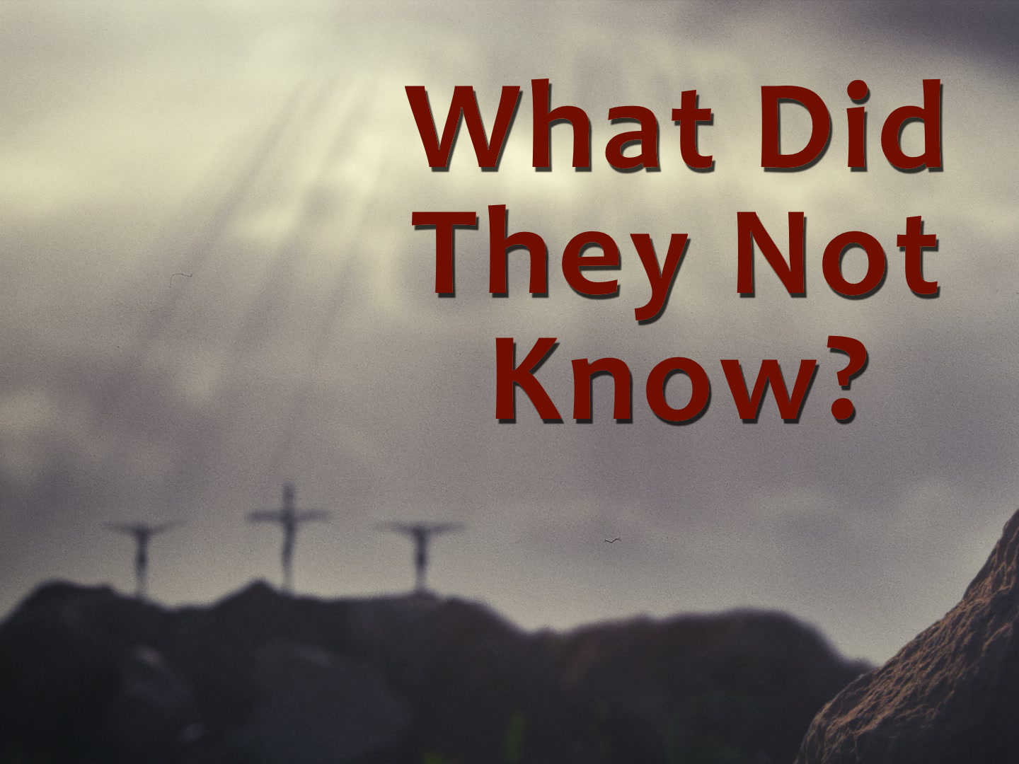
Notes:
Patient

Slide 3
What Did They Not Know?
And Jesus said, “Father, forgive them, for they know not what they do.”
Luke 23.34

Slide 4
What Did They Not Know?
And now, brothers, I know that you acted in ignorance, as did also your rulers.
Acts 13.17

Slide 5
They Accused Him falsely
And they began to accuse him, saying, “We found this man misleading our nation and forbidding us to give tribute to Caesar, and saying that he himself is Christ, a king.”
Luke 23.2; cf. 20.19-26; John 10.24-25

Slide 6
They Accused Him falsely
And though they found in him no guilt worthy of death, they asked Pilate to have him executed.
Acts 13.28

Slide 7
They Solicited False Testimony
Now the chief priests and the whole council were seeking false testimony against Jesus that they might put him to death…
Matt. 26.57-68; cf. 27.39-40; John 2.18-22; 5.18

Slide 8
They Conspired Against Him
When morning came, all the chief priests and elders of the people plotted against Jesus to put Him to death.
Matt. 27.1

Slide 9
They Were Motivated By Envy
So when they had gathered, Pilate said to them, “Whom do you want me to release for you: Barabbas, or Jesus who is called Christ?” For he knew that it was out of envy that they had delivered him up.
Matt. 27.17-18

Slide 10
What did they not know they were doing?

Slide 11
They Were Rejecting the Word
John 1.1, 14, 31-34, cf. 11-12

Slide 12
They Were Denying the Holy One
But you denied the Holy and Righteous One, and asked for a murderer to be granted to you…
Acts 3.14

Slide 13
They Were Killing the Prince of Life
And killed the Prince of life, whom God raised from the dead, of which we are witnesses.
Acts 3.15

Slide 14
They Were Crucifying the Lord of Glory
But we impart a secret and hidden wisdom of God, which God decreed before the ages for our glory. None of the rulers of this age understood this, for if they had, they would not have crucified the Lord of glory.
1 Cor. 2.7-8

Slide 15
They Were Crucifying the Christ
Let all the house of Israel therefore know for certain that God has made him both Lord and Christ, this Jesus whom you crucified.
Acts 2.36

Slide 16
They Were Betraying And Murdering the Righteous One
Which of the prophets did your fathers not persecute? And they killed those who announced beforehand the coming of the Righteous One, whom you have now betrayed and murdered…
Acts 7.52

Slide 17
They Were Fulfilling the Prophets
For those who dwell in Jerusalem, and their rulers, because they did not know Him, nor even the voices of the Prophets which are read every Sabbath, have fulfilled them in condemning Him.
Acts 13.26-41; 3.17-26

Slide 18
There Was One There That Day That Didn’t Leave That Scene In Ignorance
God’s power was on display.
He didn't miss it.

Slide 19
There Was One There That Day That Didn’t Leave That Scene In Ignorance
God’s promises were being fulfilled.
He was offered them.

Slide 20
There Was One There That Day That Didn’t Leave That Scene In Ignorance
God was persuading man to believe.
He confessed Him.

Slide 21
There Was One There That Day That Didn’t Leave That Scene In Ignorance
And when the centurion, who stood facing him, saw that in this way he breathed his last, he said, “Truly this man was the Son of God!”
Mark 15.38-39

Slide 22
Ignorantly Transgressing God’s Will Is Still A Violation Of God’s Will!
Repent therefore, and turn back, that your sins may be blotted out, that times of refreshing may come from the presence of the Lord…
Acts 3.19-20

