Slide 2
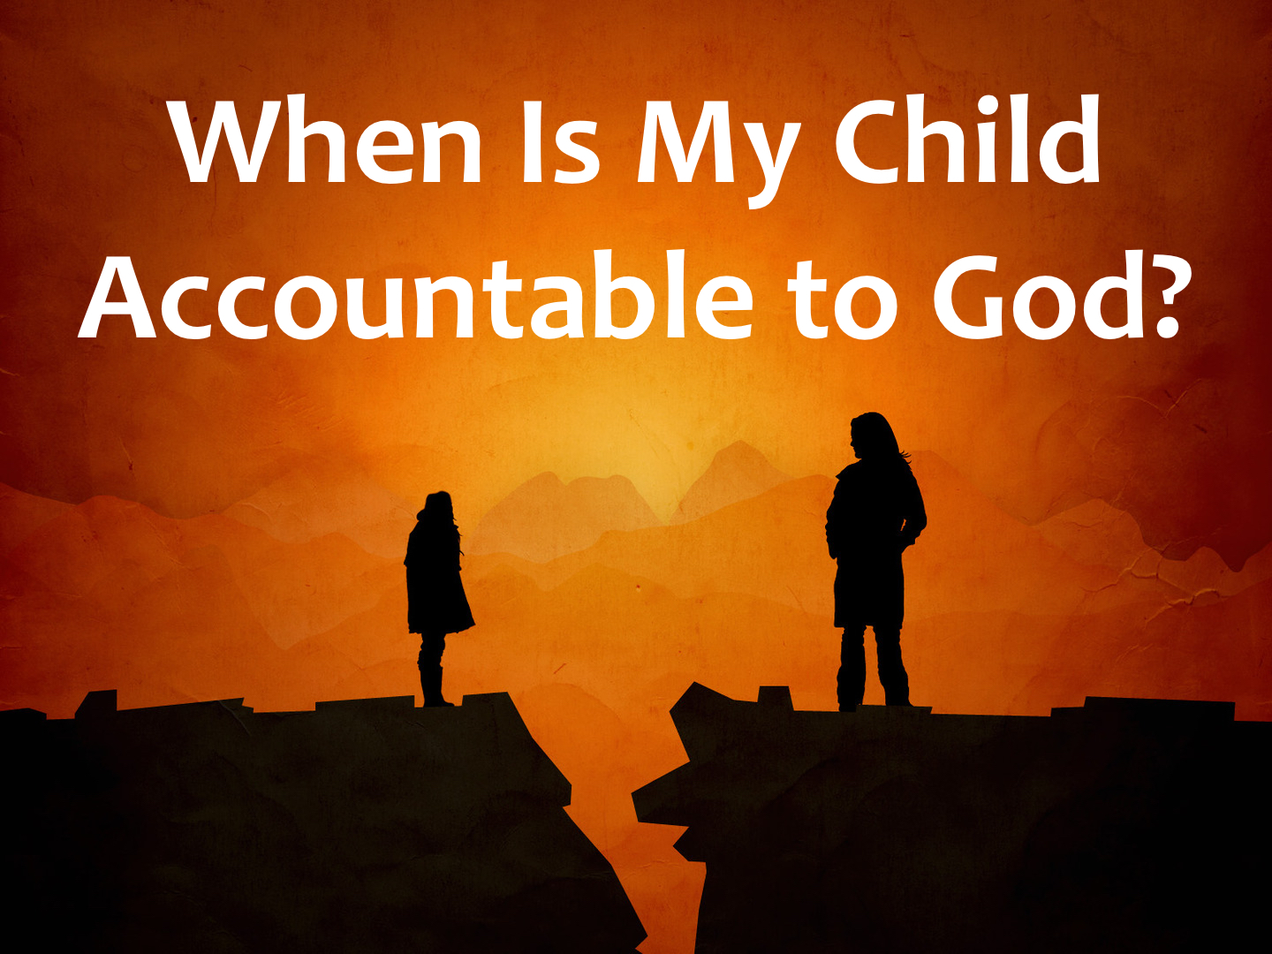

Slide 3
“Age of Accountability”
There is a point at which a child can be responsible to man and God: John 9.19-23
Jesus was 12 years old when He began to be about His Father’s business: Luke 2.41-52
King Josiah was 16 years old when he began to seek God: 2 Chron. 34.1-7
David was young (around 15) when he trusted in the Lord to fight the giant: 1 Sam. 17.33, 37

Slide 4
“Age of Accountability”
Some small boys (ESV), little children (KJV), young lads (ASV), mocked the prophet Elisha: 2 Kings 2.23-24
The prophet Samuel was a youth: 1 Sam. 3
The prophet Jeremiah was a youth: Jer. 1.6-7

Slide 5
Knowledge And Understanding
Children are innocent:
At that time the disciples came to Jesus, saying, “Who is the greatest in the kingdom of heaven?” And calling to him a child, he put him in the midst of them and said, “Truly, I say to you, unless you turn and become like children, you will never enter the kingdom of heaven. Whoever humbles himself like this child is the greatest in the kingdom of heaven. Matt. 18.1-4

Slide 6
Knowledge And Understanding
Children are innocent:
Then children were brought to him that he might lay his hands on them and pray. The disciples rebuked the people, but Jesus said, “Let the little children come to me and do not hinder them, for to such belongs the kingdom of heaven.” And he laid his hands on them and went away. Matt. 19.13-15

Slide 7
Knowledge And Understanding
A child does not know good from evil:
And as for your little ones, who you said would become a prey, and your children, who today have no knowledge of good or evil, they shall go in there. And to them I will give it, and they shall possess it. Deut. 1.39

Slide 8
Knowledge And Understanding
A child does not know good from evil:
For before the boy knows how to refuse the evil and choose the good… Isaiah 7.16

Slide 9
Knowledge And Understanding
Foolishness is not sins:
Folly is bound up in the heart of a child, but the rod of discipline drives it far from him. Prov. 22.15

Slide 10
Knowledge And Understanding
Foolishness is not sins:
When I was a child, I spoke like a child, I thought like a child, I reasoned like a child. When I became a man, I gave up childish ways. 1 Cor. 13.11

Slide 11
Knowledge And Understanding
A child may have knowledge of the Scriptures, but this does not determine his need for salvation.
  My four year old has knowledge.
  A child may be able to recite the plan of salvation.
Jesus grew in wisdom and stature: Luke 2.41-52

Slide 12
Knowledge And Understanding
There is a point when a child knows (requires knowledge) to do right and yet fails to do it (James 4.17; 1 John 3.4).
When one transgresses what he knows and understands to be right, he becomes spiritually dead: Rom. 7.7-9; cf. James 1.14-15
That is when the child needs salvation.

Slide 13
Guilt
Does your child have a personal awareness of God?
Does your child feel guilty and ashamed of his actions towards God?
Does your child believe his actions are sinful?
Does your child believe he has hurt God?
Until a child feels guilty of sin before God, he is not ready for salvation.

Slide 14
Belief
And without faith it is impossible to please him, for whoever would draw near to God must believe that he exists and that he rewards those who seek him. Heb. 11.1, 6; John 8.24
Does the child believe and trust in Jesus? That Jesus is the Son of God? The cross? Resurrection? Creation?
Does he understand these things?

Slide 15
Discipleship
Children need to know what God expects of them.
Discipleship demands responsibility, accountability, commitment, etc.

Slide 16
Discipleship
Disciples are learners and followers: Luke 6.40
  They abide in the word of God: John 8.31-32
  They bear fruit for Jesus: John 15.1-2, 5, 8
  They manifest love for others: John 13.34-35
  They love Jesus more than their family: Matt. 10.37
  They bear their cross for Jesus: Luke 14.27
  They forsake all: Luke 14.33
  They endure persecution: 2 Tim. 3.12
  They teach others: Matt. 28.19-20
  They are about the Father’s business: Luke 2.49

Slide 17
Discipleship
Can your child love Jesus more than you? Matt. 10.37
Give up his own life for the gospel’s sake? Luke 14.26; Rev. 2.10
Is your child capable of doing this?

Slide 18
Discipleship
Every command given to the Christian is to be carried out by every Christian regardless of age. Is your child capable of doing this?

Slide 19
Repentance
Repentance demands a change of heart, will and action (ceasing of sin) coupled with a godly sorrow: 2 Cor. 7.10

Slide 20
Confession
Confessing Christ is a serious commitment.
Is the child ready to confess their faith before all?
Is the child able to consider the need to endure any persecution that may come from such a confession? 2 Tim. 3.12

Slide 21
Baptism
Does your child understand the purpose of baptism?
Does your child understand the responsibilities of one who has been baptized?

Slide 22
Baptism
Baptism is for the believer and follower of Christ.
  A baby cannot believe, repent nor confess.
  Only one who has knowledge and understanding of God’s will and has chosen to disobey Him is eligible for baptism.

Slide 23
Baptism
We find no passage that teaches babies or children were baptized: cf. Acts 5.14; 8.12
Any passages dealing with children place the children in a safe zone: Matt. 18.1-4; 19.13-15

Slide 24
Baptizing Too Soon
What sins do they have to wash away?
We must not encourage them to be immersed before they are ready.
  Their unnecessary baptism creates a false hope.
  Baptism must be for the right reasons! Acts 2.38

Slide 25
Baptizing Too Soon
We must not just leave it up to them.
  Part of our training them in the Lord is teaching them to obey God: Deut. 6.4ff; Eph. 6.4

Slide 26
Conversion
Do we see a change in behavior?
Do they now show an interest in the Lord’s work?
Does the child continue to do those things he did before his “conversion”?
If he wasn’t truly converted, was he even ready?

Slide 27
For Sinners:
Hear His Son: Matt. 17.5
Believe in His Son: John 8.24
Repent of sins: Acts 17.30
Confess His Son: Rom. 10.9-10
Be immersed in His Son’s name: Acts 2.38
For Saints:
Repent of sin: Col. 3.5
Confess sin: 1 John 1.9
Remain faithful: Rev. 2.10

