Slide 2
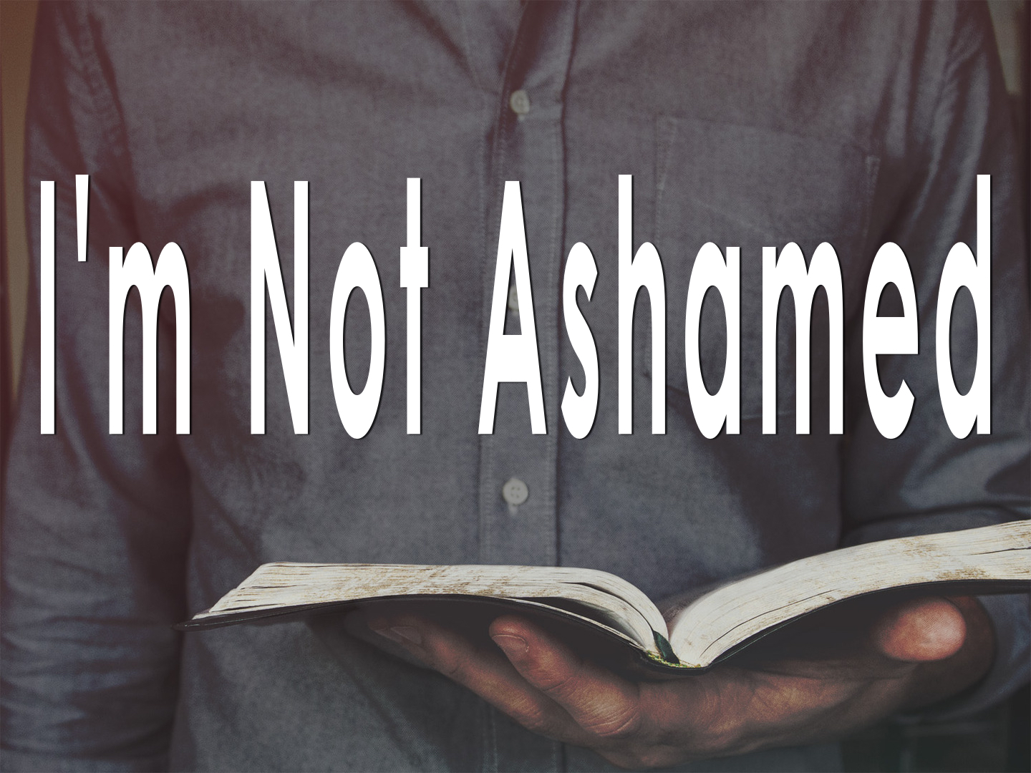

Slide 3
I’m Not Ashamed to BELIEVE
Romans 1.16-17
The gospel presents
  God as its AUTHOR
  Jesus as its ACTIVATOR
  The Holy Spirit as its AUTHENTICATOR
To be ashamed of the gospel is to be ASHAMED of God, Jesus and the Holy Spirit!

Slide 4
I’m Not Ashamed to CONFESS
Nevertheless, many even of the authorities believed in him, but for fear of the Pharisees they did not confess it, so that they would not be put out of the synagogue…
John 12.42; Matt. 26.75; 1 Tim. 6.12

Slide 5
I’m Not Ashamed to OBEY
As a SINNER: Acts 22.16; 26.19
  “But whatever gain I had, I counted as loss for the sake of Christ.” Phil 3.7
As a CHRISTIAN: 1 Tim. 4.12; 2 Tim. 1.13; 2 Tim. 2.15

Slide 6
I’m Not Ashamed to TEACH
Obligated to teach: Rom. 1.14-15; cf. Acts 9.20
Teach ALL of it, not PART of it: 2 Tim. 4.2
Therefore I testify to you this day that I am innocent of the blood of all, for I did not shrink from declaring to you the whole counsel of God. Acts 20.26-27

Slide 7
I’m Not Ashamed to SUFFER
Indeed, all who desire to live a godly life in Christ Jesus will be persecuted…
2 Tim. 3.12; cf. 2 Tim. 1.5-12; 1 Peter 4.12-19

Slide 8
I’m Not Ashamed to SUFFER
Suffering for the gospel sometimes includes SEPARATION of family: Matt. 10.34-37
We must not compromise and/or deny the faith in order to avoid persecution: Acts 20.26-27; Eph. 5.11
Who are we trying to PLEASE? Gal. 1.10; John 12.43; Matt. 15.12-13; Gal. 4.16

Slide 9
The Gospel is POWERFUL
The power to SAVE those who believe: Rom. 1.16; 1 Peter 1.22-25
Therefore put away all filthiness and rampant wickedness and receive with meekness the implanted word, which is able to save your souls. James 1.21

Slide 10
The Gospel is POWERFUL
The power to WORK effectively in believers:
For this reason we also thank God without ceasing, because when you received the word of God which you heard from us, you welcomed it not as the word of men, but as it is in truth, the word of God, which also effectively works in you who believe.
1 Thess. 2.13; cf. Col. 1.5-6; John 15.1-10

Slide 11
The Gospel is POWERFUL
The power to ACCOMPLISH its purposes: Isaiah 55.11; Heb. 4.12; Acts 2 & 7
It can save us or cause us to judge ourselves unworthy of eternal life, but either way it accomplishes the MISSION!
Acts 13.46, 48; Mark 16.16

Slide 12
PAUL Was Not Ashamed!
…as it is my eager expectation and hope that I will not be at all ashamed, but that with full courage now as always Christ will be honored in my body, whether by life or by death.
Philippians 1.20

Slide 13
JESUS Is Not Ashamed!
For both He who sanctifies and those who are being sanctified are all of one, for which reason He is not ashamed to call them brethren…
Hebrews 2.11

Slide 14
GOD Is Not Ashamed!
But as it is, they desire a better country, that is, a heavenly one. Therefore God is not ashamed to be called their God, for he has prepared for them a city.
Hebrews 11.16

Slide 15
Let US Not Be Ashamed!
And now, little children, abide in Him, that when He appears, we may have confidence and not be ashamed before Him at His coming.
1 John 2.28

Slide 16
Let US Not Be Ashamed!
For whoever is ashamed of me and of my words, of him will the Son of Man be ashamed when he comes in his glory and the glory of the Father and of the holy angels.
Luke 9.26

Slide 17
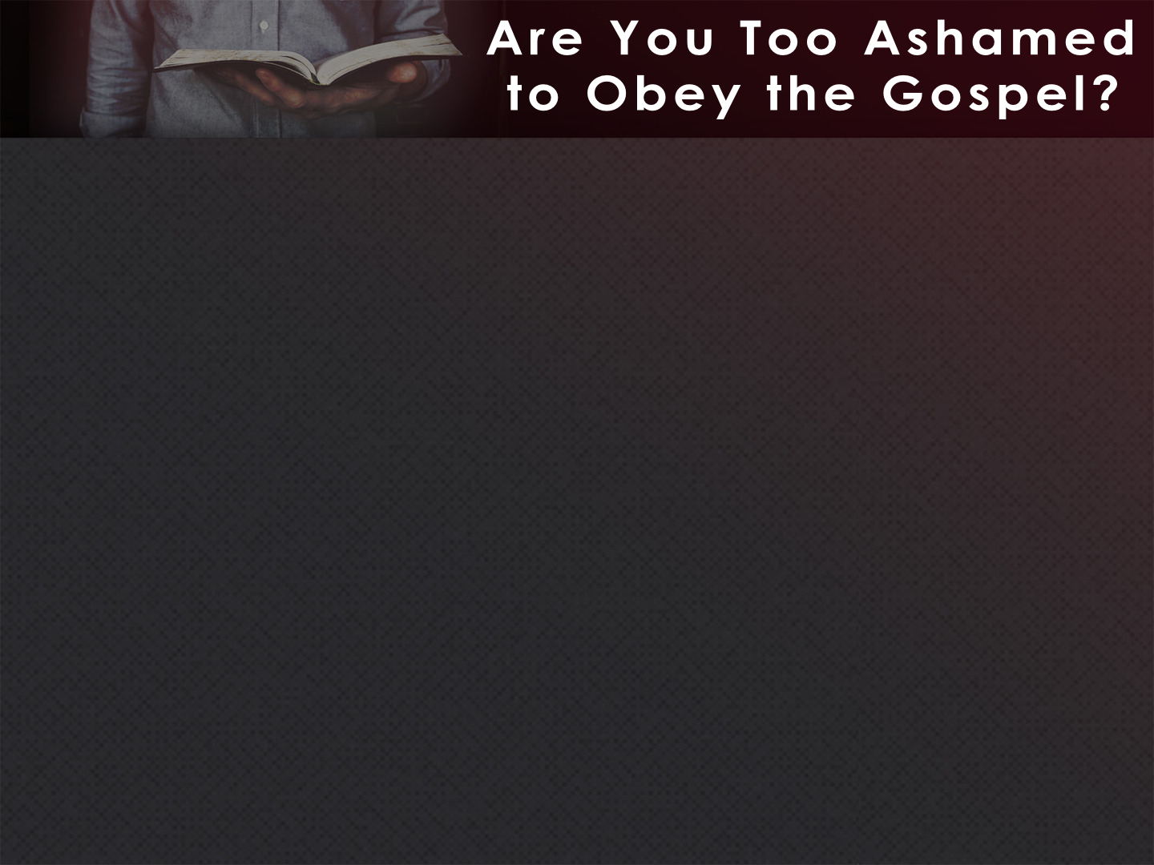
Listen to Jesus’ words: Heb. 1.1-2
He says to believe in Him: John 8.24
He says to repent of your sins: Luke 13.3
He says to confess Him: Matt. 10.32
He says to be baptized: Mark 16.16
He says to endure to the end: Matt. 24.13

