Slide 3
Barnabas Was Spiritually Mature
He was full of the Holy Spirit: Acts 6.3; 11.24
He was full of faith: Acts 11.24; Gal. 5.16, 18, 22-25

Slide 4
Barnabas Set Many Godly Examples
An example in giving: Acts 4.36-37
An example in trustworthiness: Acts 11.22-23, 30; 13.2; cf. Phil. 2.21-22
An example in promoting unity:
Used the truth to vouch for Saul: Acts 9.26-28
Used the truth to encourage: Acts 11.19-23
Used the truth to fight error: Acts 15.1-2

Slide 5
Barnabas Set Many Godly Examples
An example of friendship/love: He defended Saul and Mark: Acts 9.26-28; 15.37-39; cf. 2 Tim. 4.11
An example of repentance: Gal. 2.11-14; 6.1; 1 Cor. 9.6; 2 Peter 3.17

Slide 6
Barnabas Taught Others
He exhorted people with God’s word: Acts 13.5-12
He grounded new saints: Acts 11.22-30; 13.43; 15.30-35
He taught with boldness: Acts 13.46
He taught with persistence: Acts 13.50-51
He defended the truth: Acts 15.1-2

Slide 7
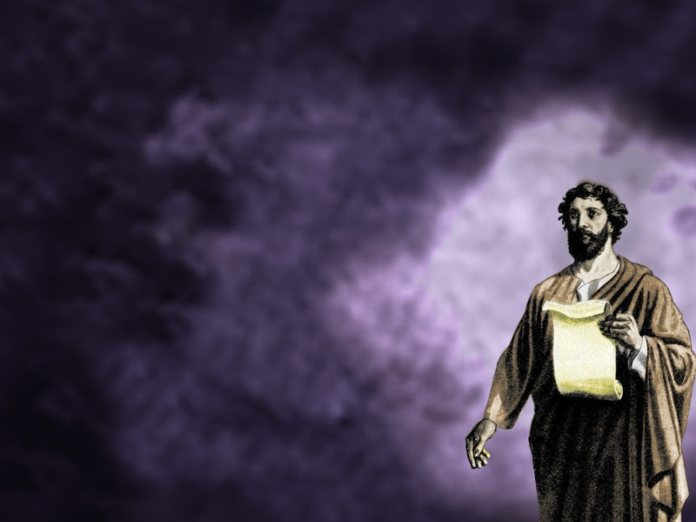
Let us strive to be like Barnabas!

