Slide 2
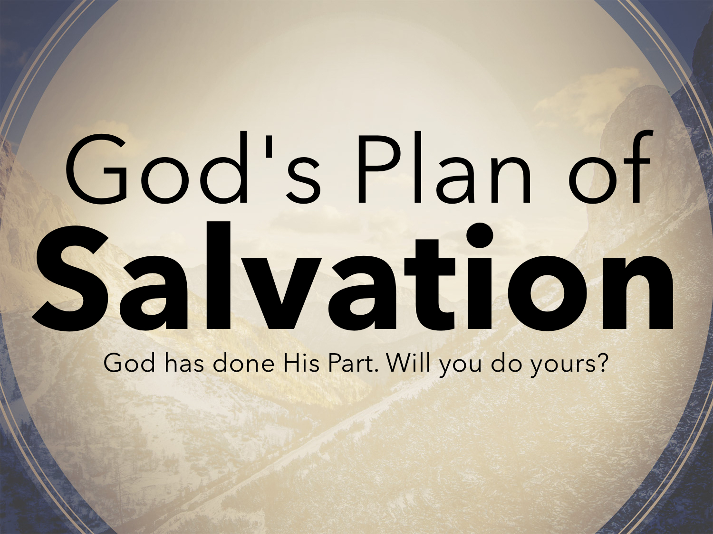

Slide 3


Slide 4


Slide 5


Slide 6


Slide 7
Why Is Repentance in the Plan?
Christ PREACHED it: Matt. 4.17; Luke 13.1-5; 24.46-47
The gospel, when preached and BELIEVED, brings men to repentance: Acts 3.19
The HEART of man is changed by repentance: Acts 2.36–38; 8.22

Slide 8
Why Is Repentance in the Plan?
No way to CORRECT sin against God without it: Jer. 25.4-5; Ezek. 18.30-32; Acts 3.19; 8.22
The alternative to repentance is to PERISH: John 3.16; 2 Peter 3.9
Thus repentance is for ALL (both sinner and saint): Acts 17.30-31; Rev. 3.19

Slide 9
Repentance Is Not…
A promise to quit sinning.
Simply quitting what you are doing that is wrong:
  Suppose a man leaves wife and family, but later comes in and sits at the table without a word?
  Do think the prodigal son could have come home without repentance? Luke 15

Slide 10
Repentance Is Not…
Faith:
Faith is different than repentance: Rom. 10.17 Acts 20.21
Faith prepares the heart to repent: Acts 2.36-38

Slide 11
Repentance Is Not…
Sorrow:
Many have quit a sin out of fear of the physical or emotional consequences, but not out of REVERENCE for God. 2 Cor. 7.10
One cannot repent without being SORRY toward God, but there is a sorrow that will NOT produce repentance: 2 Cor. 7.9; Matt. 27.3–5

Slide 12
How Do We Repent?
Repentance is a CHANGE of mind (Matt. 21.28-31) PROMPTED by godly sorrow (2 Cor. 7.10; Matt. 5.4) followed by a corresponding change of CONDUCT (Acts 26.20).
Repentance is a CHANGE of mind (Matt. 21.28-31) PROMPTED by godly sorrow (2 Cor. 7.10; Matt. 5.4) followed by a corresponding change of CONDUCT (Acts 26.20).
Repentance is a CHANGE of mind (Matt. 21.28-31) PROMPTED by godly sorrow (2 Cor. 7.10; Matt. 5.4) followed by a corresponding change of CONDUCT (Acts 26.20).

Slide 13
How Do We Repent?
We ought to BEAR FRUIT in keeping with repentance: Matt. 3.8; 1 Cor. 6.11; Rom. 6.17-22; Gal. 5.22-23

Slide 14
True Repentance Involves…
DILIGENCE
CLEARING OF YOURSELVES
INDIGNATION
FEAR
VEHEMENT DESIRE
ZEAL
VINDICATION

Slide 15
Whoever conceals his transgressions will not prosper, but he who confesses and forsakes them will obtain mercy. Proverbs 28.13

Slide 16
…not knowing that God's kindness is meant to lead you to repentance? But because of your hard and impenitent heart you are storing up wrath for yourself on the day of wrath when God's righteous judgment will be revealed. Romans 2.4-5

