Slide 2
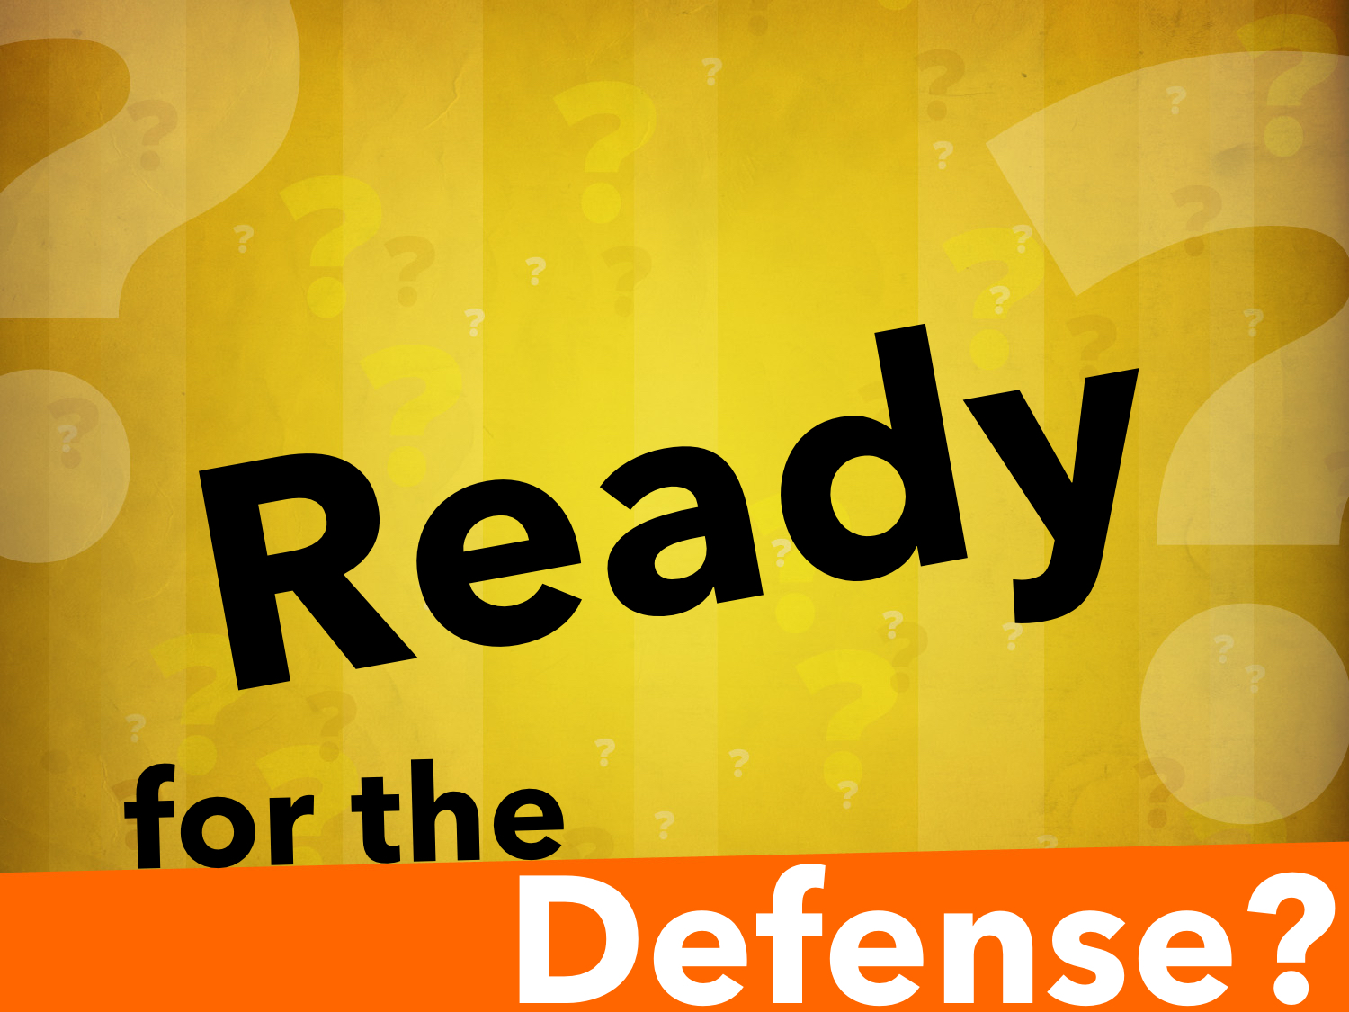

Slide 3
1 Peter 3.15 ESV
“…but in your hearts honor Christ the Lord as holy, always being prepared to make a defense to anyone who asks you for a reason for the hope that is in you; yet do it with gentleness and respect…”

Slide 4
"Sanctify the Lord God in Your Hearts"
88.27 ἁγιάζω^{c}: to feel reverence for or to honor as holy—‘to hallow, to regard as holy, to honor as holy.’ ἁγιασθήτω τὸ ὄνομά σου ‘hallowed be your name’ or ‘may your name be honored as holy’ Mt 6:9. (Louw, J. P., & Nida, E. A. (1996). Greek-English lexicon of the New Testament: based on semantic domains (electronic ed. of the 2nd edition., Vol. 1, pp. 744–745). New York: United Bible Societies.)

Slide 5
1 Peter 3.15 ESV
“…but in your hearts honor Christ the Lord as holy, always being prepared to make a defense to anyone who asks you for a reason for the hope that is in you; yet do it with gentleness and respect…”

Slide 6
We Must Have a Good Reason for Our Hope
Not our feelings, traditions, majority, etc.
Faith: Heb. 11.1, 6; 2 Cor. 5.7
Faith convinces us of things we have never seen and assures us of things we hope for!
Our hope: 1 Peter 1.3-5; Titus 1.2; 2.13; Rom. 8.24-25; cf. Acts 16.25

Slide 7
We Must Be Prepared To Defend That Hope
33.435 ἀπολογέομαι^{c}; ἀπολογίαª, ας f: to speak on behalf of oneself or of others against accusations presumed to be false—‘to defend oneself.’ (Louw, J. P., & Nida, E. A. (1996). Greek-English lexicon of the New Testament: based on semantic domains (electronic ed. of the 2nd edition., Vol. 1, p. 437). New York: United Bible Societies.)
apologia (ἀπολογία, 627), a “verbal defense, a speech in defense,” (Vine, W. E., Unger, M. F., & White, W., Jr. (1996). Vine’s Complete Expository Dictionary of Old and New Testament Words (Vol. 2, p. 29). Nashville, TN: T. Nelson.)
“clearing of (one’s) self” … a reasoned statement or argument. (Strong, J. (1995). Enhanced Strong’s Lexicon. Woodside Bible Fellowship.)

Slide 8
We Must Be Prepared To Defend That Hope
With knowledge:
Know the Bible: 2 Tim. 2.15; Psalm 1.2; Hosea 4.6; Eph. 6.17; cf. Matt. 16.13-17
All of us have the word, but not all of us know how to use the word.
Know the opposition: 2 Cor. 2.11; 2 Tim. 2.25

Slide 9
We Must Be Prepared To Defend That Hope
With determination:
Apostles were set for defense: Phil. 1.16-17; Jude 3; Acts 6.9-10; 17.1-2; 18.27-28
We must be ready!

Slide 10
We Must Be Prepared To Defend That Hope
With “gentleness and respect”
Does not mean you can’t:
“hold their feet to the fire,”
“ask pointed questions,”
“point out their error,” etc.
Cf. 1 Tim. 3.2-3; Titus 1.9-14

Slide 11
We Must Be Prepared To Defend That Hope
While our answers need to be confident, they should not be cocky, self-righteous, harsh or condescending:
Defend not out of pride.
Defend to win souls not an argument.
Defend not with envy or strife.
Defend knowing that we will be judged by same standard.

Slide 12
Ready For The Defense?
1 Peter 3.15 is as much a command for the Christian as Acts 2.38 is a command for the sinner.

