Slide 2
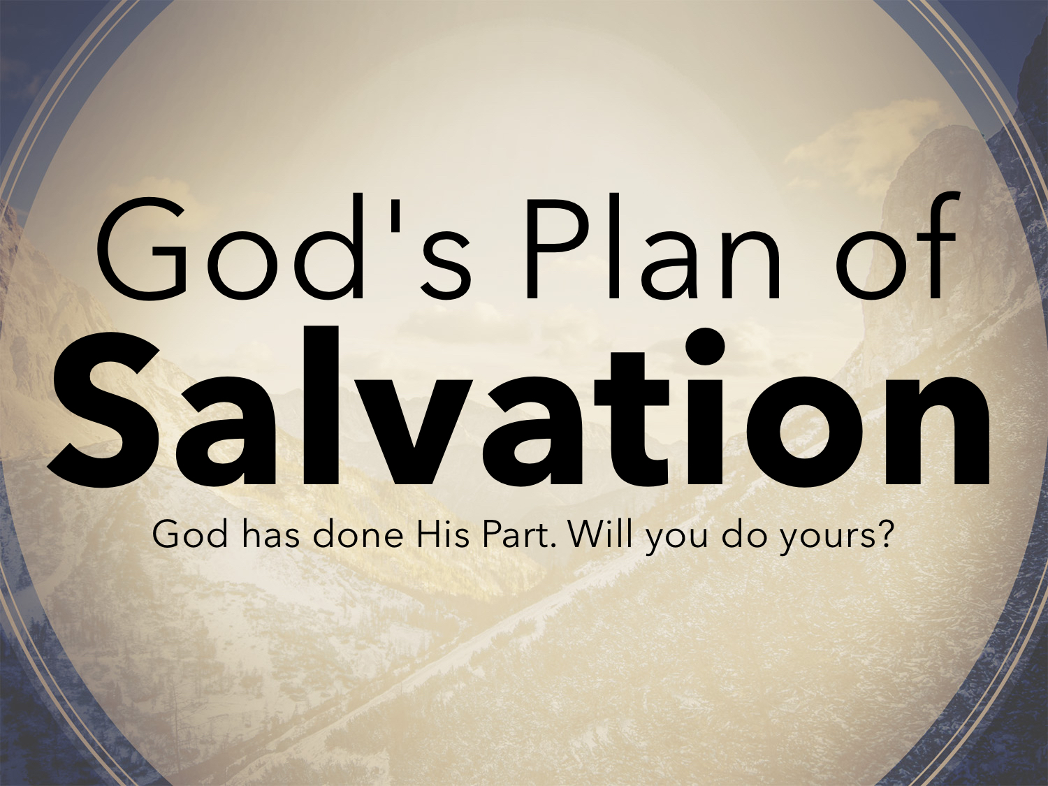

Slide 3
Why We Need A Plan
Because man is a sinner: Rom. 3.23
Because sin separates us from God: Isaiah 59.1-2
Because sin leads to death: Rom. 6.23
Because man needs Jesus’ blood: Rom. 5.9
Because man must obey Jesus: 2 Thess. 1.8-9

Slide 4
God Has Done His Part In Salvation:
The Father sent His Son: Titus 2.11-12
Jesus shed His blood: Eph. 1.7
The Holy Spirit revealed His word: Eph. 3.3-5

Slide 5
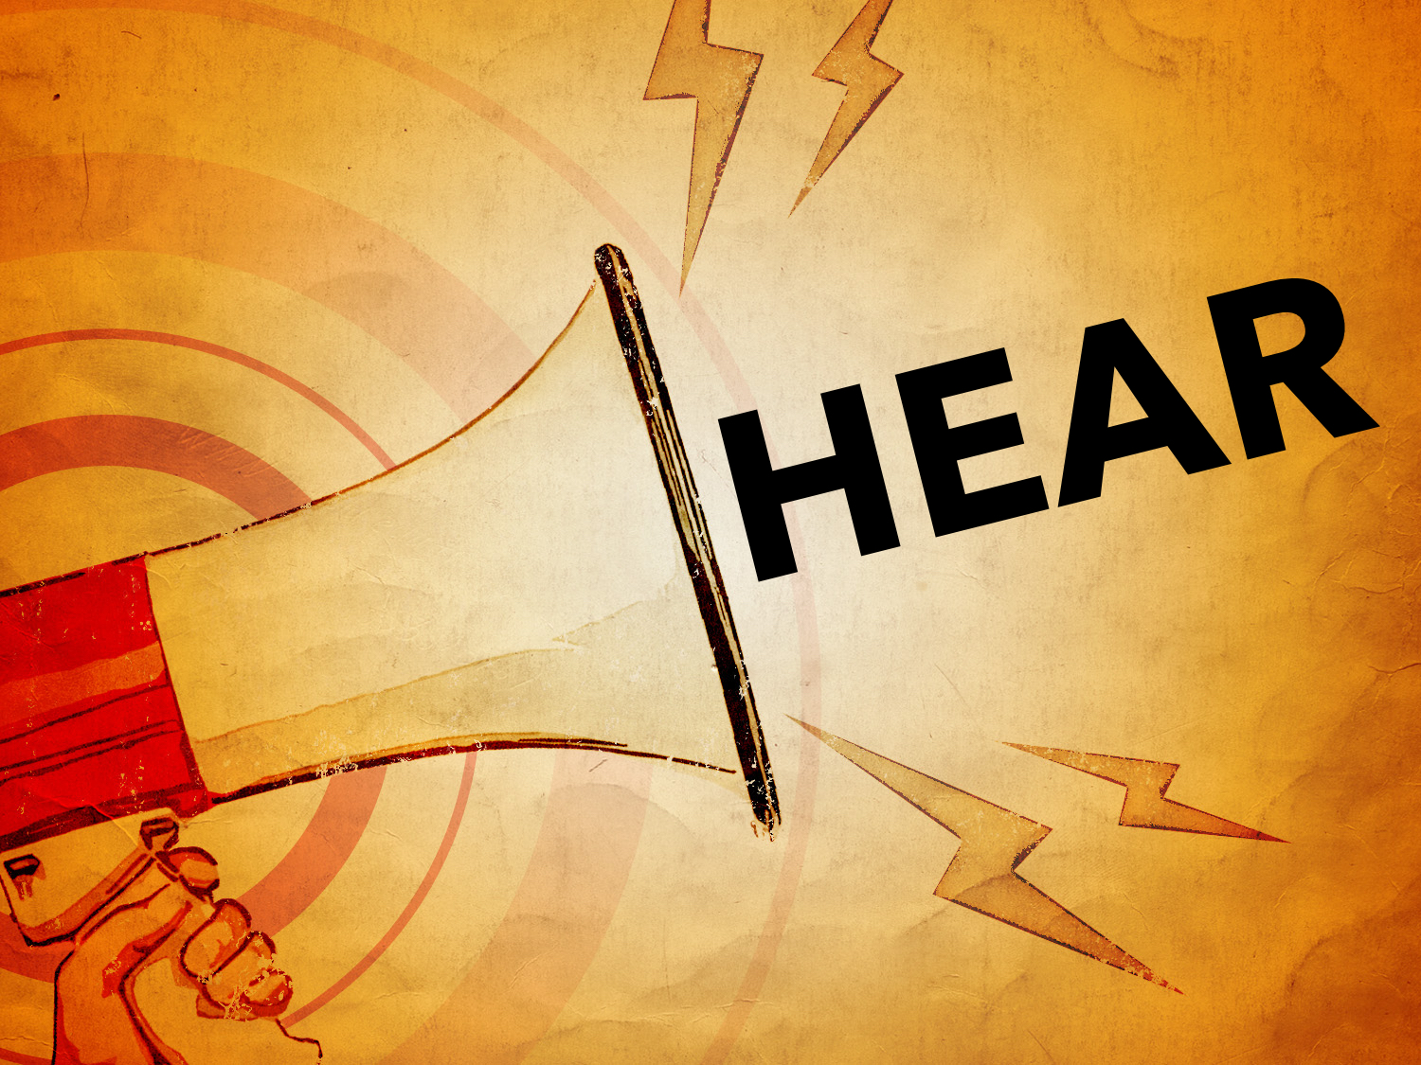

Slide 6
Review
Faith Comes By Hearing: Rom. 10.17
One must hear the gospel: John 9.35-38; Acts 8.5; 8.26-40; 9.6; 10.5-6, 32-33; 11.14; 16.30-32
Not only is hearing essential, but its also the first condition of salvation: Rom. 10.13-17

Slide 7
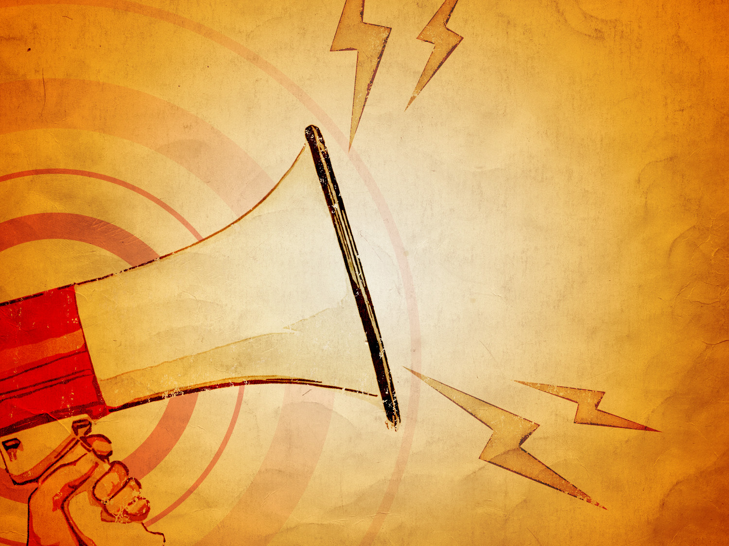
“...blessed are those who hear, and who keep what is written...” Rev. 1.3

Slide 8


Slide 9
The Gospel
And he said to them, “Go into all the world and proclaim the gospel to the whole creation. Whoever believes and is baptized will be saved, but whoever does not believe will be condemned. Mark 16.15-16

Slide 10
The Gospel
The word "gospel" means "GOOD NEWS”:
Go on up to a high mountain, Zion, herald of good news; lift up your voice with strength, O Jerusalem, herald of good news; lift it up, fear not; say to the cities of Judah, “Behold your God!”

Slide 11
The Gospel
The word "gospel" means "GOOD NEWS”:
Behold, the Lord God comes with might, and his arm rules for him; behold, his reward is with him, and his recompense before him. He will tend his flock like a shepherd; he will gather the lambs in his arms; he will carry them in his bosom, and gently lead those that are with young. Isaiah 40.9-11

Slide 12
The Gospel
The word "gospel" means "GOOD NEWS”:
She will bear a son, and you shall call his name Jesus, for he will save his people from their sins. Matt. 1.21
And the angel said to them, “Fear not, for behold, I bring you good news of great joy that will be for all the people.” Luke 2.10

Slide 13
The Gospel
The word "gospel" means "GOOD NEWS”:
And he came to Nazareth, where he had been brought up. And as was his custom, he went to the synagogue on the Sabbath day, and he stood up to read. And the scroll of the prophet Isaiah was given to him. He unrolled the scroll and found the place where it was written, “The Spirit of the Lord is upon me, because he has anointed me to proclaim good news to the poor.

Slide 14
The Gospel
The word "gospel" means "GOOD NEWS”:
He has sent me to proclaim liberty to the captives and recovering of sight to the blind, to set at liberty those who are oppressed, to proclaim the year of the Lord's favor.” And he rolled up the scroll and gave it back to the attendant and sat down. And the eyes of all in the synagogue were fixed on him. And he began to say to them, “Today this Scripture has been fulfilled in your hearing.” Luke 4.16-21

Slide 15
The Gospel
The gospel SAVES:
For I am not ashamed of the gospel, for it is the power of God for salvation to everyone who believes, to the Jew first and also to the Greek. Rom. 1.16
…and you will know the truth, and the truth will set you free. John 8.32

Slide 16
The Gospel
The gospel CHANGES:
…And such were some of you… 1 Cor. 6.11
“…He who used to persecute us is now preaching the faith he once tried to destroy…”Gal. 1.23-24
But when I saw that their conduct was not in step with the truth of the gospel… Gal. 2.14

Slide 17
The Gospel
The gospel CHANGES:
Only let your manner of life be worthy of the gospel of Christ, so that whether I come and see you or am absent, I may hear of you that you are standing firm in one spirit, with one mind striving side by side for the faith of the gospel… Phil. 1.27

Slide 18
Facts to BELIEVE
He lived on the EARTH: John 1.14
He lived without SIN: John 7.18
His words contained LIFE: John 6.68
He was approved of God by His WORKS: John 5.36; cf. Acts 2.22; John 20.30-31

Slide 19
Facts to BELIEVE
He died on a CROSS: Isaiah 53.4-6; Acts 10.39
He was a SACRIFICE for sins: Rom. 3.23; John 1.29; 1 John 4.9-10
He was BURIED: Mark 15.44-47
He was RAISED from the dead: Acts 2.24-32; Rom. 1.4

Slide 20
Now I would remind you, brothers, of the gospel I preached to you, which you received, in which you stand, and by which you are being saved, if you hold fast to the word I preached to you—unless you believed in vain. For I delivered to you as of first importance what I also received: that Christ died for our sins in accordance with the Scriptures, that he was buried, that he was raised on the third day in accordance with the Scriptures…
1 Cor. 15.1-4

Slide 21
Facts to BELIEVE
He is EXALTED in Heaven: Acts 2.33-36; Eph. 1.20-23
He will return to JUDGE the world: Acts 10.42; 17.30-31; Rev. 1.7; 22.20

Slide 22
Commands to OBEY
The gospel was presented to bring about OBEDIENCE: Rom. 1.1-6; 6.17; 10.16; 16.25-26; cf. Acts 6.7
The gospel demands a RESPONSE: 1 Peter 4.17; 2 Thess. 1.7-8

Slide 23
Promises to RECEIVE
The REMISSION of sins through the blood of Jesus: Matt. 26.28; Acts 2.38; 1 John 1.9
The GIFT of eternal life: Rom. 6.22-23; 1 John 5.11-13
All spiritual BLESSINGS found in Christ: Eph. 1.3

