Slide 2
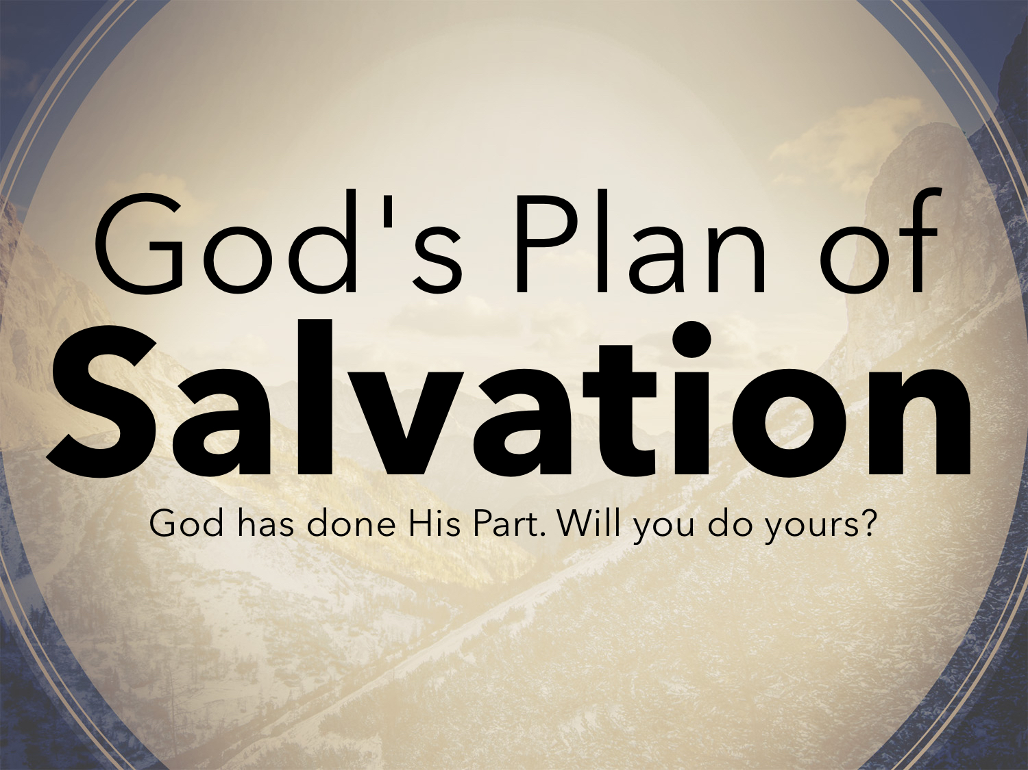

Slide 3
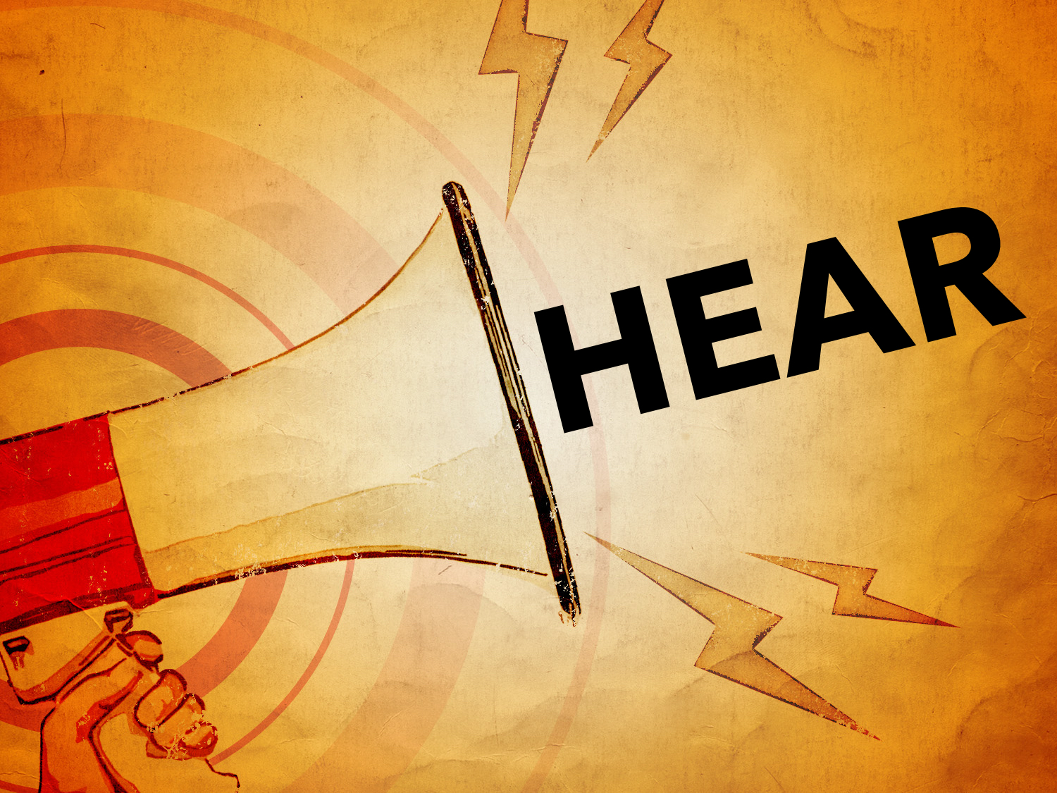

Slide 4


Slide 5


Slide 6
LOST Believers
The DEMONS: James 2.19; Matt. 8.29
The DISOBEDIENT:
Nevertheless, many even of the authorities believed in him, but for fear of the Pharisees they did not confess it, so that they would not be put out of the synagogue
John 12.42

Slide 7
SAVED Believers
Saved by the SACRIFICE of Christ: John 3.16
Saved by BELIEVING the gospel: John 3.16
Saved by OBEDIENCE to the gospel:
If you love me, you will keep my commandments. John 14.15
Why do you call me ‘Lord, Lord,’ and not do what I tell you? Luke 6.46

Slide 8
SAVED Believers
Whoever believes and is baptized will be saved, but whoever does not believe will be condemned. Mark 16.16

Slide 9
SAVED Believers
But when they believed Philip as he preached good news about the kingdom of God and the name of Jesus Christ, they were baptized, both men and women. Even Simon himself believed, and after being baptized he continued with Philip. And seeing signs and great miracles performed, he was amazed. Acts 8.12-13

Slide 10
SAVED Believers
Then he brought them out and said, “Sirs, what must I do to be saved?” And they said, “Believe in the Lord Jesus, and you will be saved, you and your household.” And they spoke the word of the Lord to him and to all who were in his house. And he took them the same hour of the night and washed their wounds; and he was baptized at once, he and all his family. Then he brought them up into his house and set food before them. And he rejoiced along with his entire household that he had believed in God.
Acts 16.30-34

Slide 11
SAVED Believers
Crispus, the ruler of the synagogue, believed in the Lord, together with his entire household. And many of the Corinthians hearing Paul believed and were baptized.
Acts 18.8

Slide 12
SAVED Believers
Bible faith is an ACTION word:
And to whom did he swear that they would not enter his rest, but to those who were disobedient? So we see that they were unable to enter because of unbelief.
Heb. 3.18-19

Slide 13
SAVED Believers
Bible faith is an ACTION word:
By faith Noah, being warned by God concerning events as yet unseen, in reverent fear constructed an ark for the saving of his household… Heb. 11.7
By faith Abraham obeyed… Heb. 11.8-9

Slide 14
SAVED Believers
Bible faith is an ACTION word:
And the Lord said to Moses and Aaron, “Because you did not believe in me, to uphold me as holy in the eyes of the people of Israel, therefore you shall not bring this assembly into the land that I have given them.”
Num. 20.12

Slide 15
SAVED Believers
Bible faith is an ACTION word:
And as Moses lifted up the serpent in the wilderness, so must the Son of Man be lifted up, that whoever believes in him may have eternal life. For God so loved the world, that he gave his only Son, that whoever believes in him should not perish but have eternal life.
John 3.14-16

Slide 16
SAVED Believers
Saved believer is working believer: Gal. 5.6; James 2.14-26
Eternal life (John 3.16), when he obeys: Heb. 5.8-9
Shall not perish (John 3.16), after he obeys: 2 Thess. 1.7-9

Slide 17
SAVED Believers
Justified (Rom 5.1-2), when he works: James 2.20-24
Purified heart (Acts 15.9), when he obeys: 1 Peter 1.22
Remission of sins (Acts 10.43), when he obeys: Acts 2.38; Rom. 6.17-18
Born of God (1 John 5.1, 4), when he obeys: 1 Peter 1.22-23; 1 John 2.29; 4.7

Slide 18
Every WORD in John 3.16 is true, but not ALL of the truth on being saved is found in John 3.16.

Slide 19
What Will the Believer EXCLUDE?
Does the "belief" that BRINGS everlasting life include or exclude:
Love?
Obedience?
Repentance?
Confession?
Baptism?

Slide 20
What Will the Believer EXCLUDE?
The believer of John 3.16 is one who OBEYS: John 14.15, 21, 23–24
The believer of John 3.16 is a BAPTIZED BELIEVER: cf. Gal. 3.26-27

