Slide 2
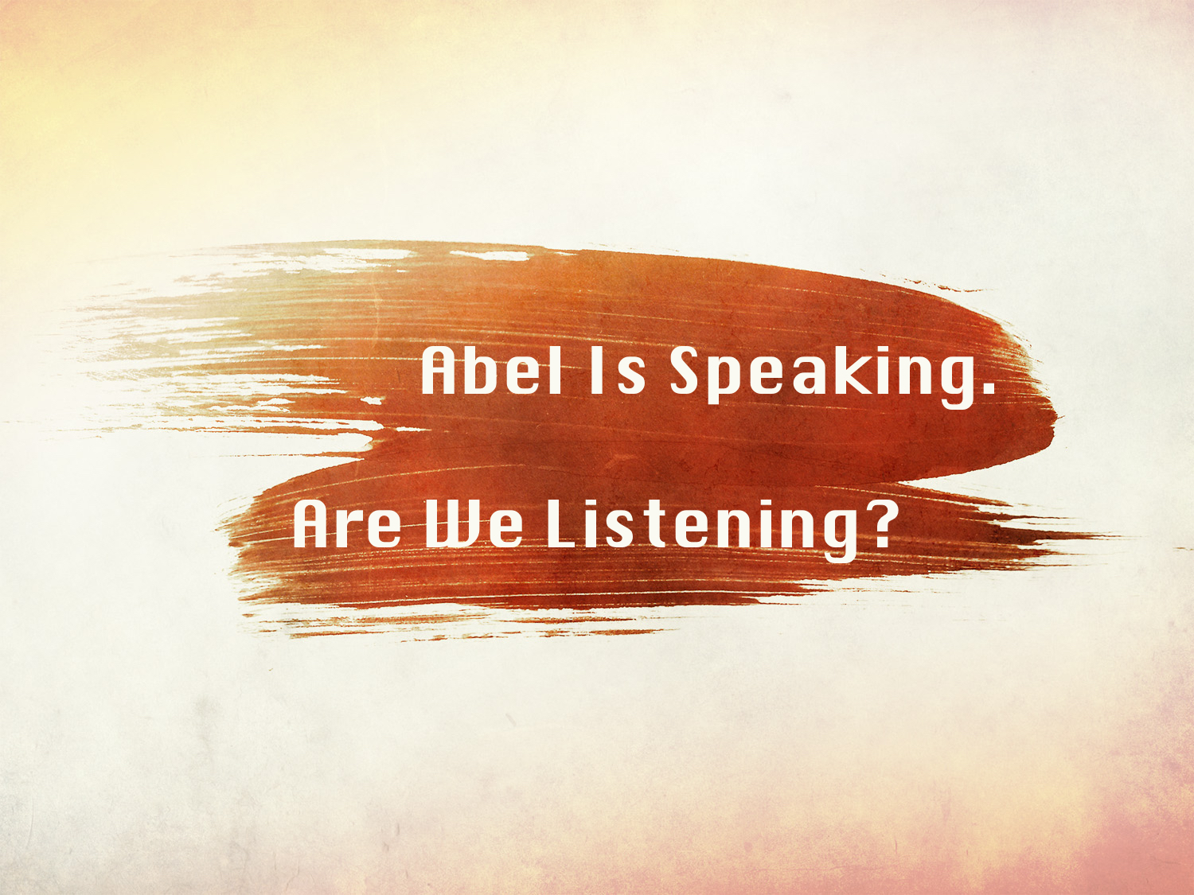

Slide 3
Abel Worshipped By Faith: Gen. 4.3-4, Heb. 11.4
True worship embraces the proper object, a genuine disposition, and adherence to the revealed truth: John 4.24
God is the subject of our worship: Matt. 4.10
We worship God according to His desire:
Heb. 12.28; Exo. 25.9; John 4.23-24

Slide 4
Abel Worshipped By Faith: Gen. 4.3-4, Heb. 11.4
Cain presumed that his offering would be acceptable to the Lord.
God’s instructions were not sufficient.
God was not pleased: Gen. 4.5

Slide 5
Abel Obeyed By Faith: 2 Cor. 5.7, Rom. 10.17
We are not to walk in the way of Cain (Jude 11), but of Abel (Heb. 11.4).
  We are not in the presence of God when we walk in the way of Cain: Gen. 4.16
  We are condemned by God when we
  walk in the way of Cain: 1 John 3.12;
  Heb. 11.7, Prov. 29.27

Slide 6
Abel Obeyed By Faith: 2 Cor. 5.7, Rom. 10.17
Abel’s faith and works bore witness to his righteousness: Matt. 23.35; Heb. 11.4; 12.24
Jesus’ blood speaks of love, redemption, cleansing from sin, peace, etc.
Abel's blood is a testimony to us -
a testimony of his faith.

Slide 7
Abel Endured By Faith: Heb. 10.36-39; 12.1
Abel endured by faith through persecution: “And through his faith, though he died, he still speaks.” cf. Rev. 2.10
Abel endured by not being influenced by his evil brother!

