Slide 2
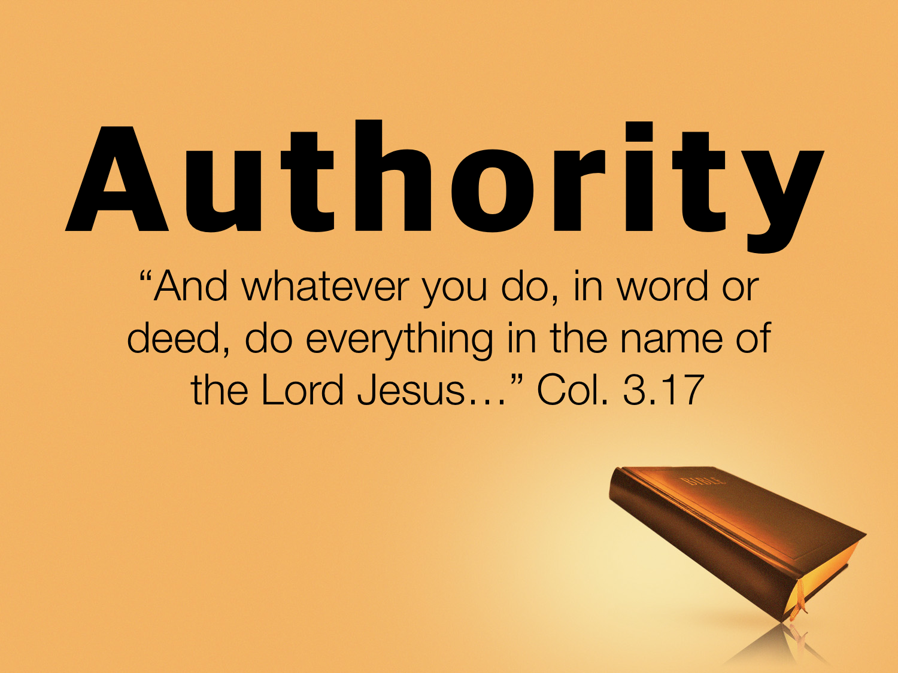

Slide 3
What Do We Mean By Authority?
Authority: "the power of rule or government," the power of one whose will and commands must be obeyed by others
(Vine's Expository Dictionary of New Testament Words)

Slide 4
Consider The Following:
We need God’s authority for all that we do.
We need God’s authority for most of what we do.
We need God’s authority for some of what we do.
We need God’s authority for none of what we do.

Slide 5
Topics Discussed Thus Far
Understanding authority.
The need for authority.
False standards of authority.
How God communicates to us.
Listen: churchofchristatnorthside.com

Slide 6
Church
Autonomy
The All-Sufficiency Of The Church

Slide 7
Defining CHURCH
The church (BODY): Matt. 16.18; Acts 2; Eph. 1.22-23; Eph. 4.4; 5.25
There are no earthly headquarters, board of directors, committees, etc. other than CHRIST.
There is no ORGANIZATIONAL structure.

Slide 8
Defining CHURCH
The Lord ADDS us to His body: Acts 2.47; 1 Cor. 12.13
The body of Christ is simply all the SAVED of all time: Matt. 16.18; Heb. 12.23

Slide 9
Defining CHURCH
Those in Christ ARE in the Church: Gal. 3.27; 2 Tim. 2.10, 19; 1 Cor. 12.13; Eph. 5.23
Satan CANNOT prevail against the church: Matt. 16.18

Slide 10
Defining CHURCH
The church (LOCAL): Rom. 16.16; 1 Cor. 1.2
The local church is the only FUNCTIONING organization of God’s people with Christ as the head.
There is organizational STRUCTURE: Phil. 1.1

Slide 11
Defining CHURCH
Agreement is INVOLVED in local membership: Acts 9.26; 2 John 9-11
RECOGNIZABLE members: cf. 1 Cor. 14.23, etc.
The local church does NOT consist of all the saved: 1 Cor. 5.1
Satan CAN prevail against the local church: Acts 20.29-31

Slide 12
Defining AUTONOMY
Autonomy: “The right or condition of self-government; A self-governing country or region; Freedom from external control or influence; independence.” (oxforddictionaries.com)
Local churches are SELF-GOVERNING:

Slide 13
Defining AUTONOMY
“And when they had appointed elders for them in every church, …” Acts 14.23
“This is why I left you in Crete, so that you might put what remained into order, and appoint elders in every town as I directed you…” Titus 1.5

Slide 14
Defining AUTONOMY
“And when they had appointed elders for them in every church, with prayer and fasting they committed them to the Lord in whom they had believed.” Acts 14.23
“This is why I left you in Crete, so that you might put what remained into order, and appoint elders in every town as I directed you…” Titus 1.5

Slide 15
Defining AUTONOMY
“Now from Miletus he sent to Ephesus and called the elders of the church to come to him.” Acts 20.17
“Pay careful attention to yourselves and to all the flock, in which the Holy Spirit has made you overseers, to care for the church of God, which he obtained with his own blood.” Acts 20.28

Slide 16
Defining AUTONOMY
“We ask you, brothers, to respect those who labor among you and are over you in the Lord and admonish you, and to esteem them very highly in love because of their work. Be at peace among yourselves.” 1 Thess. 5.12-13

Slide 17
Defining AUTONOMY
“Obey your leaders and submit to them, for they are keeping watch over your souls, as those who will have to give an account. Let them do this with joy and not with groaning, for that would be of no advantage to you.” Heb. 13.17
“And they did so, sending it to the elders by the hand of Barnabas and Saul.” Acts 11.30

Slide 18
Defining AUTONOMY
“So I exhort the elders among you, as a fellow elder and a witness of the sufferings of Christ, as well as a partaker in the glory that is going to be revealed: shepherd the flock of God that is among you, exercising oversight, not under compulsion, but willingly, as God would have you; not for shameful gain, but eagerly; not domineering over those in your charge, but being examples to the flock.” 1 Peter 5.1-3

Slide 19
Defining AUTONOMY
The need for church autonomy:
Because we have an example within God’s word: 2 Tim. 1.13
Each local church is free from the control of any other organization.
Autonomy PROTECTS the body of Christ from apostasy: Rev. 2; 3; 1 Cor. 5.1, 6-7

Slide 20
Defining AUTONOMY
What church autonomy is not:
Allow for our own laws; we must still abide by God’s law: 1 Cor. 4.16-17; 2 Thess. 2.15; 2 Tim. 2.13

Slide 21
Defining AUTONOMY
A local church may lose its autonomy: If the church SURRENDERS herself to another eldership or organization.

Slide 22
Defining BOUNDARIES
Local churches had their own ELDERSHIP: Acts 15.4; 20.17
“…appointed elders for them in every church…”: Acts 14.23
“…shepherd the flock of God that is among you…”: 1 Peter 5.2

Slide 23
Defining BOUNDARIES
Local churches DETERMINED fellowship: Acts 9.26; Acts 18.27
Local churches had a COMMON treasury: 1 Cor. 16.1-3; Phil. 4.15-16

Slide 24
Defining BOUNDARIES
Local churches SUPPORTED preachers (both their own and abroad): 1 Cor. 9.7-14; 2 Cor. 11.8-9
Local churches took care of their own needy SAINTS: Acts 2.44-45; 6.1-7
Local churches sent relief to needy BRETHREN in other congregations: Acts 11.27-30

Slide 25
Defining BOUNDARIES
Local churches EDIFIED their own: Acts 13.1; Eph. 4.11-16
Local churches ASSEMBLED and worshipped: Acts 11.26; 20.7; 1 Cor. 11, 14; Eph. 5.19
Local churches managed their own affairs in matters of JUDGMENT and EXPEDIENCY.

Slide 26
Did Local Churches Do Anything Else?
Sports teams?
Kitchens?
Gymnasiums?
Food pantries?
Support orphanages, organizations?
Etc.?
Coming Up: What the work of the church is and is not.

Slide 27
God’s Plan Of Salvation
Hear: Matt. 10.17
Believe: Acts 16.31
Repent: Acts 17.30
Confess: Rom. 10.9-10
Be immersed: Mark 16.16
Be faithful: Rev. 2.10

