Slide 2
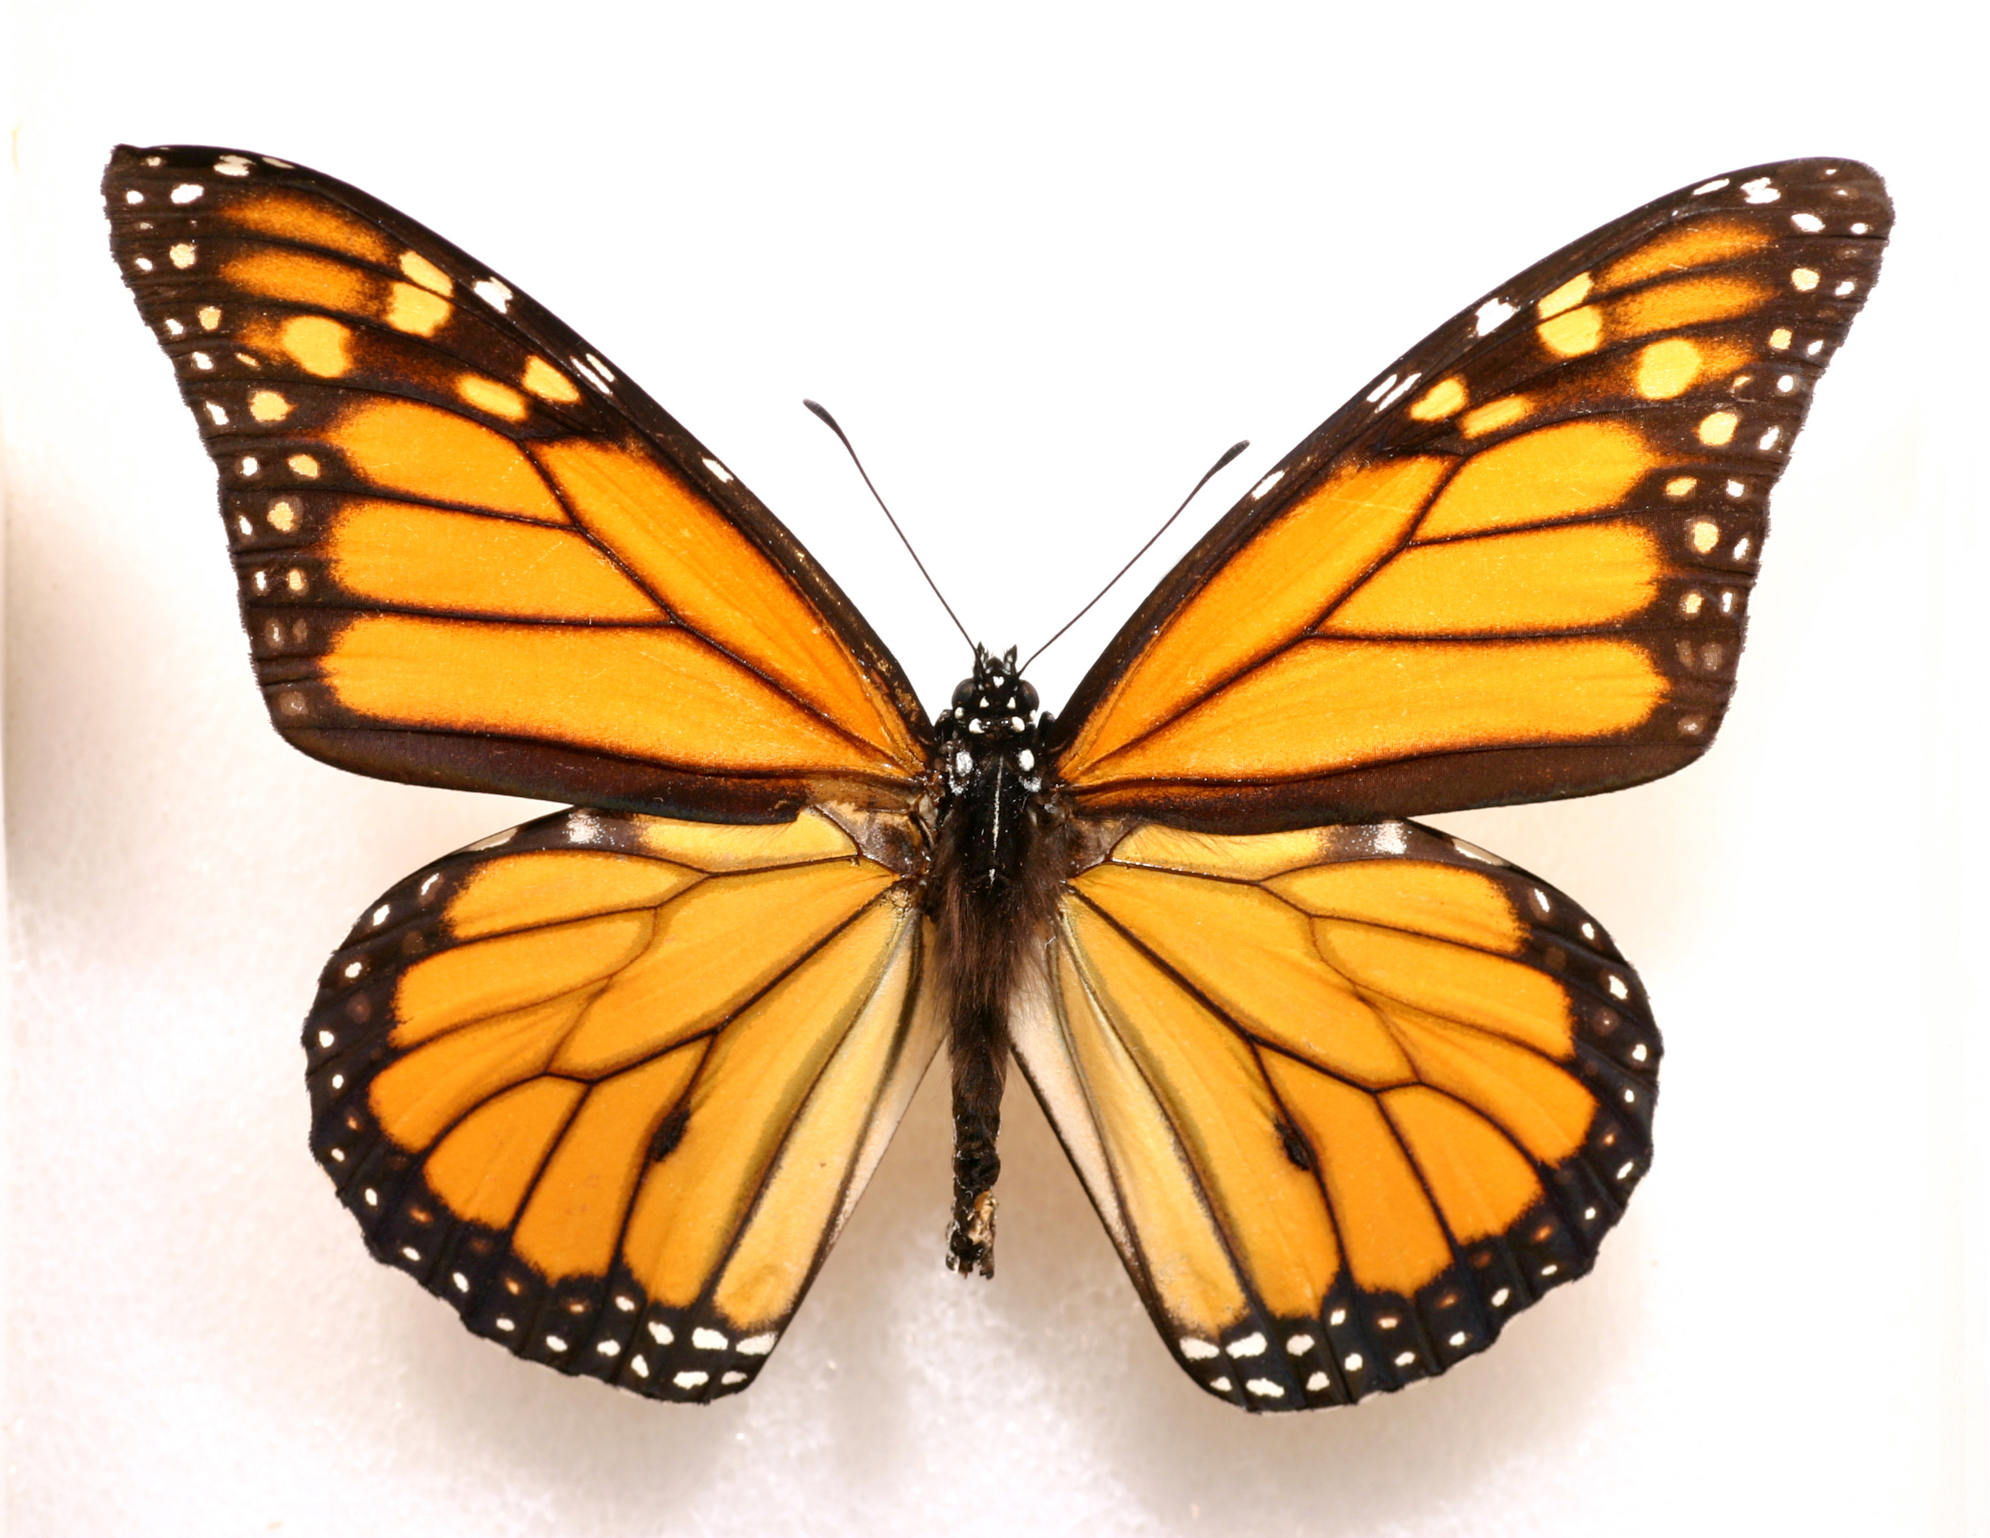
Metamorphosis

Slide 3
Metamorphosis
“a major change in the appearance or character of someone or something”
“biology: a major change in the form or structure of some animals or insects that happens as the animal or insect becomes an adult”

Slide 4
CHANGES
Our children change daily, though gradually, right before our eyes.
And the child grew and became strong, filled with wisdom. And the favor of God was upon him. Luke 2.40
And Jesus increased in wisdom and in stature and in favor with God and man. Luke 2.52

Slide 5
A Change In RELATIONSHIP
But thanks be to God, that you who were once slaves of sin have become obedient from the heart to the standard of teaching to which you were committed, and, having been set free from sin, have become slaves of righteousness. Rom. 6.17-18

Slide 6
A Change In KNOWLEDGE And UNDERSTANDING
For though by this time you ought to be teachers, you need someone to teach you again the basic principles of the oracles of God. You need milk, not solid food, for everyone who lives on milk is unskilled in the word of righteousness, since he is a child.

Slide 7
A Change In KNOWLEDGE And UNDERSTANDING
But solid food is for the mature, for those who have their powers of discernment trained by constant practice to distinguish good from evil. Heb. 5.12-14

Slide 8
A Change In FAITH And LOVE
We ought always to give thanks to God for you, brothers, as is right, because your faith is growing abundantly, and the love of every one of you for one another is increasing. 2 Thess. 3.1

Slide 9
A Change In ATTITUDES And ACTIONS
But the fruit of the Spirit is love, joy, peace, patience, kindness, goodness, faithfulness, gentleness, self-control; against such things there is no law.

Slide 10
A Change In ATTITUDES And ACTIONS
And those who belong to Christ Jesus have crucified the flesh with its passions and desires. If we live by the Spirit, let us also keep in step with the Spirit. Let us not become conceited, provoking one another, envying one another. Gal. 5.22-26

Slide 11
A Change In ATTITUDES And ACTIONS
I therefore, a prisoner for the Lord, urge you to walk in a manner worthy of the calling to which you have been called, with all humility and gentleness, with patience, bearing with one another in love, eager to maintain the unity of the Spirit in the bond of peace. Eph. 4.1-3

Slide 12
A Change In ATTITUDES And ACTIONS
to put off your old self, which belongs to your former manner of life and is corrupt through deceitful desires, and to be renewed in the spirit of your minds, and to put on the new self, created after the likeness of God in true righteousness and holiness.

Slide 13
A Change In ATTITUDES And ACTIONS
Therefore, having put away falsehood, let each one of you speak the truth with his neighbor, for we are members one of another. Be angry and do not sin; do not let the sun go down on your anger, and give no opportunity to the devil.

Slide 14
A Change In ATTITUDES And ACTIONS
Let the thief no longer steal, but rather let him labor, doing honest work with his own hands, so that he may have something to share with anyone in need.

Slide 15
A Change In ATTITUDES And ACTIONS
Let no corrupting talk come out of your mouths, but only such as is good for building up, as fits the occasion, that it may give grace to those who hear.

Slide 16
A Change In ATTITUDES And ACTIONS
And do not grieve the Holy Spirit of God, by whom you were sealed for the day of redemption.

Slide 17
A Change In ATTITUDES And ACTIONS
Let all bitterness and wrath and anger and clamor and slander be put away from you, along with all malice. Be kind to one another, tenderhearted, forgiving one another, as God in Christ forgave you. Eph. 4.22-32

Slide 18
CHALLENGES
Children face many challenges at various stages of life as they grow to physical maturity.
For not even his brothers believed in him. John 7.5
And when his family heard it, they went out to seize him, for they were saying, “He is out of his mind.” Mark 3.21

Slide 19
The Challenge Of ROOTING Ourselves In God’s Word
Now the parable is this: The seed is the word of God. The ones along the path are those who have heard; then the devil comes and takes away the word from their hearts, so that they may not believe and be saved.

Slide 20
The Challenge Of ROOTING Ourselves In God’s Word
And the ones on the rock are those who, when they hear the word, receive it with joy. But these have no root; they believe for a while, and in time of testing fall away. And as for what fell among the thorns, they are those who hear, but as they go on their way they are choked by the cares and riches and pleasures of life, and their fruit does not mature.

Slide 21
The Challenge Of ROOTING Ourselves In God’s Word
As for that in the good soil, they are those who, hearing the word, hold it fast in an honest and good heart, and bear fruit with patience. Luke 8.11-15

Slide 22
The Challenge Of ROOTING Ourselves In God’s Word
As for what was sown on rocky ground, this is the one who hears the word and immediately receives it with joy, yet he has no root in himself, but endures for a while, and when tribulation or persecution arises on account of the word, immediately he falls away.

Slide 23
The Challenge Of ROOTING Ourselves In God’s Word
As for what was sown among thorns, this is the one who hears the word, but the cares of the world and the deceitfulness of riches choke the word, and it proves unfruitful.

Slide 24
The Challenge Of ROOTING Ourselves In God’s Word
As for what was sown on good soil, this is the one who hears the word and understands it. He indeed bears fruit and yields, in one case a hundredfold, in another sixty, and in another thirty.” Matt. 13.20-23

Slide 25
The Challenge Of Dealing With The THORNS In Life
For we do not have a high priest who is unable to sympathize with our weaknesses, but one who in every respect has been tempted as we are, yet without sin. Heb. 4.15

Slide 26
The Challenge Of Dealing With The THORNS In Life
By faith Moses, when he was grown up, refused to be called the son of Pharaoh's daughter, choosing rather to be mistreated with the people of God than to enjoy the fleeting pleasures of sin. Heb. 11.24-25

Slide 27
The Challenge Of PREPARATION
And the Lord said, “Who then is the faithful and wise manager, whom his master will set over his household, to give them their portion of food at the proper time? Blessed is that servant whom his master will find so doing when he comes.

Slide 28
The Challenge Of PREPARATION
Truly, I say to you, he will set him over all his possessions. But if that servant says to himself, ‘My master is delayed in coming,’ and begins to beat the male and female servants, and to eat and drink and get drunk,

Slide 29
The Challenge Of PREPARATION
the master of that servant will come on a day when he does not expect him and at an hour he does not know, and will cut him in pieces and put him with the unfaithful.

Slide 30
The Challenge Of PREPARATION
And that servant who knew his master's will but did not get ready or act according to his will, will receive a severe beating. But the one who did not know, and did what deserved a beating, will receive a light beating.

Slide 31
The Challenge Of PREPARATION
Everyone to whom much was given, of him much will be required, and from him to whom they entrusted much, they will demand the more. Luke 12.42-48

Slide 32
Are the changes you are experiencing indicative of spiritual growth?
The number of years since becoming a Christian ≠ spiritual growth!
Are you rising to the challenges that accompany spiritual growth?

