Slide 3
The Gift Of The Holy Spirit - Review
Mark 16.15-17 | Acts 2.38 | Acts 8.12-20 | Acts 10.44-47 | Acts 19.1-7
“Go... preach... all creation” (15) | “…you will be my witnesses in Jerusalem and in all Judea and Samaria, and to the end of the earth” (1.8) | “Philip preached the good news about the kingdom...” (12a) | When Peter began to speak, the HS fell on the Gentiles (v44, cf. 11.15) | “John baptized... telling them to believe in... Jesus” (4)
“believed... baptized... Saved (16) | “Repent... baptized... forgiveness of sins...” (38a) | “When they believed…they were baptized, both men and women” (12b) | The Jews were amazed because the “gift of the HS” was poured out even on the Gentiles (45; cf. 11.17) | “When they heard this, they were baptized in the name of the Lord Jesus” (5)
“These signs will accompany those who have believed...” (17) | “...you will receive the gift of the Holy Spirit” (38b) | “Then they laid their hands on them and they received the Holy Spirit” (17) | For they were hearing them speaking in tongues and extolling God...(46) | “Paul... laid his hand upon them, the Holy Spirit came on them, and they began speaking with tongues and prophesying” (6)

Slide 4
What Were The Spiritual Gifts?
Utterance of wisdom – ability to speak new revelations of divine wisdom
Utterance of knowledge – the ability to teach the truth thus revealed
Faith – faith to perform miracles

Slide 5
What Were The Spiritual Gifts?
Gifts of healing – ability to heal all kinds of sickness
Working of miracles – the power to do extraordinary miracles
Prophecy – N.T. prophets foretold things of a temporary or personal nature

Slide 6
What Were The Spiritual Gifts?
Distinguish between spirits – ability to test the spirits
Kinds of tongues – ability to speak in various languages
Interpretation of tongues – ability to interpret languages

Slide 7
Do we have spiritual gifts today?

Slide 8
Spiritual Gifts All Throughout Scripture
John 7.39; 20.21
Acts 2.38-39, 8.12-20, 10.44-47, 11.17, 19.1-6
Eph. 3.7; 4.7-13
Gal. 3.2, 5
1 John 2.27
Etc.

Slide 9
Didn’t Jesus Say…
“…And he said to them, “Go into all the world and proclaim the gospel to the whole creation. Whoever believes and is baptized will be saved, but whoever does not believe will be condemned. And these signs will accompany those who believe: in my name they will cast out demons; they will speak in new tongues; they will pick up serpents with their hands; and if they drink any deadly poison, it will not hurt them; they will lay their hands on the sick, and they will recover...”
Mark 16.15-18

Slide 10
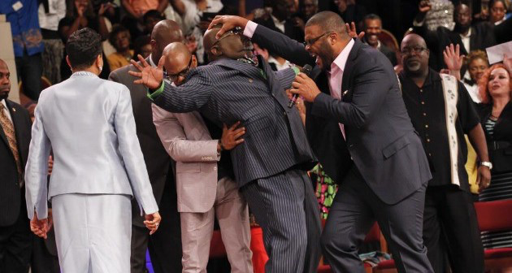

Slide 11
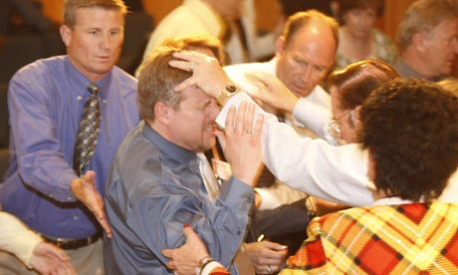

Slide 12
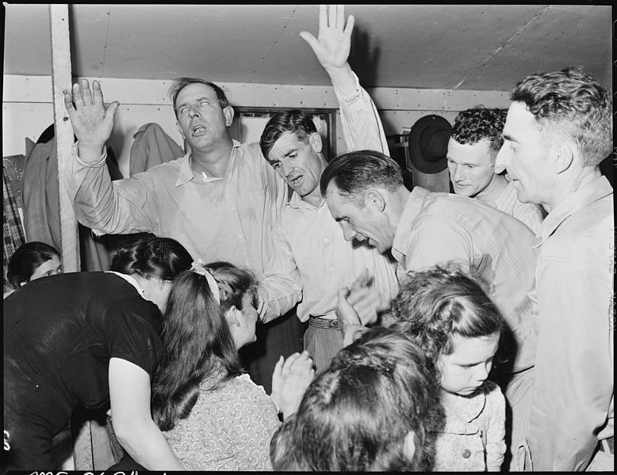

Slide 13
When we understand the purpose of spiritual gifts and the reception of the gifts we can answer this question!

Slide 14
The Purpose
Joel’s prophecy accomplished three things:
Specific gifts were given to reveal God’s word / instruct & edify the saints, 1 Cor. 12.7; 14.3, 12, 26
Note: spiritual gifts indicated that the process of revelation was not yet complete; were designed to bless the whole church

Slide 15
The Purpose
Joel’s prophecy accomplished three things:
“…signs, wonders, miracles, and various gifts of the Holy Spirit” were used to confirm to unbelievers the spoken Word as coming from God, Mark 16.20; Acts 14.3; 1 Cor. 14.22; Heb. 2.3-4
Note: when the Word was already confirmed, no need for signs, Phil. 2.25-27; 1 Tim. 5.23; 2 Tim. 4.20

Slide 16
The Purpose
Joel’s prophecy accomplished three things:
It served as testimony to universal access to God — that all were equal before God, all had the same access (Acts 10; Gal. 3.28)!

Slide 17
The Reception Of The Gifts
Spiritual gifts were ALWAYS distributed through the laying on of the apostles’ hands, Acts 8.12-20; 19.1-6; Rom. 1.11; 2 Tim. 1.6
Spiritual gifts were NEVER distributed through the laying on of Christian’s hands, Acts 8.18-19; 26-40

Slide 18
Are There Apostles Today?
The qualifications of the apostles / witnesses, Acts 1.20-22; 10.39-42; 13.26-33
Must have been with Jesus from the beginning of His ministry to His ascension

Slide 19
No Apostles = No Transference Of Spiritual Gifts
Christian
received HS by laying on of hands
Apostle
C
C
C
C
C
C
C
C
C
Note: Not every Christian had spiritual gifts, 1 Cor. 12.11, 29-30; Acts 8.39

Slide 20
Spiritual Gifts To Cease
Eph. 4.7-14

Slide 21
Spiritual Gifts To Cease
1 Cor. 13.8-13
Fail (8): to render idle, unemployed, inactivate, inoperative; to cause a person or thing to have no further efficiency; to deprive of force, influence, power; to cause to cease, put an end to, do away with, annul, abolish; to cease, to pass away, be done away… (Thayer)

Slide 22
“…That Which Is Perfect…”
Perfect (10): brought to its end, finished; wanting nothing necessary to completeness; perfect; that which is perfect…of men: full grown, adult, of full age, mature (Thayer)
Pentecostals / denomination say, “…that which is perfect… (v10) refers to Christ’s return!”
When Christ returns, there is no need for faith & hope (v13 contrast vv8-10), 1 Cor. 13.13; 2 Cor. 5.6-8; Heb. 11.1, Rom 8.24

Slide 23
The three gifts mentioned deal with the revelation of the Word of God – 1 Cor. 13

Slide 24
Tongues, Prophecies, Knowledge
Faith & Hope
Love
Word Revealed
Jesus Returns
Eternity

Slide 25
The Whole Must be of the Same Nature as a Part of that Whole
IN PART (partial)
PERFECT (complete, whole)
Part (piece) of an Apple
Part (piece) of an Orange
Know in part, Prophesy in part
Perfect (complete, whole) Apple
Perfect (complete, whole) Orange
Complete knowledge, Complete prophecy

Slide 26
“…When I became a man, I gave up childish ways…”
prophecies, tongues, knowledge, revelation in part
the complete revelation
speaking, understanding and thinking as a child
becoming a man, put away childish things (partial revelation)

Slide 27
“…now we see in a mirror dimly, but then face to face…”
prophecies, tongues, knowledge, revelation in part
the complete revelation
seeing someone through a dirty glass
seeing someone face to face (clearly)

Slide 28
“…know in part…know fully…”
prophecies, tongues, knowledge, revelation in part
the complete revelation
know in part
know as "also I am known” (known fully)

Slide 29
The Word Of God
Complete, 2 Tim. 3.16-17; James 1.25; Jude 3
We have the apostles today, cf. Luke 16.29

Slide 30
The N. T. replaced the “scaffolding” of the spiritual gifts!

Slide 31
God’s Wisdom
It is either the case that God allowed the spiritual gifts to no longer be in use after the Word was complete or when the last Christian with spiritual gifts died, the period of spiritual gifts was complete.
Either way, the spiritual gifts could not be transferred.
Gifts would have ceased around the end of the 1st century

Slide 32
We Have The Word! We Don’t Need The Gifts!
“Now Jesus did many other signs in the presence of the disciples, which are not written in this book; but these are written so that you may believe that Jesus is the Christ, the Son of God, and that by believing you may have life in his name.”
John 20.30-31

Slide 33
What About People Today Who Claim Miraculous Gifts?
“The coming of the lawless one is by the activity of Satan with all power and false signs and wonders, and with all wicked deception for those who are perishing, because they refused to love the truth and so be saved. Therefore God sends them a strong delusion, so that they may believe what is false, in order that all may be condemned who did not believe the truth but had pleasure in unrighteousness.”
2 Thess. 2.9-12

Slide 34
“…so that they may believe what is false…”

Slide 35
God’s Plan For Your Salvation
Hear The Word – Rom. 10.17
Believe The Word – John 8.24
Repent Of Sin – Acts 17.30
Confess Faith In Christ – Rom. 10.9-10
Be Immersed – Acts 22.16
Remain Faithful – Rev. 2.10

