Slide 2
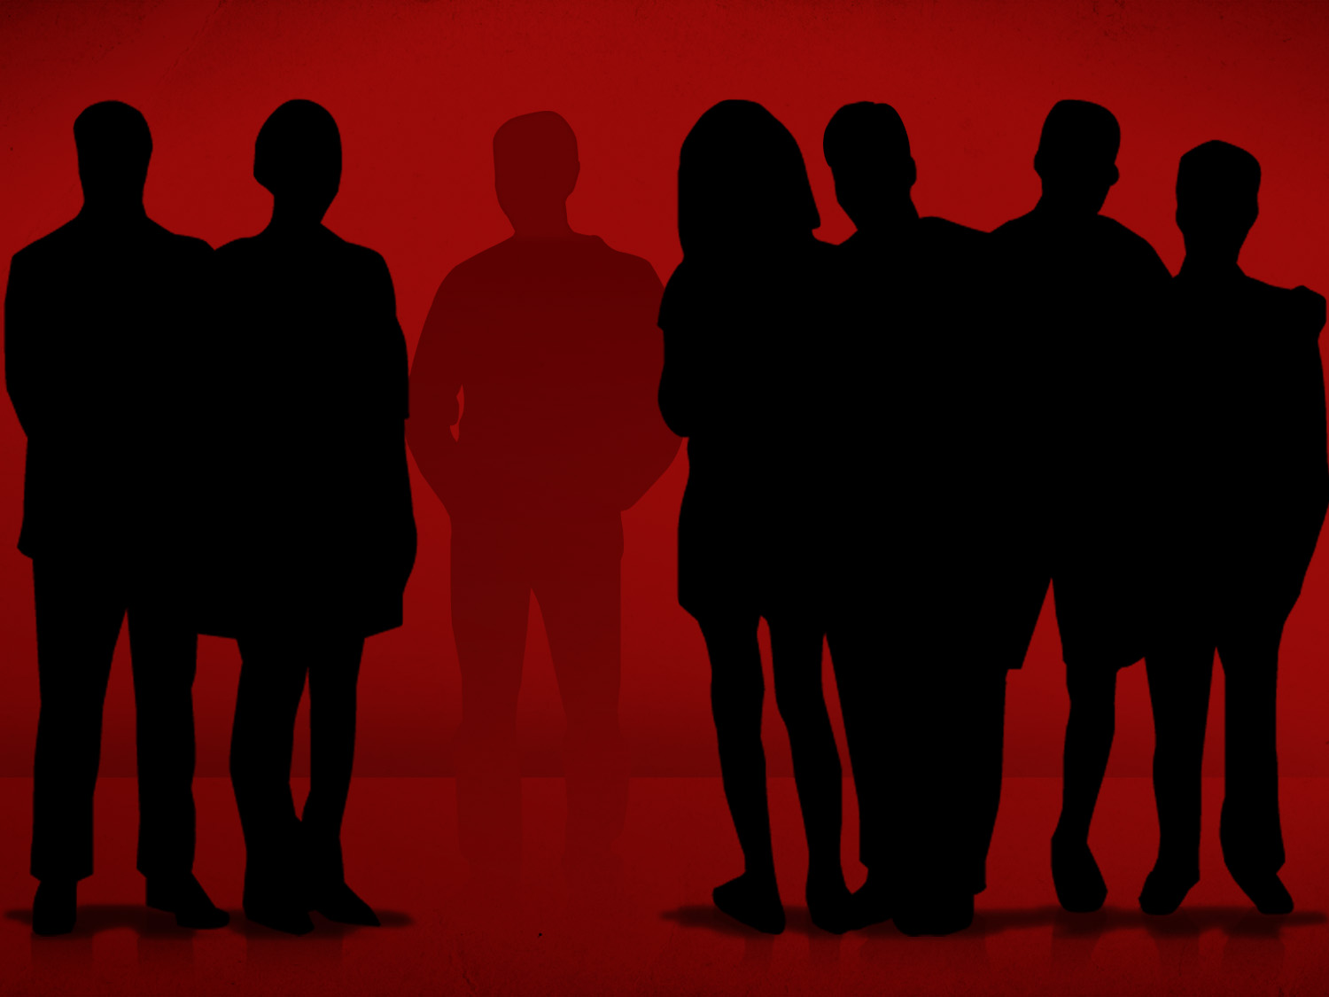
Partaking Of Sins

Slide 3
Nor Share In Other People’s Sins
Committed a sin together.
Annanias and Sapphira agreed with each other in their sin, Acts 5.1-9
Others will try to persuade us to sin, Pro. 1.10-19
We must be careful to not be partakers with them, Eph. 5.3-7, 11

Slide 4
Nor Share In Other People’s Sins
Committing The Same Sin Separately.
Jeroboam caused Israel to sin, 1 Kings 12.28-30
"...As your fathers did, so do you.” Acts 7.51

Slide 5
Nor Share In Other People’s Sins
Don’t Actually Commit The Sin, But Consent With Those Who Do.
Saul of Tarsus gave consent to Stephen's death, Acts 7.57-58; 8.1; 22.20
Guilty by association / approval, Rom. 1.28-32

Slide 6
Nor Share In Other People’s Sins
Know Another’s Guilt But Fail To Act, Rebuke & Expose
All that is needed for evil to prosper is for good people to do nothing.
Ezekiel’s responsibility, Ezekiel 3.17-21
Eli's responsibility, 1 Sam. 3.13; 2.17, 22
The same goes for the Christian & the Church.

Slide 7
Nor Share In Other People’s Sins
Improper Association
By befriending the world we are partaking in the world’s sin, James 4.4
We must expose sin, or we may encourage those in sin or cause ourselves to sin, Eph. 5.1-7
We must “Be imitators of God” (1)
We must “not be partakers with them” that practice lawlessness (7)

Slide 8
Nor Share In Other People’s Sins
Teaching or Supporting The Doctrine From Men
We are partaking in their sins, 2 John 9-11

Slide 9
Nor Share In Other People’s Sins
It is wrong to financially support error
Salvation Army, “We believe that our first parents were created in a state of innocence, but by their disobedience, they lost their purity and happiness, and that in consequence of their fall, all men have become sinners, totally depraved, and as such are justly exposed to the wrath of God.”
“We believe that repentance toward God, faith in our Lord Jesus Christ and regeneration by the Holy Spirit are necessary to salvation.”
Salvationarmyusa.com

Slide 10
Nor Share In Other People’s Sins
What about financially supporting sin?
Too many Christians are paying for sin.
Paying to watch movies that we know are full of inappropriate scenes, profanity, nudity, and so forth?
Then buying these movies when they go to DVD?
What about paying for music with inappropriate lyrics and profanity?
Does this make us just as guilty as those who actually practice sin?

Slide 11
Nor Share In Other People’s Sins
Are we working iniquity with those men who do such things by purchasing their works?, Psalm 141.4; Rom. 1.32

Slide 12
Nor Share In Other People’s Sins
Let us work to not "be partakers with the wicked," but "be partakers with the righteous”!
We can’t have it both ways, 1 Cor. 10.21; 2 Cor. 6.14
Let us be partakers of the inheritance, Col. 1.12

Slide 13
God’s Plan For Your Salvation
Hear The Gospel – Romans 10.17
Believe Jesus Is The Christ – John 8.24
Repent Of Sins – Acts 2.38
Confess Christ – Romans 10.9-10
Be Baptized – Mark 16.16
Be Faithful – Revelation 2.10

