Slide 2
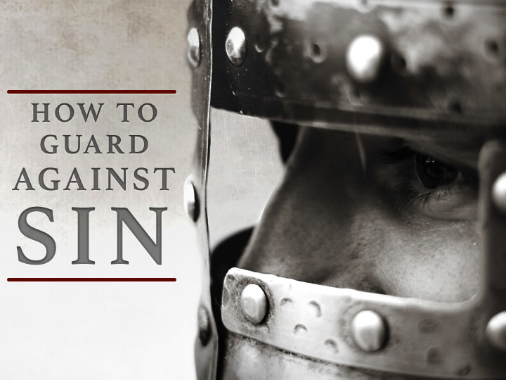

Slide 3
God Is Concerned With Our HEARTS
God SEARCHES the hearts, Jeremiah 17.10; 1 Sam. 16.7
It is our heart that either CONDEMNS us or does not condemn us, 1 John 3.19-21
The heart can be GOOD or EVIL, Psalm 51.10; Mark. 7.20-23
BLESSED are the pure in heart for they shall see God, Matt. 5.8

Slide 4
God Is Concerned With Our HEARTS
  The PARABLE of the Sower, Luke 8.4-15; Matt. 13.1-9; 18-23
The 4 kinds of SOILS are 4 kinds of hearts:
  WAYSIDE soil: never receives the Word
  ROCKY soil: receives the Word…no root, in time of temptation falls away
  THORNY soil: receives the Word…cares of the world choke the word
  GOOD soil: receives the Word…keeps it, bears fruit with patience

Slide 5
The Word Of God AFFECTS The Heart
God made us volitional creatures, that is, we are capable of making CHOICES, Rom. 6.17; 1 Peter 1.22-23
If the heart is RIGHT, we can GUARD against sin!

Slide 6
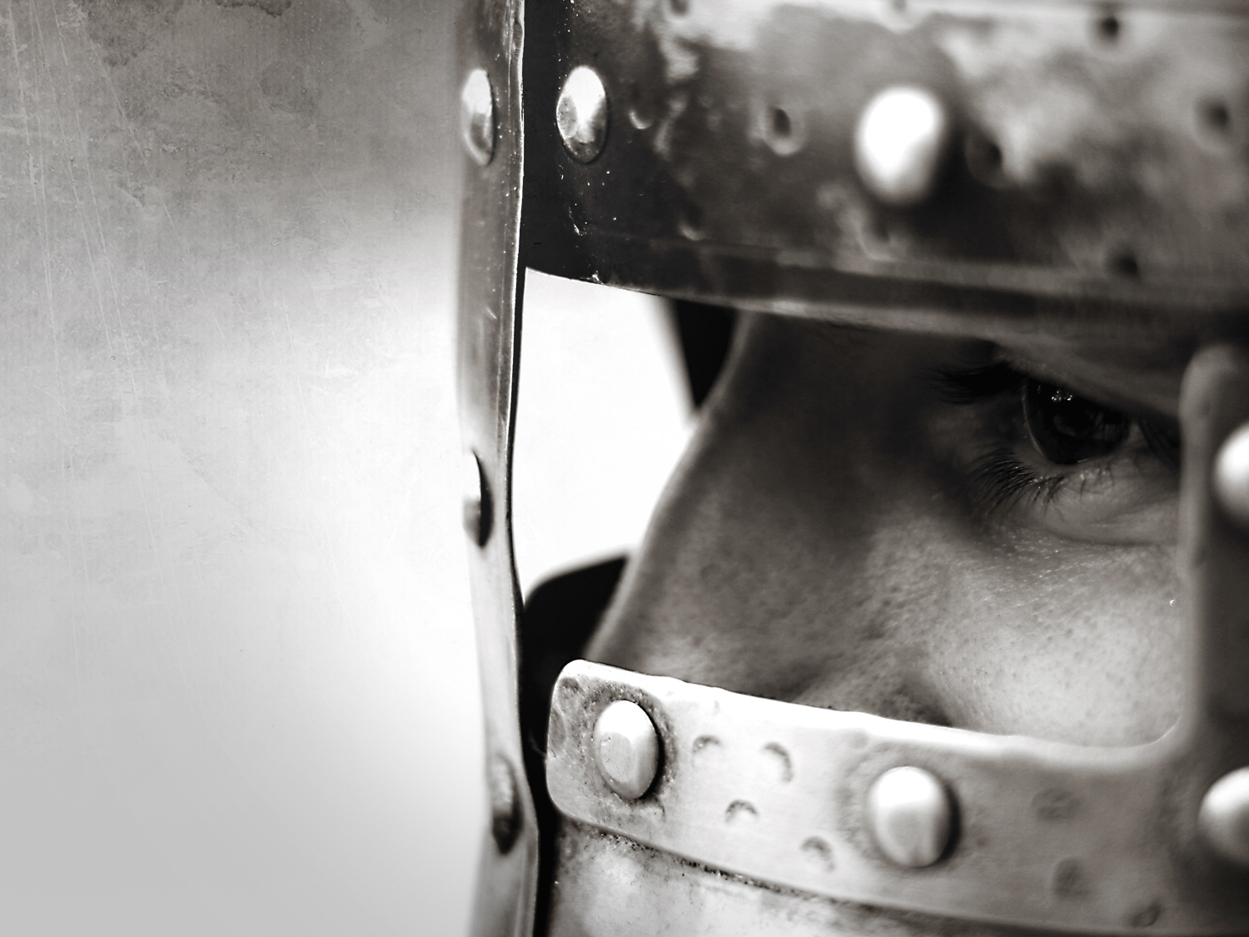
“I have stored up your word in my heart, that I might not sin against you”
Psalm 119.11
“I have stored up your word in my heart, that I might not sin against you”
Psalm 119.11

Slide 7
By IMPLANTING God’s Word in his heart, the heart was FORTIFIED against sin!

Slide 8
The Word Of God Must Be STORED In Our Hearts
    DESIRE to understand the Word of God, 1 Peter 2.2; Psalm 19.10
STRIVE to understand the Word of God, Psalm 1.1a, 2; 2 Tim. 2.15; Eph. 5.17
APPRECIATE the power of the Word of God, Rom. 1.16; Heb. 4.12; 11.3; 1 Peter 1.22-25; Psalm 19.7-11

Slide 9
The Word Of God Must Be STORED In Our Hearts
HOLD the Word of God in high esteem for its value, Psalm 119.161
STORE up the Word of God in our memory, Luke 4.1-12
APPLY the Word of God to our lives, Luke 6.46

Slide 10
The Word of God Can KEEP Us From Sinning
The Word of God IMPARTS COUNSEL concerning sin, Psalm 1.1-2; Heb. 11.25
The Word of God WARNS of punishment for sin, Rom. 6.23
The Word of God makes PROMISES for overcoming sin, James 1.12

Slide 11
The Word of God Can KEEP Us From Sinning
The Word of God informs of God's LOVE, 1 John 4.9-10
The Word of God teaches practical DUTIES, Rom. 12.9-21
The Word of God communicates STRENGTH, Eph. 6.10-20

Slide 12
Have you obeyed the Word from the heart?
Are you obeying the Word to keep from sinning?

