Slide 2
Gideon --
God’s Man

Slide 3
Israelite History
God had kept every promise He ever made to the Israelites.
He fought for them and blessed them more than any people had ever been blessed (Deuteronomy 7:14).

Slide 4
Deuteronomy 7:14
“Thou shalt be blessed above all people...”

Slide 5
Israelite History
God had kept every promise He ever made to the Israelites.
He fought for them and blessed them more than any people had ever been blessed (Deuteronomy 7:14).
All that God asked of them was for them to obey Him and worship Him alone.

Slide 6
Israelite History
God made an IF-THEN promise to His people.
God said IF they followed Him, THEN He would bless them and fight for them (Exodus 34:10-11).
However, God also said that IF the Israelites did not follow Him, THEN He would not bless them, and He would not fight their enemies for them (Joshua 23:12-13).
God ALWAYS keeps His promises!

Slide 7
Israelite History
It didn’t take long for the Israelites to forget about God’s goodness, and worship the false gods of the Canaanites.
Just as God had warned them, He stopped fighting for them, and they were conquered by other nations.
After the people had been enslaved for several years, they cried out to God.
In His mercy and goodness, He sent them a deliverer, also called a judge.

Slide 8
Israelite History
The judge rescued them from their enemies, and the people followed God. But, sadly, as soon as the judge died, they fell into the temptation of worshipping false Gods again.
Again, they were given over to their enemies, they suffered, they called out to God, He sent a deliverer, they were rescued, and they followed God - but only until that judge died.
Then they chose to sin and the cycle started all over again.

Slide 9
The ‘Cycle’ of Judges
Peace
Sin
Peace
Oppressor
Judge
Cry Out

Slide 11
Israelite History
After God used Deborah, Barak, and Jael to free them, the Israelites followed God and lived in peace for forty years (Judges 5:31).
What do you think happened next? Yes, the Israelites sinned again.

Slide 12
Judges 6:1
“Then the sons of Israel did what was evil in the sight of the LORD; and the LORD gave them into the hands of Midian seven years.”

Slide 13
The Midianites
The Midianites were very powerful and they treated the Israelites very badly. The Israelites even tried to hide from the Midianites in caves and clefts.
The Bible tells us that every year the Israelites planted their crops and then the Midianites and other tribes came and devoured the crops. There were so many Midianites that no one could even count them.
The Bible describes the people like a swarm of locusts because they ravaged everything in their path. They killed the Israelites’ animals. They destroyed nearly everything. It was difficult for the Israelites to even survive. There was barely any food left to eat, and very few animals to work the land.

Slide 14
Judges 6:6
“So Israel was brought very low because of Midian, and the sons of Israel cried to the LORD.”
God Sends A Prophet!

Slide 15
The Midianites
The Israelites cried out to God for help and God always hears the prayers of His people! (Exodus 3:7, 2 Chron. 30:27).
God sent a prophet to remind the Israelites about the amazing things He had done for them by bringing them out of Egypt and conquering their enemies in Canaan.
The prophet also reminded them that they did not listen to God’s warning about worshipping false gods.

Slide 16
Judges 6:12
Gideon is Chosen
“And the angel of the LORD appeared to him and said to him, “The LORD is with you, O valiant warrior.’”

Slide 17
Judges 6:15
“And he said to Him, ‘O Lord, how shall I deliver Israel? Behold, my family is the least in Manasseh, and I am the youngest in my father's house.’”
Sound Familiar?

Slide 18
Judges 6:16 (ESV)
“And the LORD said to him, ‘But I will be with you, and you shall strike the Midianites as one man.’”

Slide 19
The Midianite Army
The Midianite army joined with the Amalekite army. Many other eastern people joined with them. Together, they crossed the Jordan River and camped in the Jezreel Valley.
All together, over 135,000 enemy soldiers were in the middle of the Israelites’ territory (Judges 8:10).

Slide 20
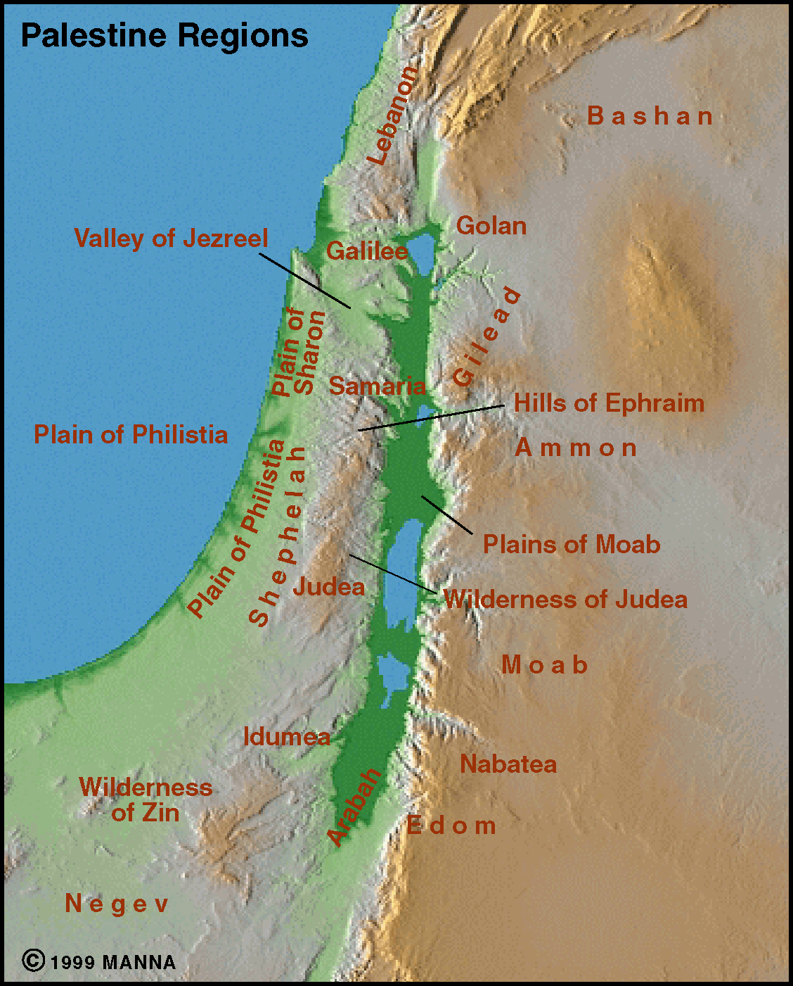

Slide 21
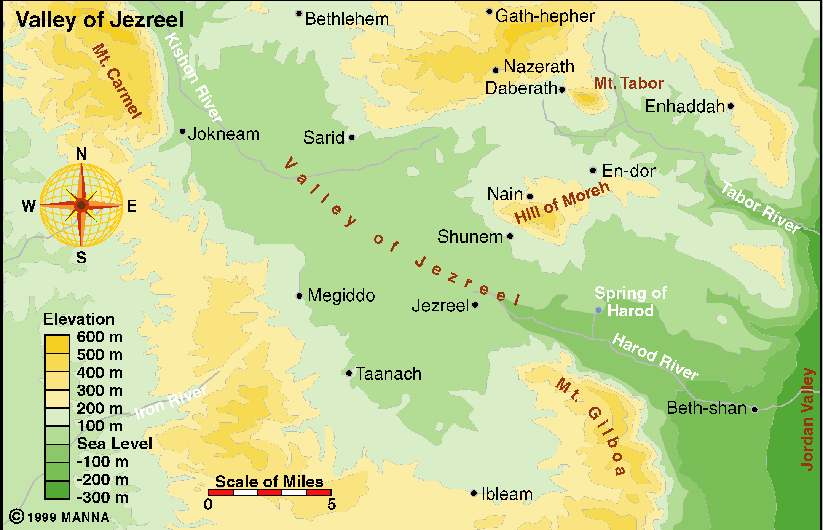

Slide 22
The Midianite Army
God’s Spirit filled Gideon and Gideon blew a trumpet to call his army together.
Many Israelite tribes joined Gideon’s army. So Gideon’s army had formed.
The Bible tells us there were about 32,000 men ready to follow Gideon into battle to take their land back from the Midianites (Judges 7:3).

Slide 23
Judges 6:36-37
“Gideon said to God, ‘You promised you would use me to save Israel. Please do something for me. I’ll put a piece of wool on the threshing floor. Suppose dew is only on the wool tomorrow morning. And suppose the ground all around it is dry. Then I will know that you will use me to save Israel. I’ll know that your promise will come true.’”

Slide 24
Gideon was still not quite convinced. A trace of doubt was lingering in his mind. We have all felt similar doubts at times. Our minds have a funny way of taking something miraculous and explaining it away. Gideon’s thoughts might have gone something like this: “Maybe there was dew on everything, but it just dried up. Maybe dirt dries faster than wool. Maybe the wet fleece really wasn’t a sign from God at all.” So he asked for another sign.

Slide 25
Judges 6:39
“Then Gideon said to God, ‘Don’t let your anger burn against me. Let me ask you for just one more thing. Let me use the wool for one more test. This time make the wool dry. And cover the ground with dew.’”

Slide 26
Comparing the Armies
Gideon’s army was camped just south of the Midianite army. The Israelites numbered about 32,000 soldiers, while the enemy numbered 135,000.
Let’s take a look at how these numbers compare to each other.

Slide 27
32,000
135,000
Does this look like a fair fight to you?

Slide 28
Army of Israel is Reduced
Judges 7:1-7
¹Then Jerubbaal (that is, Gideon) and all the people who were with him rose early and encamped beside the spring of Harod. And the camp of Midian was north of them, by the hill of Moreh, in the valley. ²The Lord said to Gideon, “The people with you are too many for me to give the Midianites into their hand, lest Israel boast over me, saying, ‘My own hand has saved me.’

Slide 29
Army of Israel is Reduced
Judges 7:1-7
³Now therefore proclaim in the ears of the people, saying, “Whoever is fearful and trembling, let him return home and hurry away from Mount Gilead.” Then 22,000 of the people returned, and 10,000 remained. ⁴And the Lord said to Gideon, “The people are still too many. Take them down to the water, and I will test them for you there…

Slide 30
10,000
135,000

Slide 31
Army of Israel is Reduced
Judges 7:1-7
...and anyone of whom I say to you, “This one shall go with you,” shall go with you, and anyone of whom I say to you, “This one shall not go with you,’ shall not go.”

Slide 32
Army of Israel is Reduced
Judges 7:1-7
⁵So he brought the people down to the water. And the Lord said to Gideon, “Every one who laps the water with his tongue, as a dog laps, you shall set by himself. Likewise, everyone who kneels down to drink.” ⁶And the number of those who lapped, putting their hands to their mouths, was 300 men, but all the rest of the people knelt down to drink.”

Slide 33
300
135,000

Slide 34
Army of Israel is Reduced
Judges 7:1-7
⁷And the Lord said to Gideon, “With the 300 men who lapped I will save you and give the Midianites into your hand, and let all the others go every man to his home.”

Slide 35
A Third Sign
Judges 7:9-25
In order to give Gideon the courage to lead the battle, God sent Gideon and one of his servants to the edge of the enemy camp during the night. There were so many soldiers and camels that it seemed like counting them would be like counting the grains of sand on the seashore. There, Gideon overheard two Midianite soldiers talking. One man told the other about a dream he had. In the dream, a round loaf of barley bread rolled into their camp and destroyed a tent. The man’s friend explained that the bread was a symbol for Gideon. He believed that God would fight for Gideon and the Midianites would be destroyed.

Slide 36
A Third Sign
Judges 7:9-25
Gideon rushed back to his own camp. He called out for his men to get up because God had handed the Midianites over to them.
He separated his men into three groups of 100 each. He gave each man a trumpet and a clay jar with a torch in it. Then Gideon’s men positioned themselves all around the camp.

Slide 37
Judges 7:20
When the three companies blew the trumpets and broke the pitchers, they held the torches in their left hands and the trumpets in their right hands for blowing, and cried, “A sword for the LORD and for Gideon!”
Judges 7:18
“When I and all who are with me blow the trumpet, then you also blow the trumpets all around the camp, and say, ‘For the LORD and for Gideon.’”

Slide 38
Judges 7:22
“When the 300 trumpets were blown, the Lord caused all of the men in the enemy camp to start fighting each other. They attacked each other with their swords. The army ran away to Beth Shittah toward Zererah. They ran all the way to the border of Abel Meholah near Tabbath.”

Slide 39
An Israelite Victory
Judges 7:24-25; 8:10-28
Gideon called for the other Israelite tribes to chase after the soldiers who had fled. All of the Midianite soldiers and their leaders were tracked down and killed (Judges 7:24-25; 8:10-13, 21).
The Midianite people never tried to attack the Israelites again (Judges 8:28).

Slide 40
“Be Our King”
Judges 8:22-23
The Israelites were so happy with Gideon that they wanted him to become their king, but Gideon refused.
The people of Israel spoke to Gideon. They said, “Rule over us. We want you, your son and your grandson to be our rulers. You have saved us from the power of Midian.” But Gideon told them, “I will not rule over you. My son won’t rule over you either. The Lord will rule over you.”
This was a wise response from Gideon. It was not Gideon who defeated the enemy. God did.

Slide 41
Not the End of the Story
Now that would make a great ending to a story. But, sadly, that is not the end of the story.
I hate to mention it, but do you remember our cycle chart?
Gideon asked the people to give him some of the jewelry that they had taken from the enemy. They gave him a large amount. He took the jewelry and made an object out of it. It looked like the apron that the high priest of Israel wore.

Slide 42
Not the End of the Story
Gideon may not have intended to do wrong, but it ended up becoming like an idol to the people. He placed it in his home town and the Israelites began to worship it.
Gideon lived for 40 more years after the Midianite battle. The Bible says there was peace during those 40 years.
Can you guess what happened as soon as Gideon died? The Israelites sinned and followed false gods.

Slide 43
The ‘Cycle’ of Judges
Peace
Sin
Oppressor
Judge
Cry Out

Slide 44
What do we learn
from this story?
We can’t rely on our own strength.
Victory begins at home.
The LORD is victorious!

Slide 45
Profile of Faith:
Gideon
Delivered Israel
Gideon stood in the gap.
Will you stand in the gap?
Your influence for good?
Hold family together?
Hold congregation together?
Hold a generation together?

Slide 46
“But He said to me, ‘My grace is all you need. My power is strongest when you are weak.’”
(2 Corinthians 12:9)

Slide 47
“My power is strongest when you are weak.”
(2 Corinthians 12:9b)

Slide 48
God uses our weaknesses to show His glory when we realize we must depend on Him.

