Slide 2
Dinosaurs And Men Walked Together
Footprints That Squash Evolution

Slide 3
According to evolutionary theories, dinosaurs and man lived 100 million years apart. Is this true?

Slide 4
Did Dinosaurs and Men Walk Together?
If evidence was found that dinosaurs and man lived at the same time, evolution would be “falsified”-- proven false. What does the evidence tell us?

Slide 5
Evidence has been found that dinosaurs and man lived at the same time!

Slide 6
Genesis 1: The Order of Creation
What God Created
Day 1
Day & Night
Day 2
Sea & Sky
Day 3
Land & Vegetation
What He Created To Dwell There
Day 4
Sun, Moon & Stars
Day 5
Fish & Birds
Day 6
Animals & Man

Slide 7
The Bible Presents Men And Dinosaurs Living At The Same Time (Genesis 2:19-20)

Slide 8
“Now out of the ground the Lord God had formed every beast of the field and every bird of the heavens and brought them to the man to see what he would call them….The man gave names to all livestock and to the birds of the heavens and to every beast of the field…”
Genesis 2:19-20
xxx

Slide 9
These Awesome Creatures Appear To Be Specifically Described In The Book Of Job

Slide 10
JOB
God is All Powerful
I Am Suffering
God is Unjust
JOB’S “FRIENDS”
God is All Powerful
You Are Suffering
You Are a Sinner

Slide 11
Neither Job Nor His Friends Had Even Begun To Understand
God’s Power!

Slide 12
God Answers In Power and Illustrates His Power In Creation!
Job 38-41

Slide 13
Let’s look at the “Behemoth” in Job 40:15-24
xxx
“Behemoth” in Hebrew translates as “gigantic beast.”

Slide 14
What do some say about this creature?
xxx
“The word has by various writers been understood to mean rhinoceros and elephant, but the description applies on the whole very well to the
hippopotamus.”
International Standard Bible Encyclopedia, p. 427

Slide 15
Let’s Look At The Facts
The Behemoth in Job 40
Eats grass like an ox - 15
Powerful muscles in belly - 16
Bends tail like a cedar - 17
Sinews of thighs knit together - 17
Bones are tubes of bronze - 18
Limbs are bars of iron - 18
Lives by the water - 21-22
Not alarmed at flooding river - 23
Can anyone capture? - 24

Slide 16
Which one looks like a behemoth to you?

Slide 17
“Leviathan” in Job 41
“The points in the description which may well apply to the crocodile are …the strong and close scales, the limbs and the teeth. It must be admitted that there are many expressions which a modern scientist would not use with reference to the crocodile, but the book of Job is neither modern, nor scientific, but poetical and ancient.”
International Standard Bible Encyclopedia, p. 1869

Slide 18
Let’s Look At The Facts
The Leviathan in Job 41
Will you mess with him? - 1-11
Limbs, strength, frame - 12
Protective armor - 13
Terrifying teeth - 14
Strong scales - 15-17
Fire-breathing (Ferocious!) - 18-21
Strong neck - 22
Flesh firm and immovable - 23

Slide 19
Which one looks like a leviathan to you?

Slide 20
What Happened To Them?
Evolutionists use their imagination in a big way in answering this question.
Because of their belief that dinosaurs “ruled” the world for millions of years, and then disappeared millions of years before man allegedly evolved, they have had to come up with all sorts of guesses to explain this “mysterious” disappearance.

Slide 21
What Happened To Them?
When reading evolutionist literature, you will be astonished at the range of ideas concerning their supposed extinction. The following is just a small list of theories:

Slide 22
What Happened To Them?
Dinosaurs starved to death; they died from overeating; they were poisoned; they became blind from cataracts and could not reproduce; mammals ate their eggs. Other causes include volcanic dust, poisonous gases, comets, sunspots, meteorites, mass suicide, constipation, parasites, shrinking brain (and greater stupidity), slipped discs, changes in the composition of air, etc.

Slide 23
Statements by Evolutionists
“If a single well verified mammal skull were to turn up in 500 million year old rocks, our whole modern theory of evolution would be utterly destroyed”
- Richard Dawkins, The Blind Watchmaker, p. 225

Slide 24
Statements by Evolutionists
“There is an infinite variety of ways in which since 1859, the general concept of evolution might have been demolished…the unequivocal discovery of a fossil population of horses in Precambrian rocks would disprove evolution. More generally, any topsy-turvy sequence of Fossils would force us to rethink our theory, yet not one single one has come to light.”
-Stephen Stanley, The New Evolutionary Timetable, p. 171

Slide 25
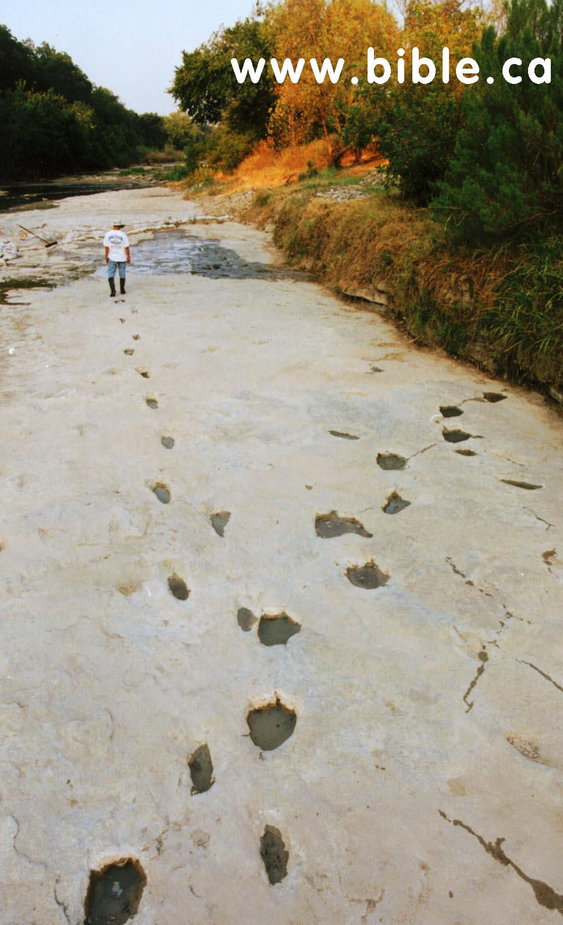
Here Are The Footprints
That Squash Evolution!
Dinosaur Valley State Park
in Glen Rose, Texas
Human Footprints in Dinosaur Tracks
14 human footprints
with left-right pattern

Slide 26
Don Patton, Archeologist and Preacher

Slide 27
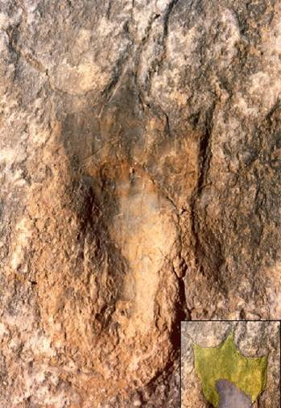
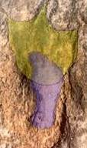
Human Track
11.5 INCHES
Dinosaur Track
24 INCHES

Slide 28
Look, a perfect fit!

Slide 29
A Fossilized Finger Was Also Found In The Same Rock Layer!

Slide 30
I Wonder What Kind of Dinosaur Made This Hammer?
This was found at London, Texas (90 miles away from the same geological period of rock)

Slide 31
Reaction of Evolutionists
Most Won’t Look.
Some Tried To Destroy The Evidence.
Some Say They Are Fake; “They’ve Been Carved.”
“We Don’t Know That Dinosaurs Didn’t Have Human Looking Feet!”
Some Even Say The Tracks Were Made By Aliens!

Slide 32
“…While seeing they do not see, and while hearing they do not hear, nor do they understand” (Matt. 13:13)
xxx

Slide 33
Dinosaurs And Men Walked Together
Will you accept the evidence?

