Slide 1


Slide 2
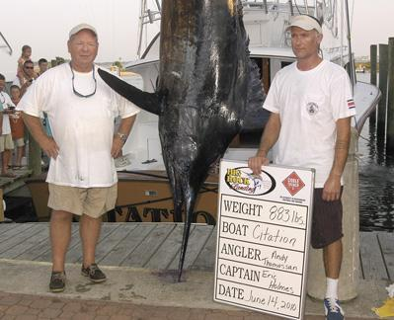
Event? - Blue Marlin Tournament
Date? - June 14, 2010
Location? - Big Rock, NC
Prize? - $1 million

Slide 3
For this fishing team, the $1-million prize is the one that got away!
Angler Andy Thomossan (left) and Capt. Eric Holmes stand beside the 883-pound blue marlin that they caught during the contest.
They thought they had won the $1-million prize, only to learn they were disqualified because one of the men on the team didn’t have a North Carolina fishing license.

Slide 4
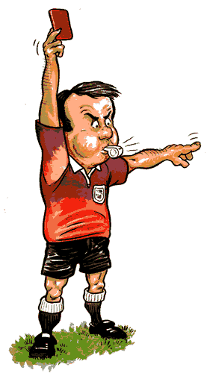
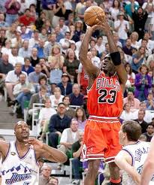
Competing According To The Rules

Slide 5
Competing According To The Rules
“An athlete is not crowned unless he competes according to the rules”
2 Timothy 2:5 (ESV)

Slide 6
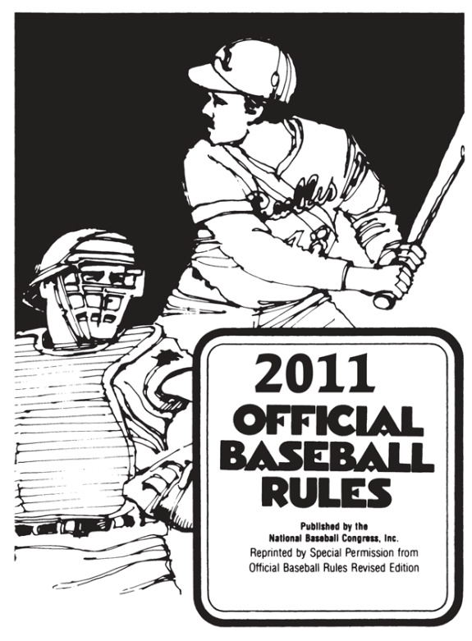
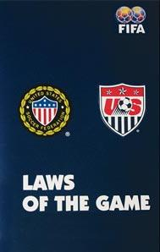
Competing According To The Rules
We can easily under- stand the necessity of competing according to the rules!
Football, soccer, golf, baseball, basketball, etc.

Slide 7
Competing According To The Rules
“Not everyone who says to Me, ‘Lord, Lord,’ will enter the kingdom of heaven, but he who does the will of My Father who is in heaven will enter.” (Matthew 7:21)
“However, let us keep living by that same standard to which we have attained.” (Phil. 3:16)
“Anyone who goes too far and does not abide in the teaching of Christ, does not have God; the one who abides in the teaching, he has both the Father and the Son.” (2 John 9)

Slide 8
Let’s Look At Some Who Did Not Compete According To The Rules:

Slide 9


Apollos
Acts 18:25
  “This man was instructed in the way of the Lord; and being fervent in the spirit, he spake and taught diligently the things of the Lord, knowing only the baptism of John.”

Slide 10
Some Galatians
Galatians 4:10-11
  “Ye observe days, and months, and times, and years. ¹¹I am afraid of you, lest I have bestowed upon you labour in vain.”

Slide 11
The twelve men at Ephesus
Acts 19:4-5
  “Then said Paul, John verily baptized with the baptism of repentance, saying unto the people, that they should believe on him which should come after him, that is, on Christ Jesus. ⁵When they heard this, they were baptized in the name of the Lord Jesus.”

Slide 12
The Jews of Jesus’ day
Matthew 15:9
  “But in vain they do worship me, teaching for doctrines the commandments of men.”

Slide 13
Many will be disappointed at the judgment
Matthew 7:21, 23
  “Not everyone that saith unto me, Lord, Lord, shall enter into the kingdom of heaven; but he that doeth the will of my Father which is in heaven. ²³…I profess unto them, I never knew you: depart from me, ye that work iniquity.”

Slide 14
Some Who Do Not Compete According To The Rules Today:
Those who teach you can reach heaven by good works
Those who say you can be saved by “faith only”
Those who practice sprinkling and pouring in the place of immersion
Those who fail to observe the Lord’s Supper every first day of the week

Slide 15
Some Who Do Not Compete According To The Rules Today:
Those who use human schemes to finance the work of the church
Those who turn the work of the local church over to human institutions
Those who substitute a different kind of music for what God authorized
Those who fail to assemble for worship
Those who are “off & on” – not diligent in their service to God

Slide 16
Competing According To The Rules
WHAT ABOUT YOU?
Are you competing according to God’s rules?
  James 4:4; 2 Cor. 6:14-18; Romans 12:13
HAVE YOU OBEYED THE GOSPEL?

