Slide 3
God is not the author of sin
sin did not originate with mankind
sin originated with angels
Listen Online
churchofchristatnorthside.com

Slide 4
The TEMPTER
The SERPENT, Gen. 3.1; 2 Cor. 11.3
He is also called the DEVIL and SATAN, Rev. 12.9
Everlasting fire was CREATED for them, Matt. 25.41
He must have been an ARCHANGEL, like Michael, having had angels assigned to him by God, Rev. 12.7
These must be the demons that make up his KINGDOM, Luke 11.14-22

Slide 5
The TEMPTED
The first HUMAN pair, Gen. 2.7, 18, 21-25
God TOLD them what to do and what not to do, 2.15-17
There were two ways for man to SIN.
By OMISSION (by refusing to do what God told him to do), James 4.17
By COMMISSION (by doing what God told him not to do), 1 John 3.4

Slide 6
The TEMPTATION
The first thing Satan did was to MISREPRESENT what God had said, v1
God
Satan
“You may surely eat of every tree of the garden, but of the tree of the knowledge of good and evil you shall not eat…” (16-17)
“…Did God actually say, ‘You shall not eat of any tree in the garden’?”

Slide 7
The TEMPTATION
The second thing Satan did was to CONTRADICT what God had said, v4
God
Satan
“…for in the day that you eat of it you shall surely die.” (17)
“…You will not surely die…”

Slide 8
The TEMPTATION
The third thing Satan did was to QUESTION God's motives in issuing the prohibitive command, v5
God
Satan
“…for in the day that you eat of it you shall surely die.” (17)
“For God knows that when you eat of it your eyes will be opened, and you will be like God, knowing good and evil.”

Slide 9
Satan created within the woman a DESIRE to eat the fruit
Gen. 3.6
1 John 2.15-17
So when the woman saw that the tree was good for food, and that it was a delight to the eyes, and that the tree was to be desired to make one wise, she took of its fruit and ate, and she also gave some to her husband who was with her, and he ate.
Do not love the world or the things in the world. If anyone loves the world, the love of the Father is not in him. For all that is in the world—the desires of the flesh and the desires of the eyes and pride of life—is not from the Father but is from the world. And the world is passing away along with its desires, but whoever does the will of God abides forever.

Slide 10
Satan created within the woman a DESIRE to eat the fruit
Gen. 3.6
1 John 2.15-17
So when the woman saw that the tree was good for food, and that it was a delight to the eyes, and that the tree was to be desired to make one wise, she took of its fruit and ate, and she also gave some to her husband who was with her, and he ate.
Do not love the world or the things in the world. If anyone loves the world, the love of the Father is not in him. For all that is in the world—the desires of the flesh and the desires of the eyes and pride of life—is not from the Father but is from the world. And the world is passing away along with its desires, but whoever does the will of God abides forever.

Slide 11
Satan created within the woman a DESIRE to eat the fruit
Gen. 3.6
1 John 2.15-17
So when the woman saw that the tree was good for food, and that it was a delight to the eyes, and that the tree was to be desired to make one wise, she took of its fruit and ate, and she also gave some to her husband who was with her, and he ate.
Do not love the world or the things in the world. If anyone loves the world, the love of the Father is not in him. For all that is in the world—the desires of the flesh and the desires of the eyes and pride of life—is not from the Father but is from the world. And the world is passing away along with its desires, but whoever does the will of God abides forever.

Slide 12
Satan created within the woman a DESIRE to eat the fruit
Gen. 3.6
1 John 2.15-17
So when the woman saw that the tree was good for food, and that it was a delight to the eyes, and that the tree was to be desired to make one wise, she took of its fruit and ate, and she also gave some to her husband who was with her, and he ate.
Do not love the world or the things in the world. If anyone loves the world, the love of the Father is not in him. For all that is in the world—the desires of the flesh and the desires of the eyes and pride of life—is not from the Father but is from the world. And the world is passing away along with its desires, but whoever does the will of God abides forever.

Slide 13
Satan created within the woman a DESIRE to eat the fruit
Gen. 3.6
1 John 2.15-17
So when the woman saw that the tree was good for food, and that it was a delight to the eyes, and that the tree was to be desired to make one wise, she took of its fruit and ate, and she also gave some to her husband who was with her, and he ate.
Do not love the world or the things in the world. If anyone loves the world, the love of the Father is not in him. For all that is in the world—the desires of the flesh and the desires of the eyes and pride of life—is not from the Father but is from the world. And the world is passing away along with its desires, but whoever does the will of God abides forever.

Slide 14
The ORIGIN Of Sin Among Us
James 1.12-18 teaches…
A PROMISE to those who endure temptations, v12
A CAUTION not to wrongfully accuse the source of those temptations, v13, 16-18
An UNDERSTANDING of how sin develops, v14-15

Slide 15
DESIRE
It is NOT a sin to be TEMPTED, Matt. 4.1-11; Heb. 4.15
Eve did not sin by being tempted; she sinned by YIELDING to temptation!

Slide 16
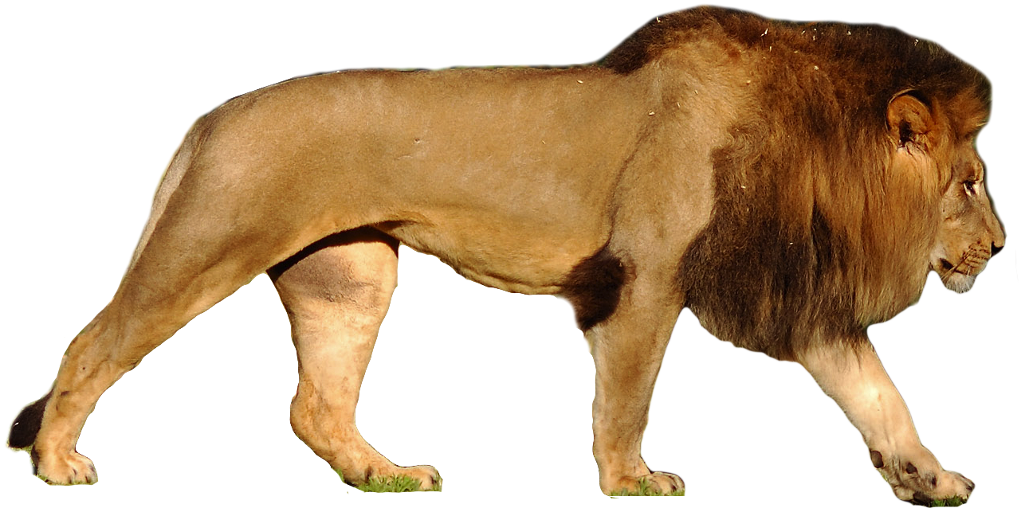
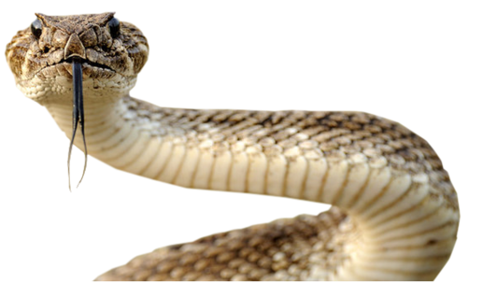
The Tempter is always LOOKING and LURKING, 1 Peter 5.8
Satan APPEALS to us as he did to Eve, 2 Cor. 11.3; 1 John 2.15-17

Slide 17
As the tempted, God has PROVIDED a way of escape, 1 Cor. 10.13
God provides the WAY; we must do the ESCAPING!
Whatever the temptation, we can OVERCOME, Heb. 2.18
Each time we YIELD, we get WEAKER, Heb. 3.13
Each time we RESIST, we grow STRONGER, James 4.7

