Slide 1
Notes:
Material by Jim Deason

Slide 2
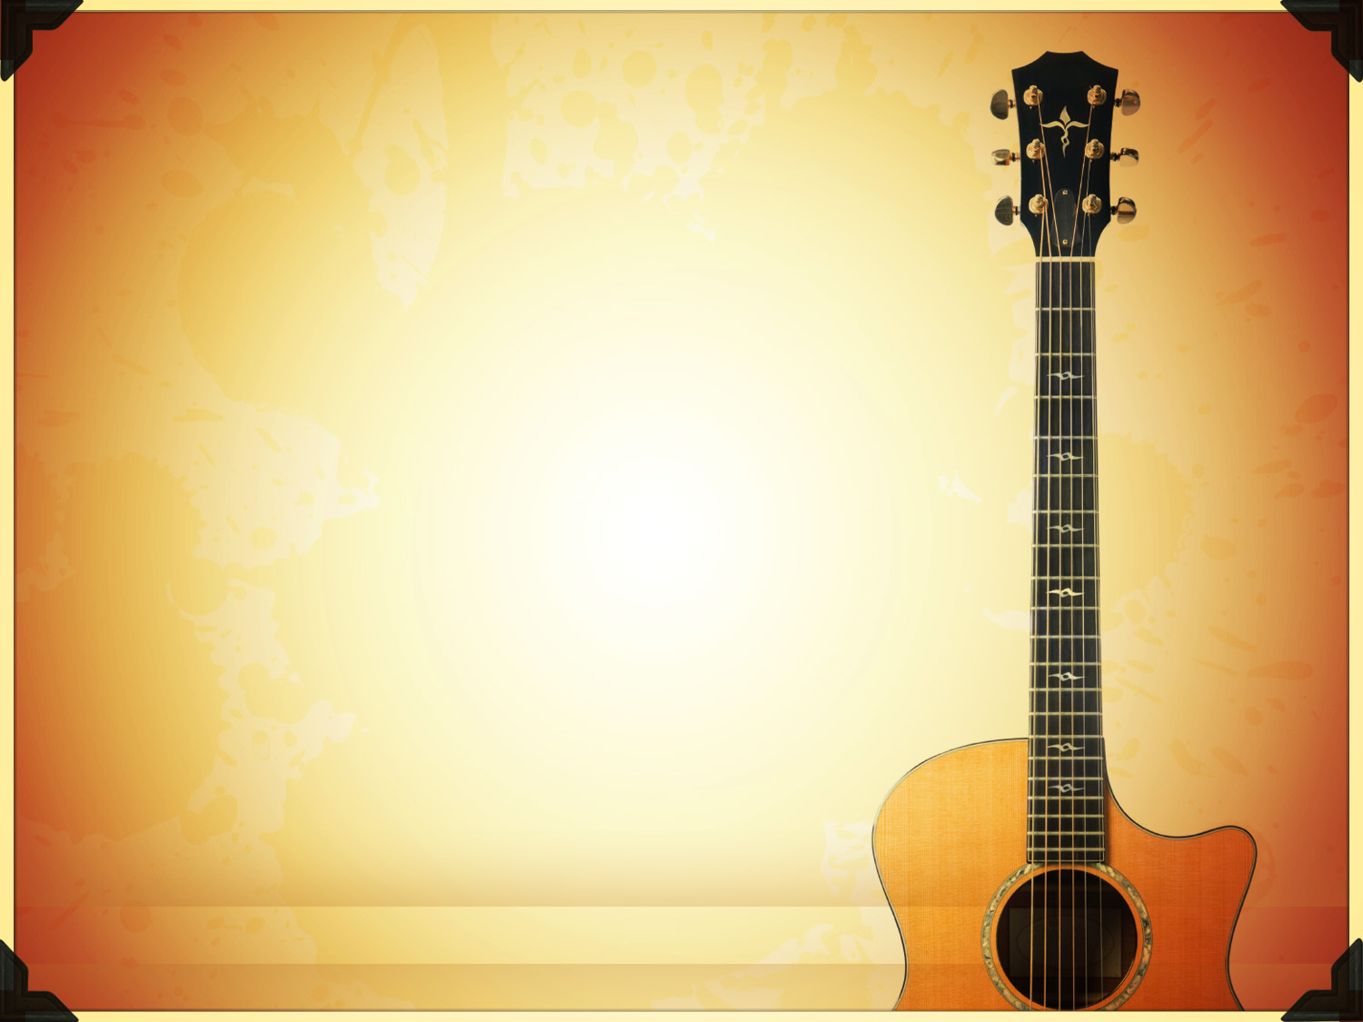
Why We Sing
& Do Not Play

Slide 3
How Does Communication Work?
We TELL someone what we want.
We SHOW someone what we want and how to do it.
We IMPLY what we expect others to get by what we say or show.

Slide 4
Why We Sing
Because the N. T. TELLS us to do so …
The church at EPHESUS (Eph. 5.18-19)
The church at COLOSSAE (Col. 3.16)
The church at CORINTH (1 Cor. 14.15)
INDIVIDUAL Christians (James 5.13)

Slide 5
Why We Sing
Because the N.T. SHOWS us...
JESUS & His Disciples (Matt. 26.30)
PAUL & SILAS (Acts 16.25)

Slide 6
Why We Do Not Play
There is no N.T. INSTRUCTION to that effect!
There is no N.T. EXAMPLE of a church using it.
There is no place where the instrument is IMPLIED.

Slide 7
Why We Do Not Play
Mechanical Instruments In Worship Are Sinful…
Not according to TRUTH (John 4.24)
Not of FAITH (2 Cor. 5.7)
Not TAUGHT by Christ (Matt. 28.18-20)
Not a GOOD work (2 Tim. 3.16-17)
Goes BEYOND what is written (1 Cor. 4.6)

Slide 8
Why We Do Not Play
Mechanical Instruments In Worship Are Sinful…
Another or perverted GOSPEL (Gal. 1.6-9)
VAIN Worship (Matt. 15.9)
Not according to the ORACLES of God (1 Pet. 4.11)
ADDING to the word of God (Rev. 22.18-19)

Slide 9
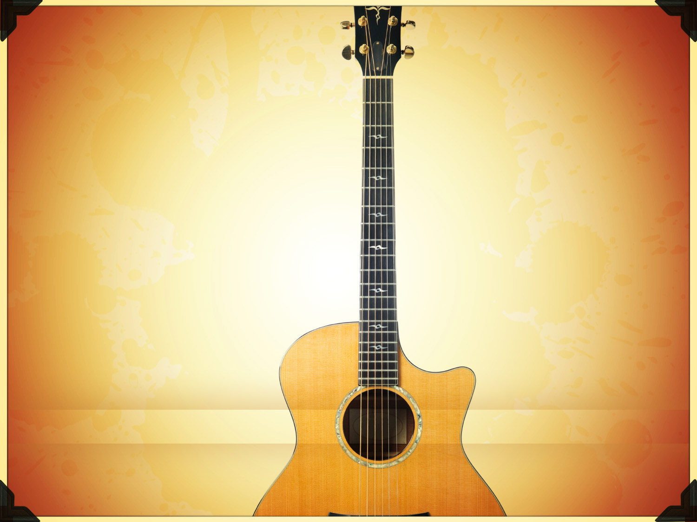
Why We Sing
& Do Not Play
God did not tell us
God did not show us
God did not imply to us
Playing is not AUTHORIZED!

Slide 10
Why We Sing
& Do Not Play
Hear (Rom. 10.17)
Believe (John 3.16)
Repent (Acts 17.30)
Confess Faith (Rom. 10.9-10)
Immersion (Acts 22.16)
Faithfull (Rev. 2.10)

Slide 11
Notes:
Material by Jim Deason

