Slide 2
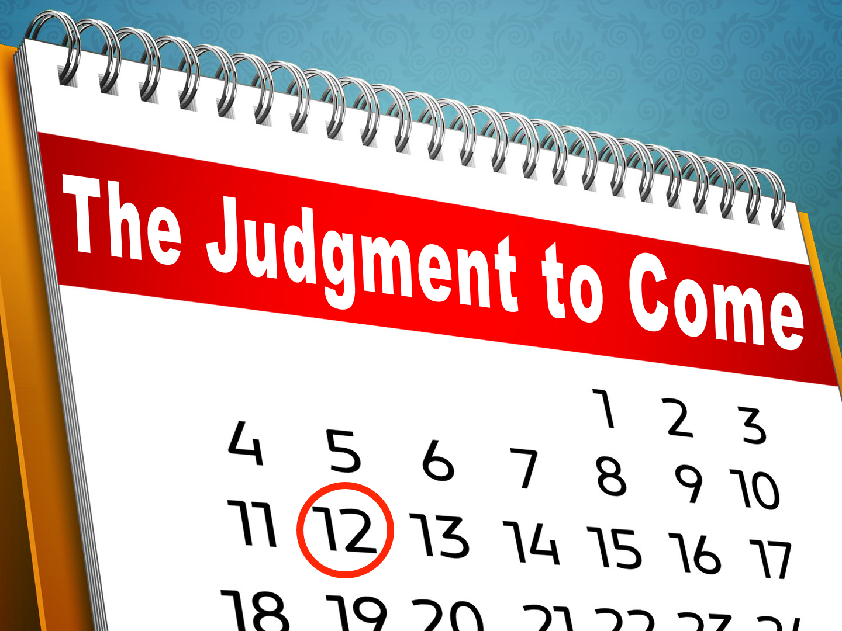

Slide 3

And after some days, when Felix came with his wife Drusilla, who was Jewish, he sent for Paul and heard him concerning the faith in Christ. Now as he reasoned about righteousness, self-control, and the judgment to come, Felix was afraid and answered, “Go away for now; when I have a convenient time I will call for you.”
Acts 24.24-25

Slide 4
The DAY Is Appointed: Acts 17.30-31
It is an UNKNOWN day: 1 Thess. 5.1-11
It is the LAST day: John 5.28-29; John 6.35-40

Slide 5
The JUDGE Is Appointed: Acts 10.42
JESUS is the judge: 2 Tim. 4.1; John 5.22, 27; 2 Cor. 5.10
We better LISTEN to Him while we live!

Slide 6
The STANDARD Is Appointed: John 12.48
We will all give ACCOUNT of ourselves to God: Rom. 14.12; Rev. 20.12, 15

Slide 7
We will be judged by…
  Our HEART: 1 Cor. 4.5; Rom. 2.16
  Our WORDS: Matt. 12.36-37
  Our ACTIONS: Eccl. 12.14

Slide 8
Since God’s word will be the standard:
  We must read and STUDY the standard: 2 Tim. 2.15; Hosea 4.6
  We must OBEY the standard: James 1.22-25; 2.12
  We must TEACH the standard: 2 Cor. 5.11

Slide 9
The EVENTS Are Appointed
The JUSTICE of God will be served & acknowledged: 2 Thess. 1.5-10; Rom. 2.5-11; Jude 14-15
ETERNAL sentence will be pronounced: Matt. 25.31-34, 41, 46

Slide 10
The saints will be CLEARED: Rom. 8.33; cf. Acts 16.35-37
The saints will be CAUGHT up: 1 Thess. 4.16-18; 1 Cor. 15.24-26; cf. Col. 1.13
The saints will be CHANGED: 1 Cor. 15.50-54; 1 John 3.2

Slide 11
The EVENTS Are Appointed
The glory & honor of Christ will be RECOGNIZED: 2 Thess. 1.10; Phil. 2.9-11
The earth will be DESTROYED: Matt. 24.35; 2 Peter 3.10

Slide 12
DEATH Is Appointed
And just as it is appointed for man to die once, and after that comes judgment…
Hebrews 9.27

Slide 13
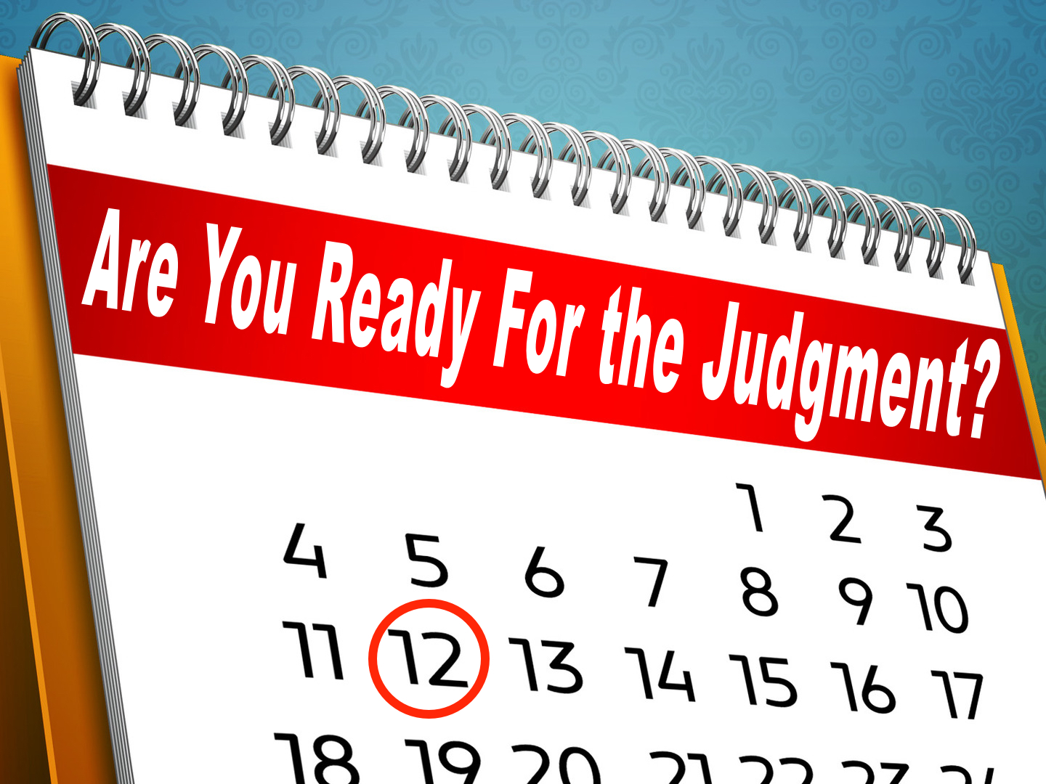

Slide 14
…Now as he reasoned about righteousness, self-control, and the judgment to come, Felix was afraid and answered, “Go away for now; when I have a convenient time I will call for you.”
Acts 24.24-25

Slide 15
Henceforth there is laid up for me the crown of righteousness, which the Lord, the righteous judge, will award to me on that Day, and not only to me but also to all who have loved his appearing.
2 Timothy 4.8

