Slide 2
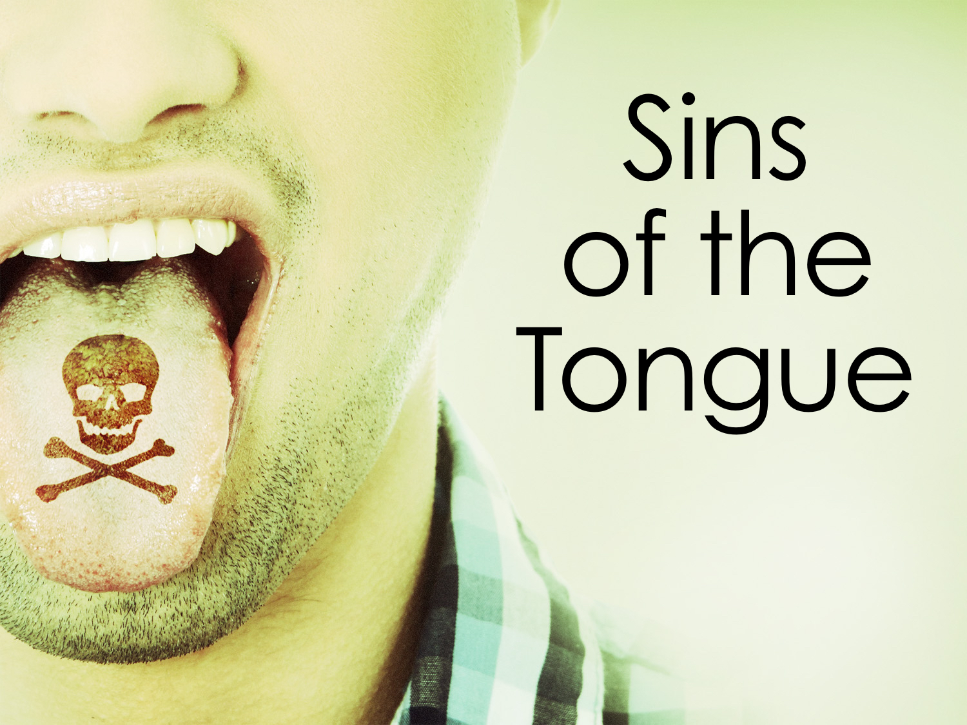

Slide 3
But I say to you that for every idle word men may speak, they will give account of it in the day of judgment. For by your words you will be justified, and by your words you will be condemned.
Matthew 12.36-37

Slide 4
What Are “Idle Words”?
“…literally, "inactive," "useless" (Mt 20:3,6). In Lu 24:11 "idle talk" corresponds to one Greek word which means "empty gossip" or "nonsensical talk." (International Standard Bible Encyclopaedia, . "Dictionaries :: Idle; Idleness." Blue Letter Bible. 5 May, 2003. Web. 4 Mar, 2016. <http://www.blueletterbible.org/search/Dictionary/viewTopic.cfm>.)
“denotes "inactive, idle, unfruitful, barren" … "to reduce to inactivity:" … it is used … metaphorically in the sense of "ineffective, worthless," as of a word, Mat 12:36 …” (Vine, W. "Dictionaries :: Idle." Blue Letter Bible. 24 Jun, 1996. Web. 4 Mar, 2016. <http://www.blueletterbible.org/search/Dictionary/viewTopic.cfm>.)

Slide 5
Idle Words: Gossip
Besides that, they learn to be idlers, going about from house to house, and not only idlers, but also gossips and busybodies, saying what they should not. So I would have younger widows marry, bear children, manage their households, and give the adversary no occasion for slander. For some have already strayed after Satan.
1 Tim. 3.13-15

Slide 6
Idle Words: Lying
“Lying lips are an abomination to the Lord” Prov. 12.22
“…all liars shall have their part in the lake which burns with fire and brimstone, which is the second death” Rev. 21.8

Slide 7
Idle Words: Evil Speaking
Eph. 4.29, 31; 5.3-4; Col. 3.8-9
Corrupt [rotten, i.e. worthless … ["Greek Lexicon :: G4550 (KJV)." Blue Letter Bible. Web. 4 Mar, 2016. <http://www.blueletterbible.org/lang/lexicon/lexicon.cfm?Strongs=G4550&t=KJV>.]
Filthy [shamefulness, i.e. obscenity … ["Greek Lexicon :: G151 (KJV)." Blue Letter Bible. Web. 4 Mar, 2016. <http://www.blueletterbible.org/lang/lexicon/lexicon.cfm?Strongs=G151&t=KJV>.]

Slide 8
Idle Words: Evil Speaking
Coarse (crude) Jesting: Eph. 5.3-4
Coarse: “unrefined in taste, manner, or language” “easily turning; nimble-witted, witty, sharp...” (Thayer)
Turning something impure, hurtful, or vicious; Making sexual jokes, comments, innuendos, or vulgar jokes; wittiness in a vulgar sense

Slide 9
Idle Words: Euphemisms
Euphemisms: “the substitution of a mild, indirect, or vague expression for one thought to be offensive, harsh, or blunt.” (Dictionary.com)
A substitute for profanity or bad words.

Slide 10
Idle Words: Euphemisms
Heck instead of hell
Jeez instead of Jesus
Gosh instead of God
Oh Lord!, Good Lord! instead of Lord
OMG!, Oh my gosh instead of Oh my God

Slide 11
Idle Words: Profanity
Profanity is to take something holy and make it unholy, common, pollute it.
God does not TOLERATE those who profane His name: Exo. 20.7; Lev. 19.12; 24.11-16, 23; 2 Tim. 2.16
We can profane God’s name WITHOUT using His name in vain: Ezek. 36.20-23; Rom. 2.24; 1 Tim. 6.1

Slide 12
Idle Words: Cursing
Cursing is to invoke evil or calamity on someone (“I wish you were dead,” “Curse you,” etc.)
Eccl. 10.20; Mark 7.10; Matt. 26.73-74; Rom. 12.14; James 3.9-10

Slide 13
Idle Words: Swearing
Swearing: “to make a solemn declaration or affirmation … to use profane oaths or language…” (dictionary.com)
“I swear I'm going to get him sooner or later” or “I swear by God I didn’t do it”, etc.
Mark 14.71; James 5.12; Matt. 23.16-22; 5.33-37

Slide 14
God’s Word on the Matter
Our words reveal our CHARACTER:
Matt 12.34-35; 15.17-20; Psalm 59.12
Thus God DISAPPROVES of idle words:
Matt. 12.36-37

Slide 15
God’s Word on the Matter
Our words must promote CLEANLINESS:
Eph. 5.3-4
Thus God DESIRES holiness:
Psalm 19.14; 1 Cor. 11.1; 1 Peter 2.21-23

Slide 16
God’s Word on the Matter
Our words can CONDEMN us:
Matt 12.37
Thus God DEMANDS self-control:
Prov. 4.23; 13.3; 17.27;
Eccl. 5.3; James 1.19, 26

Slide 17
Will We Be Condemned or Justified By Our Words?
I tell you, on the day of judgment people will give account for every careless word they speak, for by your words you will be justified, and by your words you will be condemned.
Matthew 12.36-37

