Slide 2
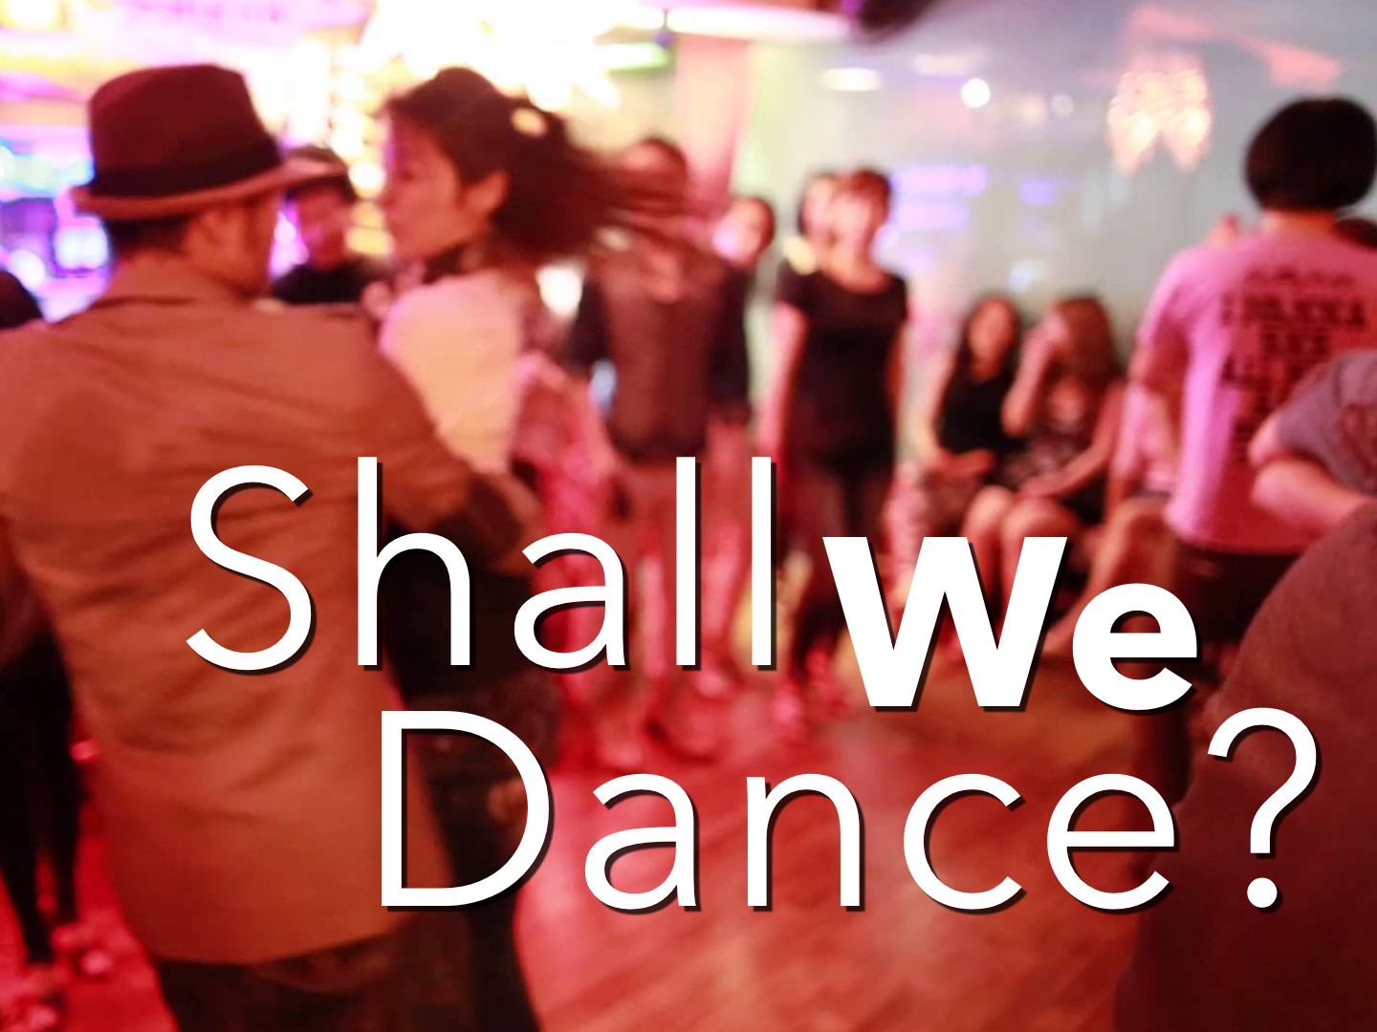

Slide 3
What Do We Mean By Dancing?
People gathering for the purpose of arousing and stimulating lust by moving their bodies in lust-producing movements in public and private as a form of recreation involving people who are not scripturally married to one another.

Slide 4
Dancing That Does Not Fit the Modern Dance
Expression of worship & joy: Psalm 149.1-3; 150.4
Miriam & the women: Exo. 15.20-21
Jephthah's daughter: Judges 11.34
Women of Israel: 1 Sam. 18.6-7
Maidens of Shiloh: Judges 21.19-23
King David: 2 Sam. 6.12-16
Expression of gladness: Psalm 30.11; Eccl. 3.4; Lam. 5.15; Jer. 31.4, 13
The prodigal son: Luke 15.25

Slide 5
Summary
These are dances that express praise to God and celebration for God’s favor or express joy and celebration in general.
There is no element of sensuality mentioned.
There is no intention to entertain, exercise or create lust.
There is no mention of gender-mixed dancing.

Slide 6
Dancing That Does Fit the Modern Dance
Dancing around the golden calf: Exo. 32.6, 19, 25
Now these things took place as examples for us, that we might not desire evil as they did. Do not be idolaters as some of them were; as it is written, “The people sat down to eat and drink and rose up to play.” 1 Cor. 10.6-7
Daughter of Herodias: Matt. 14.3-11

Slide 7
Summary
These dances were sensual and lewd.
These dances weren’t for worship to God, joy or celebration.
Gender-mixed dancing is mentioned and condemned.

Slide 8
What’s Wrong With Dancing?
But solid food is for the mature, for those who have their powers of discernment trained by constant practice to distinguish good from evil.
Hebrews 5.14

Slide 9
What’s Wrong With Dancing?
"Sexual intention movements and mimicked copulatory actions also appear on the dance floor, helping to suggest the patterns of behavior yet to come.”
[Desmond Morris, Manwatching: A Field Guide to Human Behavior, p. 246]
It is, at the very least, questionable.
It breaks down barriers of modesty.
It encourages an unwholesome behavior.
It is lascivious or lewd in nature.

Slide 10
What’s Wrong With Dancing?
Now the works of the flesh are manifest, which are these; Adultery, fornication, uncleanness, lasciviousness, Idolatry, witchcraft, hatred, variance, emulations, wrath, strife, seditions, heresies, Envyings, murders, drunkenness, revellings, and such like: of the which I tell you before, as I have also told you in time past, that they which do such things shall not inherit the kingdom of God. Gal. 5.19-21
“…unbridled lust, excess, licentiousness, lasciviousness, wantonness [sexually lawless or unrestrained (dictionary.com)], outrageousness, shamelessness, insolence … of carnality, lasciviousness: 2 Co. 12:21; Gal. 5:19; Eph. 4:19; 2 Pet. 2:7; plur. “wanton (acts or) manners, as filthy words, indecent bodily movements, unchaste handling of males and females, etc.”…”
(Thayer, J. H. (1889). A Greek-English lexicon of the New Testament: being Grimm’s Wilke's Clavis Novi Testamenti (pp. 79–80). New York: Harper & Brothers.)
Lascivious means, “inclined to lustfulness; arousing sexual desire; indicating sexual interest or expressive of lust or lewdness”
(Dictionary.com)

Slide 11
What’s Wrong With Dancing?
And lest, when I come again, my God will humble me among you, and that I shall bewail many which have sinned already, and have not repented of the uncleanness and fornication and lasciviousness which they have committed. 2 Cor. 12.21

Slide 12
What’s Wrong With Dancing?
The night is far spent, the day is at hand. Therefore let us cast off the works of darkness, and let us put on the armor of light. Let us walk properly, as in the day, not in revelry and drunkenness, not in lewdness and lust, not in strife and envy. But put on the Lord Jesus Christ, and make no provision for the flesh, to fulfill its lusts. Rom. 13.12-14

Slide 13
What’s Wrong With Dancing?
Do not love the world or the things in the world. If anyone loves the world, the love of the Father is not in him. For all that is in the world—the lust of the flesh, the lust of the eyes, and the pride of life—is not of the Father but is of the world. And the world is passing away, and the lust of it; but he who does the will of God abides forever. 1 John 2.15-17

Slide 14
What’s Wrong With Dancing?
…no longer should live the rest of his time in the flesh for the lusts of men, but for the will of God. For we have spent enough of our past lifetime in doing the will of the Gentiles—when we walked in lewdness, lusts, drunkenness, revelries, drinking parties, and abominable idolatries. In regard to these, they think it strange that you do not run with them in the same flood of dissipation, speaking evil of you. 1 Peter 4.1-4

Slide 15
What’s Wrong With Dancing?
It is a work of the flesh!

Slide 16
Attempts to Justify Dancing
"The dance will be chaperoned.”
  Why must a dance be chaperoned in the first place?
  Can you chaperone their emotions and feelings?

Slide 17
Attempts to Justify Dancing
“I don’t want to be left out!” Or, “I want to fit in.” Or, ”All my child’s friends are going.”
  What if all your friends were smoking? Drinking? Drugs? Premarital sex?
  We must take moral stands & say "no”! Rom. 12.2; 1 Peter 4.4; 2 Tim. 3.12; 2 Cor. 12.10; 1 Cor. 15.33
  Our goal is to glorify God in all things: 1 Cor. 10.31; Gal. 1.10

Slide 18
Attempts to Justify Dancing
"I don't lust when I dance. I can control myself and not have lustful thoughts.”
  Can you control the lustful thoughts of others?
  What about your son? Daughter?
  What about your partner?
  What about those watching you?

Slide 19
Attempts to Justify Dancing
"I don't lust when I dance. I can control myself and not have lustful thoughts.”
  Self-control also means avoiding situations where you will be tempted: Rom. 13.14; Eph. 4.27; 1 Cor. 10.12; 2 Tim. 2.22
  Christians should seek to avoid causing anyone to stumble: Matt. 18.6-7

Slide 20
Attempts to Justify Dancing
“But, my child wants to go to the prom … homecoming dance … etc.”
  Be a parent and say, “no”!
  Stop trying to please the children and please God!
  That’s what parents are here for: Eph. 6.4

Slide 21
Attempts to Justify Dancing
“But, my child wants to go to the prom … homecoming dance … etc.”
  Talk with your children about Bible principles.
  Tell them they don’t need to be in those situations.
  Find alternatives to sinful activities: bowling, etc.

Slide 22
Attempts to Justify Dancing
Parent: “I frequented those places/engaged in those activities in my youth and I turned out OK.”
  Confess your sins to God.
  What about your son? Daughter? Dancing partner?
  Don’t let your child make the same mistakes and face the same obstacles you did!

Slide 23
Attempts to Justify Dancing
“How about if I just sit and watch?” “How about getting my picture taken?”
  How close do we want to get to the “line” without falling? 1 Thess. 5.21-22; Prov. 4.14-15
  Remember your influence: Matt. 5.13-16
  What if your children are asked to participate?
  Attendance screams acceptance! Rom. 1.32

Slide 24
Attempts to Justify Dancing
”I’m only a senior once!”
  Is one night of sin worth losing an eternity in heaven?

Slide 25
Attempts to Justify Dancing
Woe to those who call evil good and good evil, who put darkness for light and light for darkness, who put bitter for sweet and sweet for bitter!
Isaiah 5.20

Slide 26
What’s Wrong With Dancing?
Take away the music.
Take away the strobe and laser lights.
Take away the dance floor.
Take away all the people except two.
A vertical expression of a horizontal desire!

Slide 27
What’s Wrong With Dancing?
“What’s right with it?”

