Slide 2
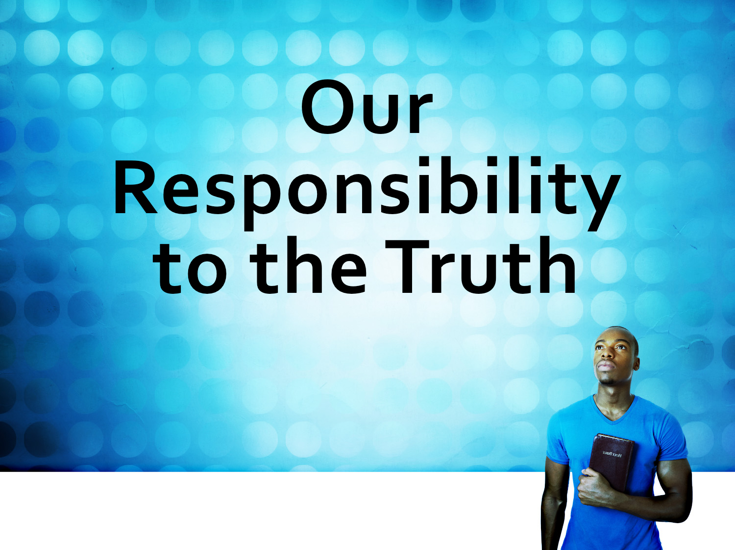

Slide 3
RIGHTLY Divide the Word of Truth
God’s WORD is truth:
John 17.17; Eph. 1.13; 2 Tim. 2.15
“handling aright the word of truth.” (ASV)
“handling the word of truth with precision.” (ISV)

Slide 4
RIGHTLY Divide the Word of Truth
Let us handle God’s word HONESTLY and not DECEITFULLY: 2 Tim. 3.7; 2 Cor. 4.2; 2 Peter 3.16

Slide 5
Be ESTABLISHED in the Truth
Therefore I intend always to remind you of these qualities, though you know them and are established in the truth that you have.
2 Peter 1.12-15
One way to be established in the truth is to be REMINDED constantly of the truth.

Slide 6
Be ESTABLISHED in the Truth
“Finally, my brothers, rejoice in the Lord. To write the same things to you is no trouble to me and is safe for you.”
Philippians 3.1
“Remind them of these things…”
2 Timothy 2.14

Slide 7
Be ESTABLISHED in the Truth
This is the IMPORTANCE of Bible study and preaching!

Slide 8
Be ESTABLISHED in the Truth
Once established I have REACHED spiritual maturity!

Slide 9
WALK in truth
…walking in the truth, just as the Father commanded us. 2 John 1.4; 3 John 1.3-4
Walking in the light (or truth) is PRACTICING truth: 1 John 1.5-8

Slide 10
SPEAK Forth the Words of Truth
…“I am not mad, most noble Festus, but speak the words of truth and reason. Acts 26.25
When we possess the truth we must SHARE it: Mark 16.15; Rom 1.16; Acts 4.18-20; Jer. 20.9
Each one of us must speak the truth with his NEIGHBOR: Eph. 4.25

Slide 11
SPEAK Forth the Words of Truth
Why? Because God, “…desires all people to be saved and to come to the knowledge of the truth” 1 Tim. 2.4

Slide 12
Speaking the Truth in LOVE
We must “speak the truth,” but also “in love.” Eph. 4.15
Without love our message is MEANINGLESS: 1 Cor. 13.1-3
We must be MOTIVATED by our love for the souls of men.
Some will not WANT the truth: Rom. 1.18, 25; 2 Thess. 2.10
Have I therefore become your enemy because I tell you the truth? Galatians 4.16

Slide 13
OBEY the Truth
Our obedience is required to PURIFY our souls:
1 Peter 1.22
Everlasting punishment AWAITS those who do not obey
2 Thessalonians 1.8-9

Slide 14
OBEY the Truth
Those who once obeyed the truth can…
SWERVE from the truth: 2 Tim. 2.18
OPPOSE the truth: 2 Tim. 3.8
Turn away from LISTENING to the truth: 2 Tim. 4.4
WANDER from the truth: James 5.19
Practice NOT the truth: 1 John 1.6

Slide 15
OBEY the Truth
You ran well. Who hindered you from obeying the truth?
Galatians 5.7; cf. 3.1

Slide 16
Our Responsibility to the Truth
Jesus said, “If you hold to my teaching, you are really my disciples. Then you will know the truth, and the truth will set you free.”
John 8.31-32

Slide 17
Our Responsibility to the Truth
“Buy truth, and do not sell it…” Prov. 23.23

