Slide 2


Slide 3


Slide 4


Slide 5


Slide 6


Slide 7
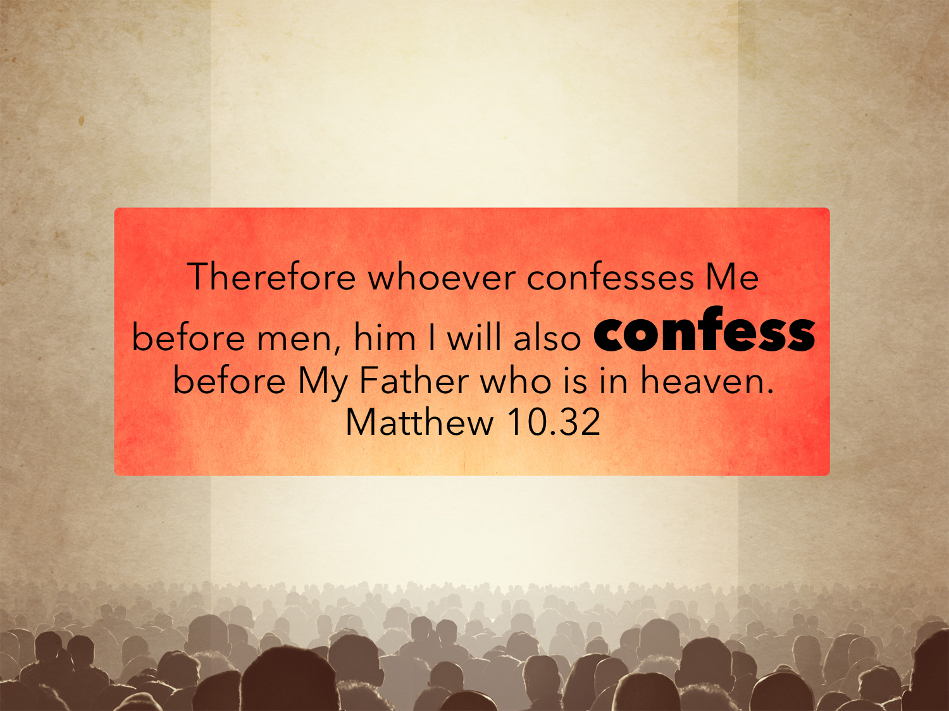

Slide 8


Slide 9


Slide 10
Biblical Faithfulness
Absolute trust, self-surrender, confidence and obedience in regard to Jesus Christ
When one is faithful we can completely rely on them, completely depend on them and completely accept their word.

Slide 11
Why Is Faithfulness in the Plan?
Because GOD and His WORD are faithful

Slide 12
Why Is Faithfulness in the Plan?
God is faithful… 1 Cor. 1.9
…faithful word… Titus 1.9
For when God made a promise to Abraham, since he had no one greater by whom to swear, he swore by himself, saying, “Surely I will bless you and multiply you.” And thus Abraham, having patiently waited, obtained the promise. Heb. 6.13-15

Slide 13
Why Is Faithfulness in the Plan?
And those who know your name put their trust in you, for you, O Lord, have not forsaken those who seek you. Psalm 9.10
And without faith it is impossible to please him, for whoever would draw near to God must believe that he exists and that he rewards those who seek him. Heb. 11.6

Slide 14
Why Is Faithfulness in the Plan?
Because CHRIST was faithful unto death
And being found in human form, he humbled himself by becoming obedient to the point of death, even death on a cross. Phil. 2.8
…if we deny him, he also will deny us; if we are faithless, he remains faithful—for he cannot deny himself. 2 Tim. 2.12-13

Slide 15
Why Is Faithfulness in the Plan?
Faithfulness is a TWO-WAY street: God is faithful to us; therefore we MUST be faithful to Him.
We have HOPE and a REASON to obey because He is faithful.

Slide 16
Faithfulness Includes
Being faithful in ALL things: 1 Tim. 3.11; Luke 16.10; Matt. 23.23

Slide 17
Faithfulness Includes
FAITH: Hebrews 11.1, 6, 8; Gal. 3.6-9, 26-29
TRUSTWORTHY: Matt 24.45-47; 25.21, 23
LOYALTY: Gen. 39.8-9; 22-23
ENDURANCE: Matt. 24.13; Acts 11.23; 13.43; 14.22; Rev 3.5; 14.12
OBEDIENCE: LIP service is not faithfulness. Obedience PROVES our faithfulness: James 2.18, 20, Acts 16.15; 1 John 3.18; 1 Thess. 5.17; Heb. 10.25

Slide 18
Faithfulness Includes
Having a COMPLETED faith:
A WORKING faith: James 2.22; Gal. 5.6; 1 Cor. 15.58; 2 Peter 1.5-10
A WALKING faith: 2 Cor. 5.7; Gal. 5.16, 22, 25; Gen. 5.22; Heb. 11.5
A WINNING faith: 1 Cor. 9.25; 2 Tim. 4.7-8; James 1.12; Rev. 2.10; 3.11

Slide 19
Faithfulness Includes
BLESSINGS for the faithful: 1 Peter 3
The ABILITY to lead others to Christ: vv1-2
The APPROVAL of God: v12
An ANSWER to unjust criticism: vv15-17; 1 Peter 2.12; Phil. 2.15; Dan. 6.4; 1 Tim. 3.7

Slide 20
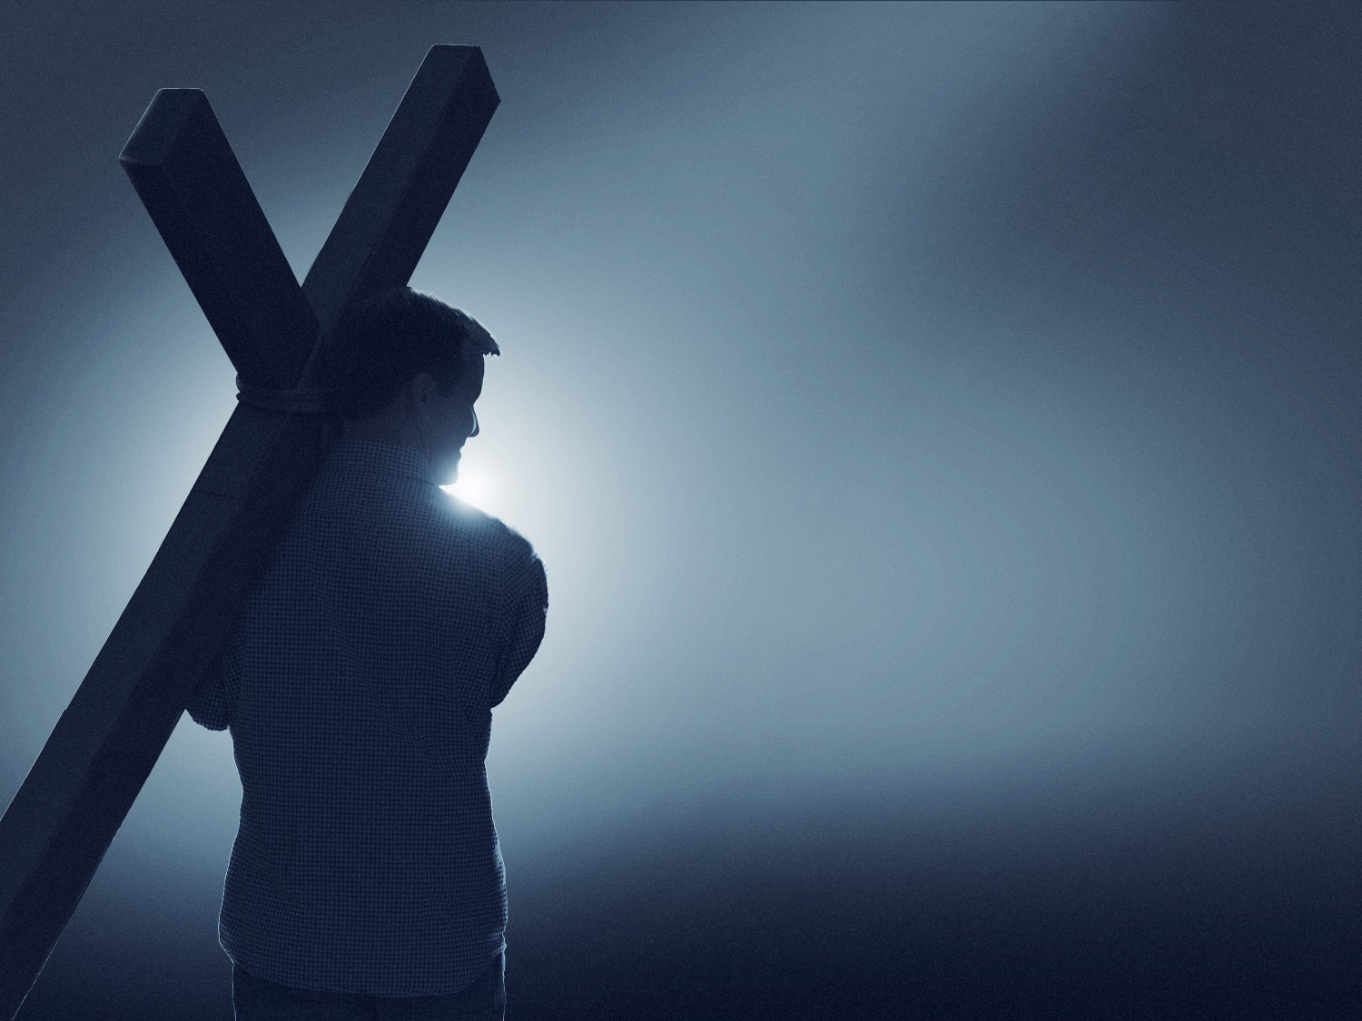
God will remain faithful to you; will you remain faithful to Him?

