Slide 2
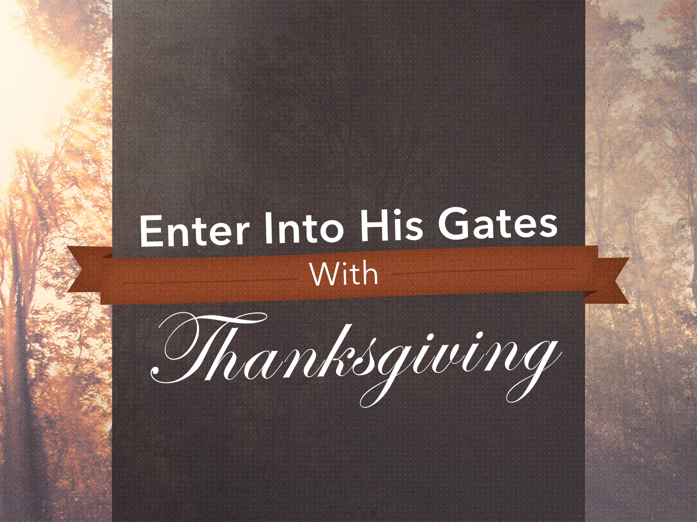

Slide 3
do not be anxious about anything, but in everything by prayer and supplication with thanksgiving let your requests be made known to God.
Philippians 4.6

Slide 4
Continue steadfastly in prayer, being watchful in it with thanksgiving.
Colossians 4.2

Slide 5
giving thanks always and for everything to God the Father in the name of our Lord Jesus Christ
Ephesians 5.20

Slide 6
Give Thanks ALWAYS
Psalm 34.1: “I will bless the Lord at all times; his praise shall CONTINUALLY be in my mouth.”
Thanksgiving ought to come BEFORE (2 Chron. 20.20-21) and AFTER (Luke 17.11-19) God’s blessings.

Slide 7
Give Thanks ALWAYS
See what kind of love the Father has given to us, that we should be called CHILDREN of God; and so we are…
1 John 3.1

Slide 8
Give Thanks for EVERYTHING
Things PHYSICAL
Things SPIRITUAL
Things GOOD & BAD
1 Thess. 5.16-18; cf. Acts 16.25; Job 1.21
All things work together for GOOD: Rom. 8:28, 35-39; cf. Col. 4.18; Phil. 1.12-14

Slide 9
Give Thanks for EVERYTHING
We should ENLARGE upon our blessings rather than EXAGGERATE our troubles!

Slide 10
Give Thanks to God the FATHER
He is the giver of all good GIFTS: James 1.17
He is the SOURCE of all blessings: Acts 17.24-25
While our thanks is to the heavenly Father, Jesus DESERVES our thanks for His willingness to die for us: Heb. 7.26-27

Slide 11
Give Thanks in the NAME of Our Lord Jesus Christ
And whatever you do, in word or deed, do everything in the name of the Lord Jesus, giving thanks to God the Father through him.
Colossians 3.17

Slide 12
Why does Paul command this?

Slide 13
Ingratitude Toward God is the Height of UNGODLINESS
Surely the righteous shall give thanks to your name; the upright shall dwell in your presence.
Psalm 140.13 cf. Rom. 1.20-21

Slide 14
The Christian’s Life Ought to OVERFLOW With Thanksgiving
…rooted and built up in him, strengthened in the faith as you were taught, and overflowing with thankfulness.
Colossians 2.7 cf. 3.15

Slide 15
A thankful life is a PRAYERFUL life.
Through him then let us continually offer up a sacrifice of praise to God, that is, the fruit of lips that acknowledge his name.
Hebrews 13.15
A life VOID of prayer is an unthankful life.

Slide 16

For the sinner:
Believe: Acts 16.31
Repent: Acts 2.38
Confess faith: 1 Tim. 6.12
Be immersed: Acts 22.16
For the saint:
Remain faithful: Rev. 2.10
Repent: Col. 3.5
Confess faults: 1 John 1.9

