Slide 3
The Problem With the Pope
It is a product of apostasy.
It is an unbiblical office: Its qualifications. Its lineage. Its titles.
Pope, Vicar of Christ, Holy Father, supreme pontiff of the Universal Church, Prince of the apostles, etc. cf. Matt. 23.9
Biblical offices: Eph. 4.11; Phil. 1.1, 1 Tim. 3

Slide 4
The Problem With the Pope
Its supposed supremacy:
“Papal supremacy is the doctrine of the Roman Catholic Church that the pope, by reason of his office as Vicar of Christ and as pastor of the entire Christian Church, has full, supreme, and universal power over the whole Church, a power which he can always exercise unhindered: that, in brief, ‘the Pope enjoys, by divine institution, supreme, full, immediate, and universal power in the care of souls.’” (Wikipedia.com)

Slide 5
The Problem With the Pope
“Papal infallibility is a dogma of the Catholic Church that states that, in virtue of the promise of Jesus to Peter, the Pope is preserved from the possibility of error ‘When, in the exercise of his office as shepherd and teacher of all Christians, in virtue of his supreme apostolic authority, he defines a doctrine concerning faith or morals to be held by the whole Church.’ This doctrine was defined dogmatically in the First Vatican Council of 1869–1870, but had been defended before that, existing already in medieval theology and being the majority opinion at the time of the Counter-Reformation [ca. AD 1545-1648].” (Wikipedia.com)

Slide 6
The Problem With the Pope
Its supposed supremacy: Matt. 28.18; Eph. 1.22-23; 5.22-24

Slide 7
The Problem With the Pope
"Jesus our Lord, founded but one Church, which He was pleased to build on Peter. Therefore, any church that does not recognize Peter as its foundation stone is not the Church of Christ, and therefore cannot stand, for it is not the work of God.”
(James Cardinal Gibbons, The Faith of Our Fathers, p. 82 quoted from Bible.ca)
For no one can lay a foundation other than that which is laid, which is Jesus Christ. 1 Cor. 3.11

Slide 8
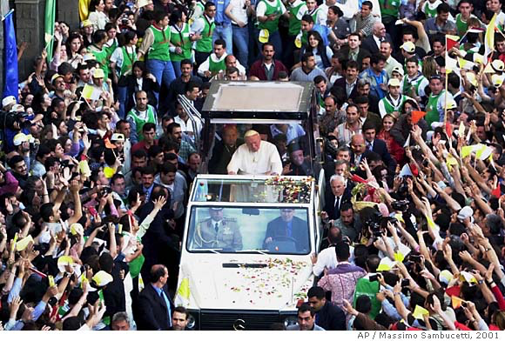
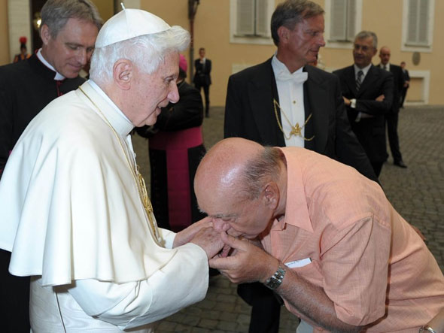
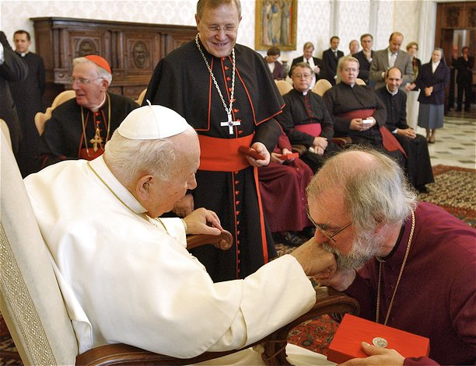
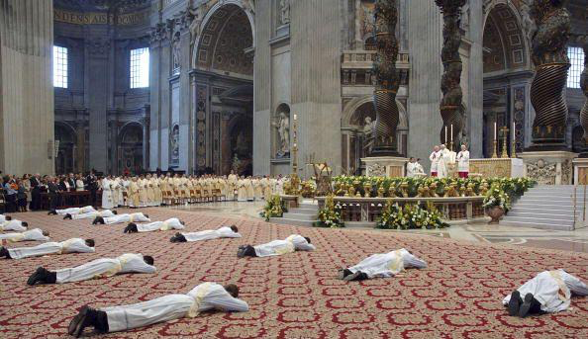
The Problem With the Pope
Its accepted worship:
Notes:
Images from: http://ivarfjeld.com/2012/05/28/catholics-and-anglicans-worship-their-pope-in-the-same-manner/
https://supathought.files.wordpress.com/2013/03/mn_pope_2001_02.jpg
http://static3.businessinsider.com/image/4e3b005f69beddd71a000019/dick-vitale-pope-benedict-ring-kissing.jpg

Slide 9
The Problem With the Pope
Its accepted worship: Matt. 4.10; 2 Thess. 2.3-4

Slide 10
The Problem With Peter Being the First Pope
He did not fit the mold of a modern pope.
He was married: Matt. 8.14: 1 Cor. 9.5; 1 Tim. 3.2; 1 Tim. 4.1-3

Slide 11
The Problem With Peter Being the First Pope
He never claimed supremacy or authority: 1 Peter 5.1; cf. Acts 15.13, 19-20
He was fallible: Gal. 2.14
He opened his letters just as Paul did: 1 Peter 1.1; 2 Peter 1.1; Rom. 1.1; Titus 1.1
He did not accept worship: Acts 10.25-26

Slide 12
Arguments For Peter Being the First Pope
Matt. 16.18 (Mark 8.27-29): Cf. Matt. 18.1-4
Matt. 16.19
John 21.15-17: Cf. 1 Peter 5.1-4; Acts 20.28
“Peter is mentioned first in all the list of the apostles,” etc.

