Slide 2


Slide 3


Slide 4


Slide 5


Slide 6


Slide 7
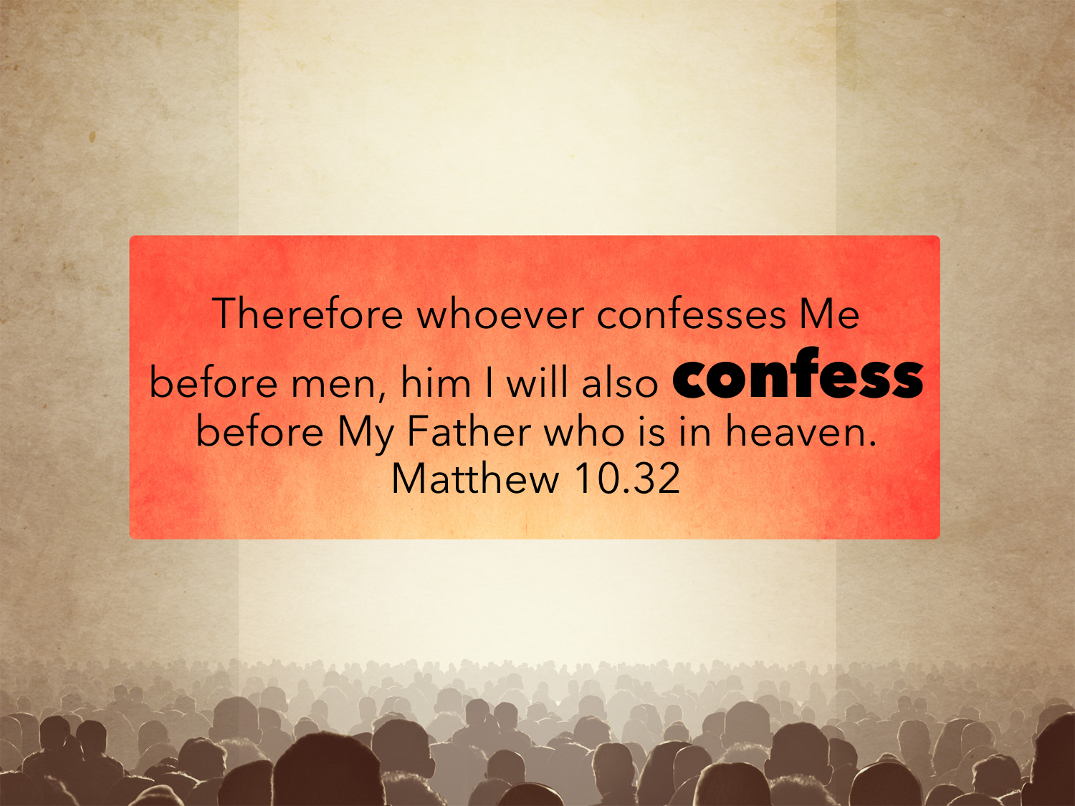

Slide 8

Why Is Confession In the Plan?
God DETERMINED it to be a condition of salvation: Matt. 10.32-33; Rom. 10.9-10; John 12.42

Slide 9
Why Is Confession In the Plan?
Matt. 16.13-18: “You are the Christ, the Son of the living God.”
John 1.49: “…you are the Son of God!...”
John 4.42: “…this is indeed the Savior of the world.”

Slide 10
Why Is Confession In the Plan?
John 11.27: “I believe that you are the Christ, the Son of God”
John 20.28: “My Lord and my God!”
1 Tim. 6.12-13; John 18.36-37

Slide 11
Why Is Confession In the Plan?
Confession ALONE does not save: John 3.16; Acts 17.30
Confession of faith is not a confession of SINS.

Slide 12
Confession Of Faith
“to express openly one’s allegiance to a proposition or person—‘to profess, to confess, confession.’ … usually involving a public utterance and an expression of confidence or allegiance.” (Louw, J. P., & Nida, E. A. (1996). Greek-English lexicon of the New Testament: based on semantic domains (electronic ed. of the 2nd edition., Vol. 1, pp. 417–419). New York: United Bible Societies.)

Slide 13
Confession Of Faith
Confession that is necessary in conversion involves:
  Belief in one’s HEART that God has raised Jesus from the dead.
  A statement acknowledging the CONVICTION that Jesus is Lord, Son of the living God.
Confession is a PLEDGE of allegiance to Jesus’ authority: Matt. 7.21; Luke 6.46

Slide 14
Why Should We Confess?
To OBTAIN salvation: Rom. 10.9-10
To be BAPTIZED: Acts 8.36-38 NKJV
“Now as they went down the road, they came to some water. And the eunuch said, “See, here is water. What hinders me from being baptized?” Then Philip said, “If you believe with all your heart, you may.” And he answered and said, “I believe that Jesus Christ is the Son of God.” So he commanded the chariot to stand still. And both Philip and the eunuch went down into the water, and he baptized him.”

Slide 15
Why Should We Confess?
To Have FELLOWSHIP with God: 1 John 4.15
  Do we “HOLD FAST” our confession? Heb. 3.1; 4.14; 10.23
  Confession is a TEST of discipleship: John 12.42-43; 9.22

Slide 16
When Will You Confess?
“…so that at the name of Jesus every knee should bow, in heaven and on earth and under the earth, and every tongue confess that Jesus Christ is Lord, to the glory of God the Father.”
Phil 2.10-11

Slide 17
When Will You Confess?
“for it is written, ‘As I live, says the Lord, every knee shall bow to me, and every tongue shall confess to God.’” Rom. 14.11
EVERY tongue will confess Jesus.
The question is WHEN?

Slide 18
When Will You Confess?
“A willing confession now, with other things being equal, produces a blessing in this world and being confessed ultimately by Jesus before God and holy angels in judgment. A compelled confession at judgment will only add up to eternal condemnation”
[Studies In Romans, Robert Taylor, Jr., 249, quoted by Ryan Goodwin]

