Slide 3
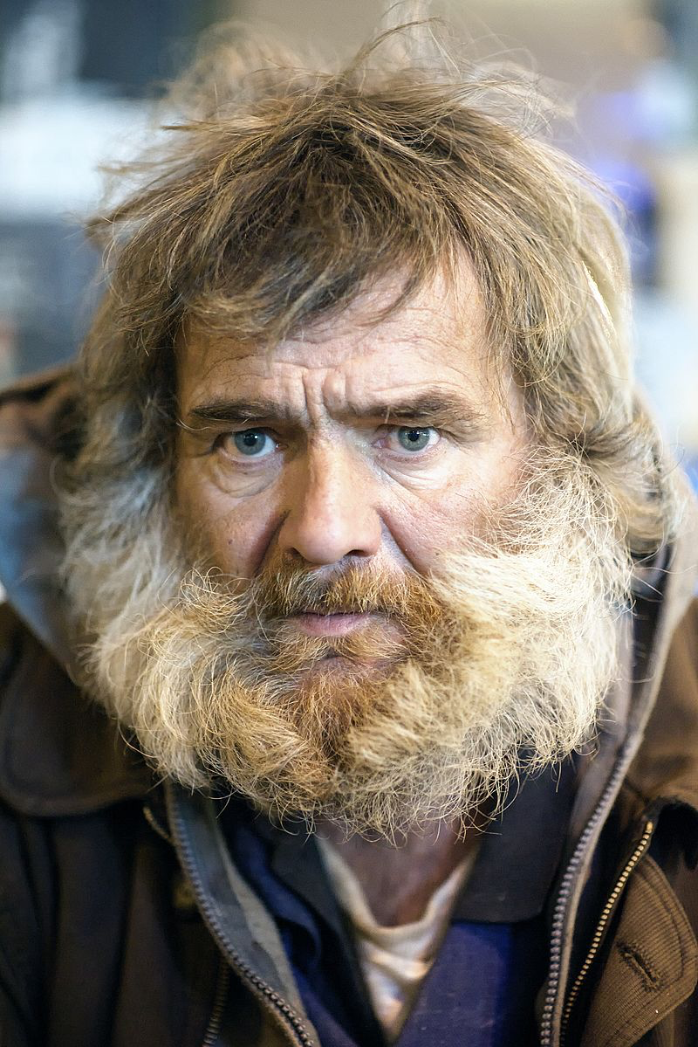
Would we have a problem with this man in the assembly?

Slide 4
James 2.1-13
It is inconsistent with faith in Christ: vs1; cf. Luke 19.10; 20.21; Matt. 9.10-13; Rom. 2.11; Acts 10.34-35
Two things that do not go together: faith in Christ & partiality! Eph. 5.1; 1 Cor. 11.1

Slide 5
Social Barriers Broken Down in Christ
There is neither Jew nor Greek, there is neither slave nor free, there is no male and female, for you are all one in Christ Jesus. Gal. 3.28
Do we refuse friendship with someone because of the color of their skin, level of education and income, health, age, sex, popularity, etc.?

Slide 6
James 2.1-13
It is inconsistent with righteous judgment: vs4; cf. Deut. 1.16-17; 10.17; 16.19
How we treat someone is based off what we think of that person.

Slide 7
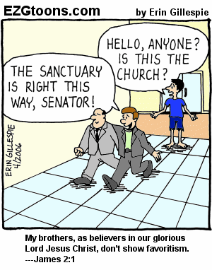
James 2.1-13
It is inconsistent with honoring all men: vs6; cf. 1 Peter 2.17; Rom. 15.5-7; Luke 4.18; 7.22
Honoring the rich is a form of selfishness: Jude 16

Slide 8
James 2.1-13
It is inconsistent with the law of love: vvs8-11
Do we show favoritism toward our brethren? What about toward outsiders?

Slide 9
James 2.1-13
It is inconsistent with the law of liberty: vvs12-13; James 1.25; John 8.32; 1 Peter 1.17
Let us show mercy to others or else we will receive judgment without mercy!

Slide 10
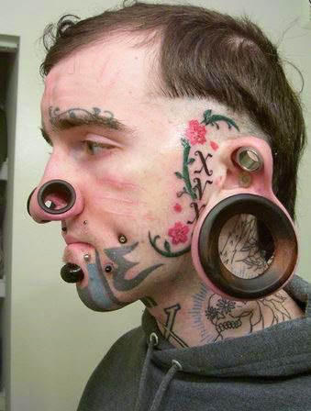
Which man needs the gospel?
Who are we to stand in the way of another’s salvation? Acts 10.47-48; 11.17

