Slide 2
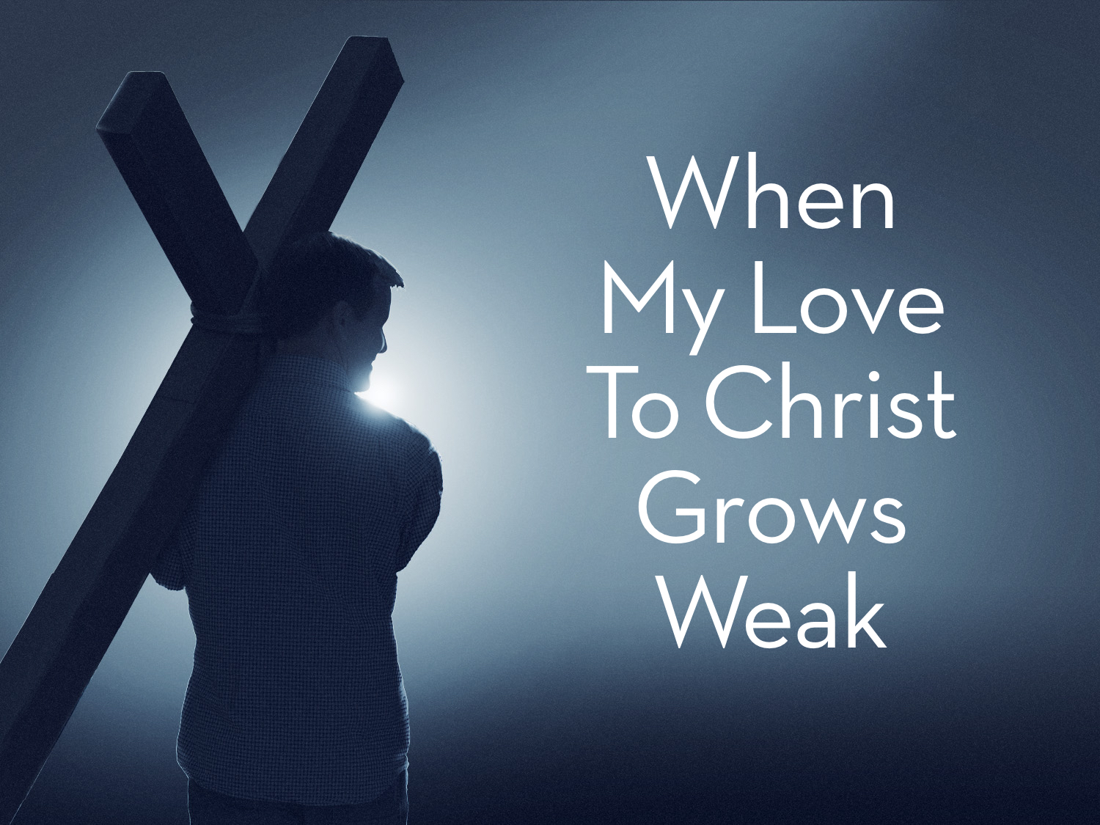

Slide 3
When My Love To Christ Grows Weak
When my love to Christ grows weak / When for deeper faith I seek / Then in thought I go to thee / Garden of Gethsemane.

Slide 4
When My Love To Christ Grows Weak
Often times our love weakens: Matt. 24.12
Sometimes we abandon the love we first embraced: Rev. 2.2-5; Rev. 1.20b; John 14.15

Slide 5
When My Love To Christ Grows Weak
When for deeper faith I seek: Luke 17.5
We must desire to gain deeper faith: Prov. 3.5
Go to the source: Rom. 10.17
We must respond by faith: John 15.1-8; James 2.14-26

Slide 6
When My Love To Christ Grows Weak
Then in thought I go to thee, Garden of Gethsemane: Matt. 26.36-56

Slide 7
There I Walk Amid The Shades
There I walk amid the shades / While the lingering twilight fades / See that suffering, friendless One / Weeping, praying there alone

Slide 8
There I Walk Amid The Shades
Consider the sufferings of Jesus in the garden: Matt. 26.37-38; Luke 22.44
Jesus was suffering all alone: Matt. 26.39-41; Only the Father was caring for Him: Luke 22.43; Heb. 5.7

Slide 9
There I Walk Amid The Shades
Consider the sufferings of Jesus in the garden: Matt. 26.37-38; Luke 22.44
Jesus was suffering all alone: Matt. 26.39-41
Only the Father was caring for Him: Luke 22.43; Heb. 5.7

Slide 10
When My Love For Man Grows Week
When my love for man grows weak / When for stronger faith I seek / Hill of Calvary, I go / To thy scenes of fear and woe

Slide 11
When My Love For Man Grows Week
We must love our fellow man: Matt. 22.37-39; 2 Cor. 5.10-11
Hill of Calvary I go / To Thy scenes of fear and woe: Matt. 27.30; 39-44

Slide 12
There Behold His Agony
There behold His agony, / Suffered on the bitter tree / See His anguish, see His faith / Love triumphant still in death

Slide 13
There Behold His Agony
Christ suffered tremendously on the cross: Luke 23.33; Isaiah 53
See His anguish, faith: Luke 23.46; Phil. 2.8; 1 Peter 2.21-24
Love Triumphant still in death: Rev. 1.5; Eph. 5.2

Slide 14
Then To Life I Turn Again
Then to life I turn again / Learning all the worth of pain / Learning all the might that lies / In a full self sacrifice

Slide 15
Then To Life I Turn Again
We must look to a life of service even in the midst of tribulation: Luke 9.23-26; Acts 14.22
Learning all the might that lies in a full self-sacrifice: Luke 9.57-62; Matt. 6.33

