Slide 2
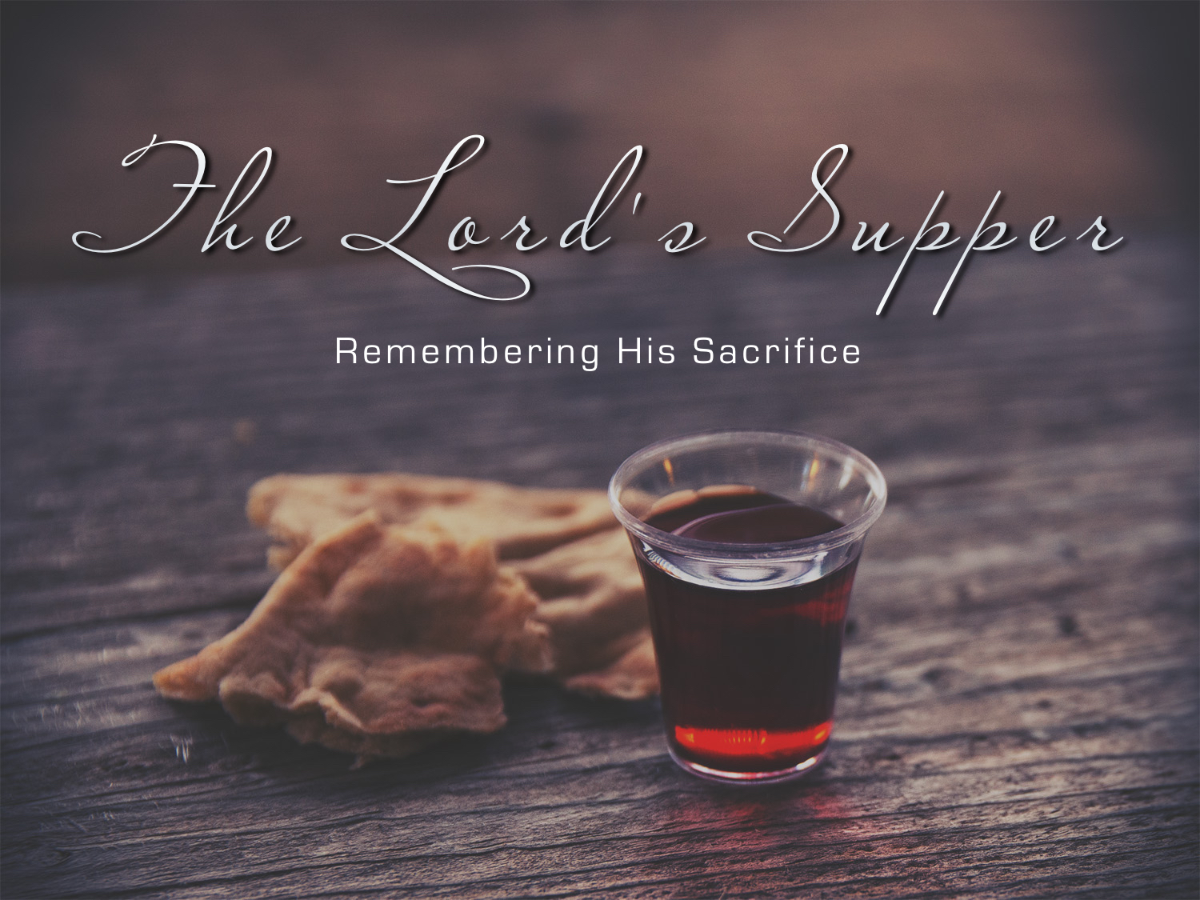

Slide 3
A COVENANT Meal: 1 Cor. 11.23-25
His blood is the seal of the New Covenant in that it ratified the conditions of salvation and the promises of God, as contained in that covenant: Heb. 9.15-22
The covenant meal reminds the saint of the remission of sins he has received - and is receiving - by virtue of that blood.

Slide 4
A MEMORIAL Meal: 1 Cor. 11.23-25
The Jews had a memorial: Exo. 12; note 14, 21-27; 13.3, 9; Deut. 16.1-8
The Passover: Commemorated the death of the lamb & deliverance from Egyptian bondage.

Slide 5
A MEMORIAL Meal: 1 Cor. 11.23-25
The Lord’s Supper: commemorates the death of the Lamb & deliverance from the bondage of sin: John 1.29
Christ instituted the L. S. as a memorial to Himself: Matt. 26.26-29; Mark 14.22-25; Luke 22.19-20

Slide 6
A MEMORIAL Meal: 1 Cor. 11.23-25
The unleavened bread reminds us of His body untainted by sin: Heb. 2.9
The fruit of the vine reminds us of His innocent blood, which was poured out in His death: Matt. 26.28
The first day of the week reminds us of His resurrection.

Slide 7
A MEMORIAL Meal: 1 Cor. 11.23-25
A child of God who neglects or fails to meet with the saints around the Lord’s Table to remember the Savior’s death implicitly treats with contempt the death of Christ, virtually counting “the blood of the covenant by which he was sanctified a common thing.” Heb. 10.28-29

Slide 8
A FELLOWSHIP meal: 1 Cor. 10.16-17
In rejecting the fellowship meal, one has rejected fellowship with the body and blood of Christ and rejected a means of access to the mercy and grace of God. 1 John 1.5-7

Slide 9
A UNITY meal: 1 Cor. 11.18
God called for unity: John 17.20-21; 1 Cor. 1.10
There is unity because of the blood of Jesus: Gal. 3.28; Eph. 2.13-18
In the midst of a divided church (1 Cor. 11.18), Paul wanted them to wait for one another (1 Cor. 11.33) and eat together.

Slide 10
A PROCLAMATION meal: 1 Cor. 11.26

Slide 11
How To PROPERLY Partake Of The Meal
Use proper ELEMENTS: Mat 26.26-29; Mark 14.1, 12; Exo. 12.17-20; Deut. 16.1-4
Lord’s Supper is not a supper that satisfies HUNGER, but one that satisfies a REMEMBRANCE of our Lord’s death!

Slide 12
How To PROPERLY Partake Of The Meal
At the proper TIME: Acts 2.42; 20.7; Heb. 10.24-25; 1 Cor. 16.1-2
The weekly assembly proves the frequency of the Lord’s Supper; they stand or fall together.

Slide 13
How To PROPERLY Partake Of The Meal
In the proper PLACE: Acts 2.42; 20.7; 1 Cor. 11.17, 18, 20, 33, 34
With the proper PARTICIPANTS: Acts 2.42; 20.7
Exhibiting a proper MINDSET and FOCUS:

Slide 14
How To PROPERLY Partake Of The Meal
It’s not the time to be…
  letting our minds wander
  talking to those around us; passing notes
  getting up and going out
  going through our purses, wallets, etc.
  playing with the children, etc.
Participants must observe with reverence (27, 29) and self-examination (28)

Slide 15
How To PROPERLY Partake Of The Meal
Look UPWARD: 1 Cor. 10.16-17; Matt. 26.29
Look BACK: 1 Cor. 11.29; Psalm 22; Isaiah 53
Look FORWARD to when He comes: 1 Cor. 11.26b
Look OUTWARD by proclaiming: 1 Cor. 11.26a
Look INWARD to examine: 1 Cor. 11.28

Slide 16
The Lord’s Supper is not designed for the satisfaction of physical hunger and thirst, or for the physical nourishment of the body, but to meet spiritual needs.

Slide 17
God’s Plan For Your Salvation
Hear His word: Rom. 10.17
Believe in His word: Heb. 11.6
Repent of your sins: Acts 2.38
Confess your faith: Rom. 10.9-10
Be immersed: Mark 16.16

