Slide 3
What Is Not The Issue?
It is not about a place to prepare the LS: wash the trays, cook the bread, store the juice, etc.
It is not about a place for taking care of needy saints: Acts 6
It is not because of our personal preferences.

Slide 4
What Is Not The Issue?
It is not about eating and drinking in the building:
“Why, if these people are right, a mother couldn’t even give her baby a bottle of milk in the building!”
Ex. water for teachers, preacher’s lunch, food for diabetics, we eat the LS, etc.

Slide 5
What Is Not The Issue?
It is not that the building (floor, walls, roof) is sacred.
It is not because we do not like recreation or eating together.
It is not because we cannot afford these facilities.

Slide 6
What Is The Issue?
1. Is the local church authorized to sponsor, arrange or provide for “church kitchens,” “fellowship halls,” and “church meals”?
2. Is the local church authorized to sponsor, arrange or provide social and recreational activities for its members and others?

Slide 7
What Is The Issue?
3. Are social activities a part of the work of a local church that we are commanded to do together as a congregation?
4. Does the New Testament authorize the church to use its treasury for social and recreational purposes?

Slide 8
What Is The Issue?
Authority is the issue!
Did God tell, show or imply that the church may provide and plan for social activities?

Slide 9
What Happened?
Missionary societies (1830’s - 40’s); instrumental music (1850’s); colleges in church budget (1930’s); orphan homes (1950’s); sponsoring church (1950’s); social gospel (1960’s), etc.
If it’s lawful for a church to assemble for a common meal, why did we wait so long to do it?

Slide 10
What Happened?
"It is not the duty of the church to provide entertainment for young or old. It is not a part of the program of the church to provide playgrounds, programs of entertainment, or supervisors of such programs… It is not the mission of the church to furnish amusement for the world or even for its own members. Innocent amusement in proper proportion has its place in the life of all normal persons but it is not the business of the church to furnish it...The church was not established to feature athletics...For the church to turn aside from its divine work to furnish amusement and recreation is to pervert its mission. It is to degrade its mission....Building recreation rooms and providing and supervising recreational activities at the expense of the church is a departure from the simple gospel plan as revealed in the New Testament…"
--GOSPEL ADVOCATE, Teacher's Annual Lesson Commentary on Bible School Lessons, B.C. Goodpasture, 1951, pp. 225-229.

Slide 11
What Happened?
Issues of 1950’s / 60’s made two shifts:
1. Spiritual to social
2. Individual to church

Slide 12
What Happened?
Church supported colleges, schools / day care, dining halls, bus ministry, gymnasiums, ball teams, etc.
Every kind of GIMMICK was thought of to bring in the lost!

Slide 13
What Happened?
This shift diminished the gospel power: 2 Thess. 2.14; Rom. 1.16
This shift changed the mission of the church from spiritual to physical: John 18.36; 1 Cor. 1.18, 21; Rom. 14.17

Slide 14
What Happened?
For the word of the cross is folly to those who are perishing, but to us who are being saved it is the power of God. 1 Cor. 1.18
For since, in the wisdom of God, the world did not know God through wisdom, it pleased God through the folly of what we preach to save those who believe. 1 Cor. 1.21

Slide 15
What Happened?
For the kingdom of God is not a matter of eating and drinking but of righteousness and peace and joy in the Holy Spirit. Rom. 14.17

Slide 16
What Is The Local Church To Do?
We need New Testament authority for local church actions:
And whatever you do, in word or deed, do everything in the name of the Lord Jesus, giving thanks to God the Father through him. Col. 3.17
Everyone who goes on ahead and does not abide in the teaching of Christ, does not have God. Whoever abides in the teaching has both the Father and the Son. 2 John 9

Slide 17
What Is The Local Church To Do?
We need New Testament authority for local church actions:
And whatever you do, in word or deed, do everything in the name of the Lord Jesus, giving thanks to God the Father through him. Col. 3.17
Everyone who goes on ahead and does not abide in the teaching of Christ, does not have God. Whoever abides in the teaching has both the Father and the Son. 2 John 9

Slide 18
What Is The Local Church To Do?
Command | Aid
Build an ark: Gen. 6.14 | Tools
Lord’s Supper: 1 Cor. 11.23-26 | Table, trays
Sing: Eph. 5.19 | Songbooks
Contribute: 1 Cor. 16.1-2 | Basket, Bank account
Baptize: Matt. 28.19 | Baptistery
Social & recreational activities: ??? | Kitchen, dining hall, chairs, tables, gymnasium, etc.

Slide 19
What Is The Local Church To Do?
The work of the church:
Edification: Eph. 4.11-12
Evangelism: Mark 16.15
Limited Benevolence: 1 Cor. 16.1-2
Worship: Acts 2.42; Eph. 5.19

Slide 20
What Is The Local Church To Do?
Churches are to have regular assemblies: Acts 20.7; Heb. 10.24-25; 1 Cor. 11.18
Churches are to discipline erring brethren: 1 Cor. 5.4; Matt. 18.17
Churches are to observe the Lord’s Supper on the first day of the week: Acts 20.7; 1 Cor. 11.23ff

Slide 21
What Is The Local Church To Do?
Churches are to sing songs: 1 Cor. 14.26; Eph. 5.19; Col. 3.16
Churches are to pray together: Acts 2.42; 12.5; Col. 4.2
Churches are to teach God’s word: 1 Cor. 14.26; Eph. 4.11-14; 1 Thess. 1.8; 2 Tim. 4.2

Slide 22
What Is The Local Church To Do?
Churches are to have a collection: 1 Cor. 16.1-2
Churches are to support the preaching of the gospel / elders: Phil. 4.15-16; 1 Tim. 5.17-18
Churches are to provide for destitute saints: Acts 4.34-35; 2 Cor. 8, 9

Slide 23
What Is The Local Church To Do?
Churches are to plan and provide for social activities: ???
Where do social meals / recreational activities fit into these spiritual functions?

Slide 24
Answering The Arguments
“It is a good work!”:
Good works (Eph. 2.10, Titus 2.14, 3.1, 8) are defined by the God: 2 Tim. 3.16-17
Since God specified the areas of work for the local church, this excludes any other works a church might want to do.

Slide 25
Good Work?

Slide 26
Good Work?

Slide 27
Good Work?

Slide 28
Answering The Arguments
“Aren’t Christians to fellowship?”:
Bible fellowship means sharing, communion, participation in, joining together: Ex. Acts 2.42; 1 Cor. 1.9; Phil. 1.5; 3.10; 1 John 1.1-4

Slide 29
Answering The Arguments
Koinōneō (Strong’s G2841): Share (Rom. 15.27; Gal. 6.6; Heb. 2.14; 1 Peter 4.13); Contribute (Rom. 12.13); partnership (Phil. 4.15); Take part in (1 Tim. 5.22); Takes part in (2 John 11)
koinōnia (Strong’s G2842): Fellowship (Acts 2.42; 1 Cor. 1.9; 2 Cor. 6.14; 13.14; Gal. 2.9; Eph. 3.9 (KJV); 1 John 1.3, 6, 7); Contribution (Rom. 15.26; 2 cor. 9.13); Participation (1 Cor. 10.16; Phil. 2.1); Taking Part (2 Cor. 8.4); Partnership (Phil. 1.5); Share (Phil. 3.10; Heb. 13.16); Sharing (Philemon 6)
koinōnikos (Strong's G2843): Share (1 Tim. 6.18)

Slide 30
Answering The Arguments
koinōnos (Strong’s G2844): Taking part (Matt. 23.30); Partners (Luke 5.10); Participants (1 Cor. 10.18, 20); Share (2 Cor. 1.7); Partner (2 Cor. 8.23; Philemon 17); Partners (Heb. 10.33); Partaker (1 Peter 5.1); Partakers (2 Peter 1.4)
Metochē (Strong’s G3352): Partnership (2 Cor. 6.14)
Sygkoinōneō (Strong’s G4790): Take no part (Eph. 5.11); Share (Phil. 4.14; Rev. 18.4); Take part in (Rev. 18.4)

Slide 31
Answering The Arguments
Redefining bible words…
Churches build halls to house social gatherings and call them fellowship halls.
Christians get together to play basketball or softball and call it fellowship.
Christians gather for a meal and someone thanks God for the time of fellowship.

Slide 44
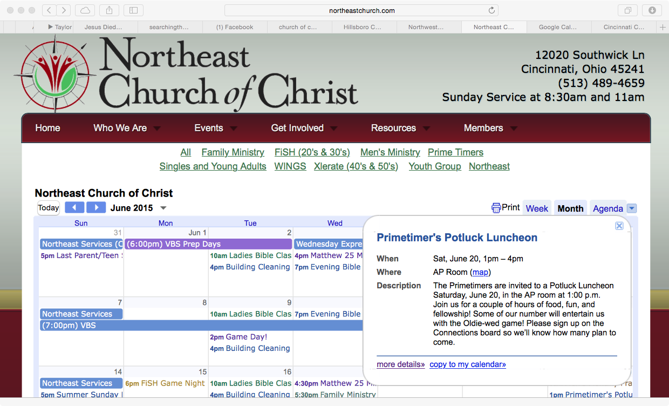

Slide 47
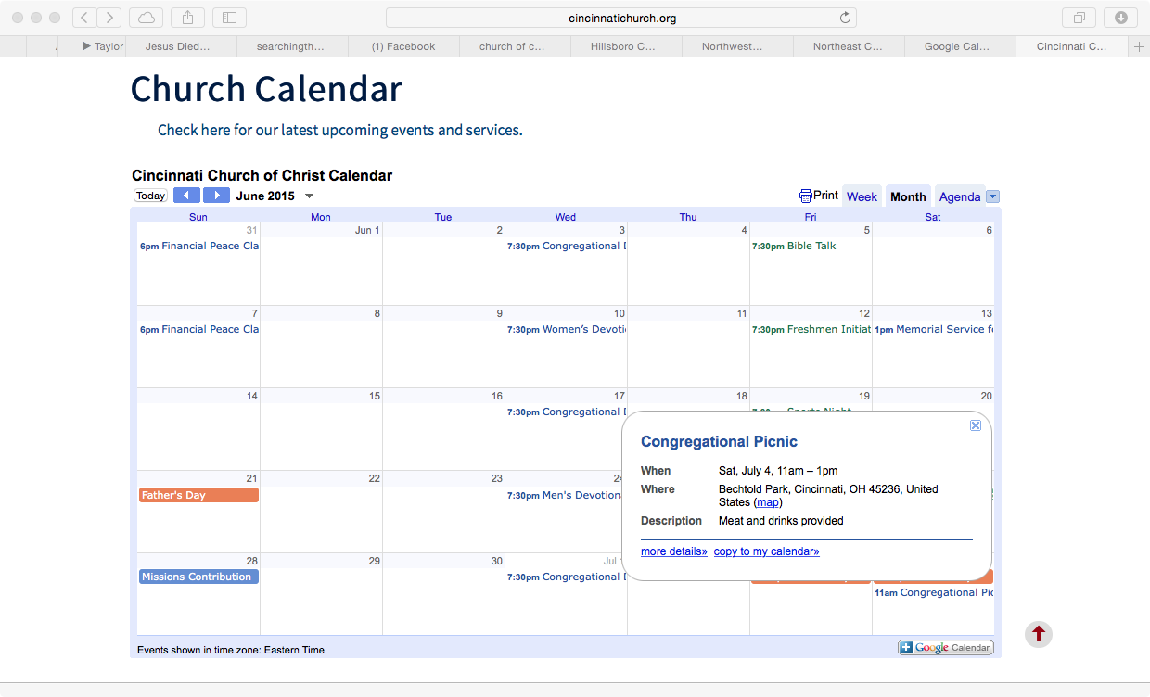

Slide 50
Answering The Arguments
Fellowship is used to show Christians sharing with the Godhead and other Christians in a spiritual nature: 1 Cor. 10.16-17
Not once in the entire Bible does "fellowship" refer to a common meal or recreational entertainment!

Slide 51
Answering The Arguments
“Isn’t the church to edify the saints?”
Spiritual edification: 1 Cor. 14.12, 26; Eph. 4.11-16; Acts 20.32; 2 Tim. 3.16-17
In the name of edification, we find churches building and maintaining schools, colleges, family life centers, dining halls, kitchens, gymnasiums, youth groups, family outings, social services, live bands, pageants, special events, etc.

Slide 52
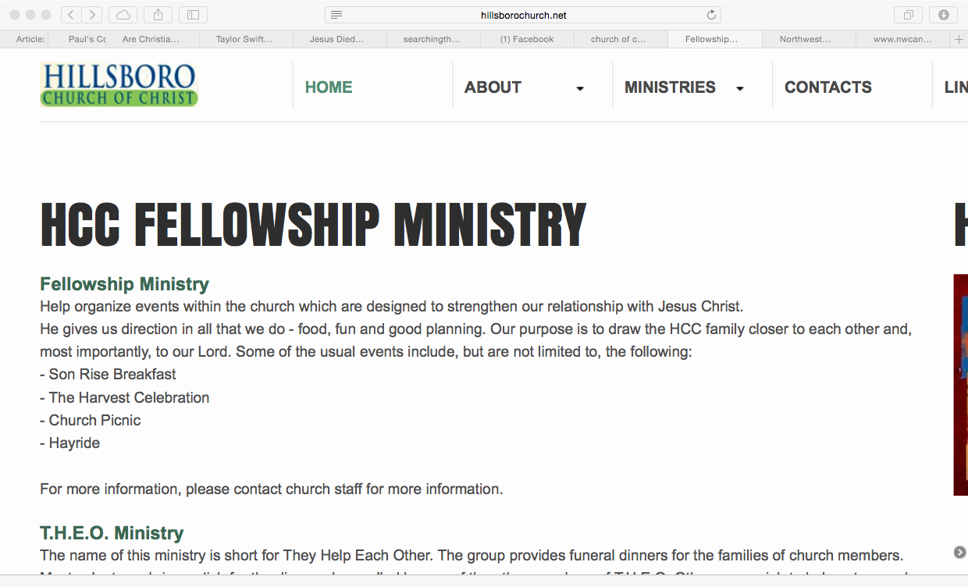

Slide 53
Answering The Arguments
“Didn’t Jesus feed the 5000?”:
Jesus preached and had compassion on the hungry people so he fed them: Matt. 14.14-16, Mark 6.34-36
Jesus was not feeding them to draw them to Himself! John 6.44-45; 12.32; 2 Thess. 2.14
Jesus condemned them when they followed Him for food: John 6.26-27
This has nothing to do with the church: Matt. 16.18; Acts 20.28

Slide 56
Answering The Arguments
“Didn’t Christians in the Bible eat together?”
The early Christians ate from house to house: Acts 2.46
The ONLY example of a common meal being eaten “as the church” was condemned! 1 Cor. 11.17-34
"Have you not fellowship halls and church kitchens to eat and drink in?”
"If anyone is hungry, let him wait until after the services and assemble together at that time to satisfy his hunger.”

Slide 57
Answering The Arguments
“The Bible mentions love feasts (Jude 12; 2 Peter 2.13)”:
There is no conclusive evidence for what these love feasts were.
Of what did the "love feasts" consist?
How often were the "love feasts" observed?
We know they cannot be authorizing a church sponsored meal based on 1 Cor. 11.22, 34

Slide 58
Answering The Arguments
“The building isn’t sacred”:
The building has been purchased for the church to assemble for worship, to evangelize, etc. (cf. Matt. 21.12-13)
The building is to be used for SCRIPTURAL purposes. If it is not to be used for spiritual purposes, then it has no right to exist in the first place!

Slide 60
Answering The Arguments
“The meal is provided by the members not the church. The food, plates, utensils are not provided by the treasury.”
The church built the building with the room for these meals to take place.
The meals have been facilitated by the church and have become a work of the church.
The building is to be used for the purpose of edification, evangelism, worship and benevolence.

Slide 61
Answering The Arguments
There’s a difference between an incidental use and intentional use of the building.
Ex.: We do not come together to use the restroom, but we may need to use the restroom when we come together.

Slide 62
Answering The Arguments
Preacher’s lunch, workday, drinking water, etc. are incidentals. Coming together for social meals and activities (even outside of the treasury) is an intentional use of the building.
Socializing before and after church is incidental. Planning and providing is not.

Slide 63
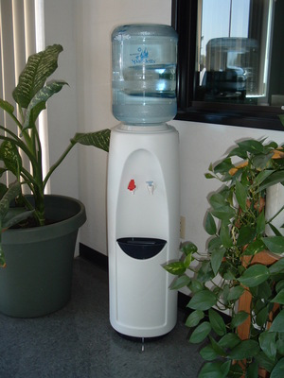
Answering The Arguments
“If we can’t have family life centers, camp grounds, dining halls, kitchens, gymnasiums, etc. owned by the churches, we can’t have a water cooler.”
Willie the water cooler was invited.
Willie is an incidental to assembling.
He wasn’t purchased for entertainment!

Slide 64
Why We Do Not Have Dining Halls
Satan has us to do the right things in the wrong way.
The church is not a social club: Acts 20.28; 1 Peter 2.5
We are not a glorified social center in competition with country clubs, denominations, the YMCA, theme parks, etc.

