Slide 2
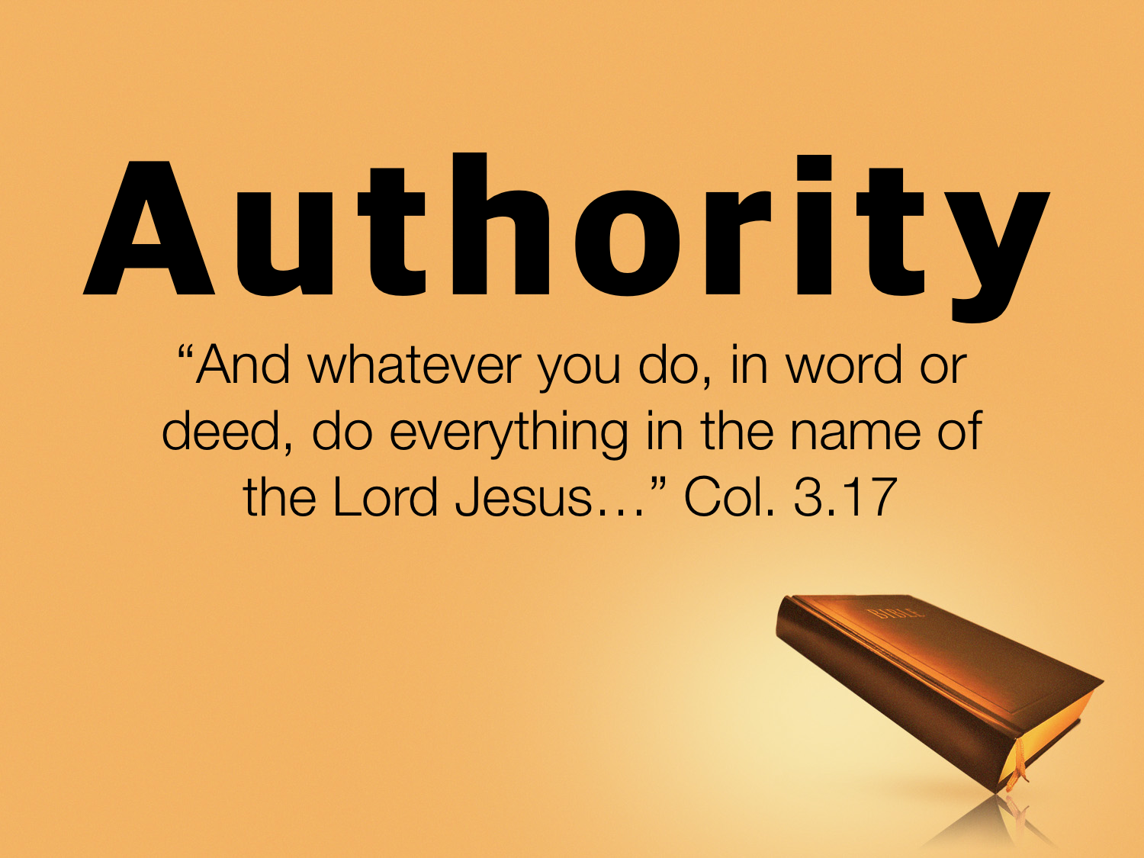

Slide 3
What Do We Mean By Authority?
Authority: "the power of rule or government," the power of one whose will and commands must be obeyed by others
(Vine's Expository Dictionary of New Testament Words)

Slide 4
Consider The Following:
We need God’s authority for all that we do.
We need God’s authority for most of what we do.
We need God’s authority for some of what we do.
We need God’s authority for none of what we do.

Slide 5
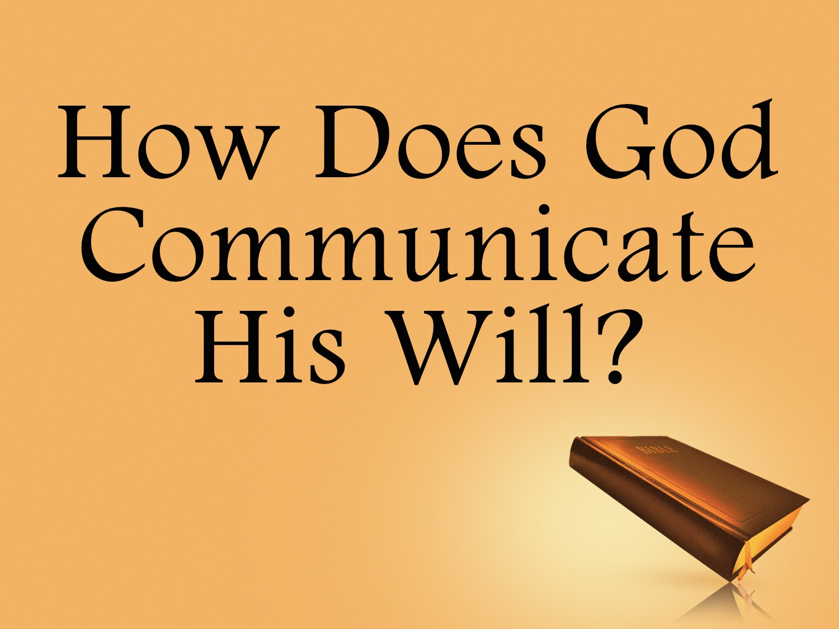

Slide 6
Review
God chose to communicate His will with words
Men were expected to understand and obey the words of God: Exo. 20.1ff, cf. Acts 7.38; Deut. 4.4-5, 10; Jer. 1.9-10

Slide 7
How Communication Works
You tell something to someone you want them to know or do.

Slide 8
How Communication Works
You show something to someone you want them to know or do.

Slide 9
How Communication Works
You imply something to someone you want them to know or do.

Slide 10
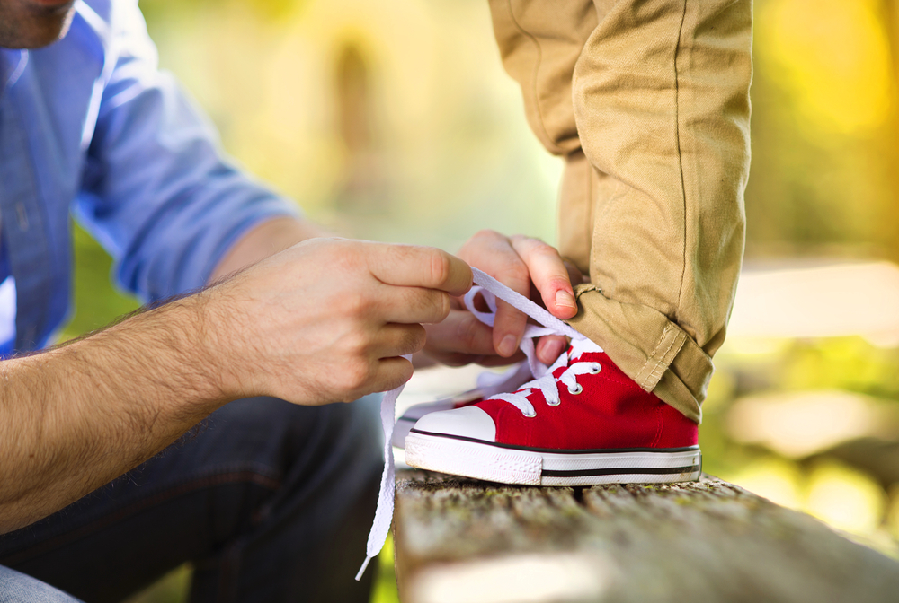
How do we teach kids to tie their shoes?
Notes:
http://blog.novakdjokovicfoundation.org/media/2015/03/father-helping-son-to-tie-his-shoe.jpg

Slide 11
How Communication Works
All human communication: tell, show, imply
It is impossible to communicate anything without one of these methods
Can you communicate to
me another way without TSI?

Slide 12
How Communication Works
God communicates to us the same way we communicate to each other: Deut. 4.5; Jer. 1.9
Because God used words to reveal His will then we must understand that these words will:
  Tell us something
  Show us something
  Imply something

Slide 13
A common objection: “God did not tell us, show us or imply to us…”
  A church building
  A projector
  A songbook, etc.

Slide 14
How Communication Works
Exclusive (specific): Excludes everything except what has been specified. Cannot add to or take from.
Inclusive (generic): not specific; commands and instructions in God’s word that are not specified.

Slide 15
How Communication Works
“Go to the store and buy milk and bread.”
General: any store; milk, bread
“Go to Kroger and buy 2% milk and %100 whole wheat bread.”
Specific: Kroger; 2% milk,
100% whole wheat

Slide 16
How Communication Works
Because God used words to reveal His will then we must understand that these words will:
  Tell us something
  Show us something
  Imply something
He will be either generic or
specific in His communication!

Slide 17
How Communication Works
Case: | Generic | Specific
Noah | Wood | “Gopher” Gen. 6.14ff
Naaman | Water | “Jordan” 2 Kings 5.9
Passover | Animal | “Lamb” Exo. 12.15

Slide 18
How Communication Works
Case: | Generic | Specific
Ark | Carry | Carry by poles and place upon the shoulders of the men of Levi, of the family of Kohath: Exo.25.14-15; Num. 3.30-31; 4.15; 7.9
Praise | Music | “Sing” Eph. 5.19
Preach | “Go” | “Gospel” Mark 16.15

Slide 19
How Communication Works
When was God specific about a church building, projector, etc.?
  Something does not necessarily need to be specified to be authorized.
  General authority includes all that is necessary to the carrying out of a command.

Slide 20
How Communication Works
Command: “Go to the store and buy milk and bread.”
  How is he going to get to the store? Drive, walk, bike?
  How will he carry the groceries? In his arms; bag?
  Which store? Kroger? Walmart?
  What kind of milk and bread? 1%? 2%?; White? Wheat?
  How will he buy the groceries? Cash, check, credit card?
  General = a matter of judgment. Use whatever aid to carry out the command.

Slide 21
How Communication Works
Command: “Drive to the store and use cash to buy milk and bread.”
General and specific authority are both used.
  Specific: How is he going to get to the store? Drive.
  General: How will he carry the groceries? Which store? What kind of milk and bread?
  Specific: How will he buy the groceries? Cash

Slide 22
Specific Command | General Authority | Action
Build Ark: Gopher Wood; measurements; one door, etc. | Tools necessary to build the ark, cart | Ark Built
Was God’s word altered? Added to or taken from?
Baptize: In the name of Jesus for the remission of sins: Acts 2.38 | Baptistery, pool, lake (body of water not specified) | Baptism
Sing: Speak to one another; make melody in heart: Eph. 5.18 | Songs, leader, books, projector, memorize | Singing
Teach: the gospel: Mark 16.15 | Projector, white board, radio program, TV show, bulletin, website, social media, publisher, CD/Tape, etc. | Teaching

Slide 23
Specific Command | General Authority | Action
Build Ark: Gopher Wood; measurements; one door, etc. | Tools necessary to build the ark, cart | Ark Built
Was God’s word altered? Added to or taken from?
Assemble: Heb. 10.25, etc. | Place, buy/rent, under a tree, etc. (place not specified), pews | Assembling
Give; first day of the week: 1 Cor. 16.2 | Collection plate, box, bank account, treasurer | Giving
Lord’s Supper: 1 Cor. 11 | Trays, cups, table, buy or make the bread, etc., refrigerator to house juice/bread | Lord’s Supper

Slide 24
Specific Command | General Authority | Action
Build Ark: Gopher Wood; measurements; one door, etc. | Tools necessary to build the ark, cart | Ark Built
Was God’s word altered? Added to or taken from?
Support Preachers: 1 Cor. 9:4-14, etc. | Provide money, food, a house, transportation, etc. | Supported
Relieve needy saints: 1 Tim. 5, etc. | Pay doctor bills, buy food, provide care, nursing home, etc. | Relieved
Specific commands allow for aids to carry out command.
Specifics include aids, but exclude additions.

Slide 25
Specific Command | Authorizes | Action | Addition
Build Ark: Gen. 6.14-22 | Tools | Ark Built | Oak, Pine, Cedar, Metal
Ark: Exo.25.14-15; Num. 3.30-31; 4.15; 7.9; Deut. 10.8 | poles and placed upon the shoulders of the men of Levi, of the family of Kohath; no one should touch the ark | Carried by poles and placed upon the shoulders of the men of Levi, of the family of Kohath | David used a cart to carry the Ark Uzzah touched the Ark
If it changes the command, it’s an addition!

Slide 26
Command | Authorizes | Action | Addition
Build Ark | Tools | Ark Built | Oak, Pine, Cedar, Metal
Baptize | Baptistery | Baptism | Pour, sprinkle
Sing | Books | Singing | Instruments; clap hands; a choir; solo singing
Teach | Projector | Teaching | False doctrine
Assemble | Place, pews | Assembling | Kitchen, gym
Give | Collection plate | Giving | Yard sale
Lord’s Supper | Trays, cups | Lord’s Supper | Pepsi & pizza
If it changes the command, it’s an addition!

Slide 27
Are Examples Binding?
Example: “one that serves as a pattern to be imitated or not to be imitated; such as a good example;” “a punishment inflicted on someone as a warning to others;” “one that is representative of all of a group or type;” “a parallel or closely similar case especially when serving as a precedent or model;” “an instance (as a problem to be solved) serving to illustrate a rule
or precept or to act as an exercise
in the application of a rule.”
(www.merriam-webster.com)

Slide 28
Are Examples Binding?
God calls us to follow the pattern: John 13.15; 1 Cor. 11.1; Phil. 3.17; Phil. 4.9; 2 Tim. 1.13; Heb. 8.5

Slide 29
Are Examples Binding?
Command/Examples | Lord’s Supper | Assemble | Giving
General command | 1 Cor. 11.25 | Heb. 10.25 | 2 Cor. 9.7
Specific command: Day / frequency |  |  | 1 Cor. 16.2
General Example | Acts 2.42 | Acts 11.26 | Acts 2.42
Specific Example: Day / frequency | Acts 20.7 | Acts 20.7
When God specifies, all else is excluded!

Slide 30
Are Examples Binding?
Case: | Generic | Specific
Noah | Wood | “Gopher” Gen. 6.14ff
Naaman | Water | “Jordan” 2 Kings 5.9
Passover | Animal | “Lamb” Exo. 12.15
When God specifies, all else is excluded!

Slide 31
Are ALL Examples Binding?
If when one thing is specified all else is excluded, then what about partaking of the Lord’s Supper in the “upper room”? Acts 20.8
This is an extreme use of God’s word!

Slide 32
Are ALL Examples Binding?
Which upper room?
The place is generic in Scripture: John 4.21
  A school: Acts 19.19
  The temple in Jerusalem: Acts 2.46; 5.19-20
  In homes: Rom. 16.3-5; 1 Cor. 16.19
  In synagogues: James 2.2

Slide 33
Determining Doctrine
Doctrine
Giving: 1 Cor. 16.1-2; 2 Cor. 9.7
Authorized
Sunday 7 AM Weekly 4PM Freewill 1-100% Collection plate Money box Bank account Treasurer After the Lord’s supper After the sermon After the second song
Not Authorized
Monday Tuesday Wednesday Thursday Friday Saturday First Sunday of month only Tithing Yard sales Church Business Bake sales Raffles Online giving

Slide 34
When God Is Silent
The Bible does not list everything we can and cannot do.
Silence does not authorize, it prohibits: Lev. 10.1-3
Command | This includes | Silence
Go to the store and buy milk and bead. | Any form of transportation; any store; any milk & bread; bag to carry groceries | Candy bar, movie, video game, etc.

Slide 35
When God Is Silent
What God Said | This includes | The silence of God
Priests from the tribe of Levi: Heb. 7.11-14; 8.4 | Any of the descendants of Aaron | Reuben Benjamin Ephrai Judah
Sing: Eph. 5.19; Col. 3.16 | Books, projector, etc. | Mechanical instruments
When God is silent on something, it does not authorize that something!

Slide 36
Communication
We tell, show, imply something to someone we want them to know or do.
We give generic commands which includes all; specific commands which excludes all other.
Our specific commands include aids, but exclude additions.
Our silence authorizes nothing.
All human communication works this way.

Slide 37
Communication
God communicates with us the same way he created us to communicate with one another!

Slide 38
God’s Plan Of Salvation
Hear: Matt. 10.17
Believe: Acts 16.31
Repent: Acts 17.30
Confess: Rom. 10.9-10
Be immersed: Mark 16.16
Be faithful: Rev. 2.10

