Slide 2
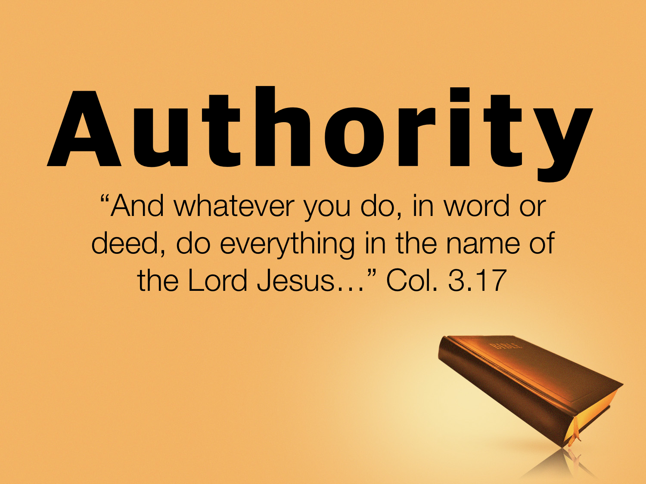

Slide 3
What Do We Mean By Authority?
Authority: "the power of rule or government," the power of one whose will and commands must be obeyed by others
(Vine's Expository Dictionary of New Testament Words)

Slide 4
Consider The Following:
We need God’s authority for all that we do.
We need God’s authority for most of what we do.
We need God’s authority for some of what we do.
We need God’s authority for none of what we do.

Slide 5
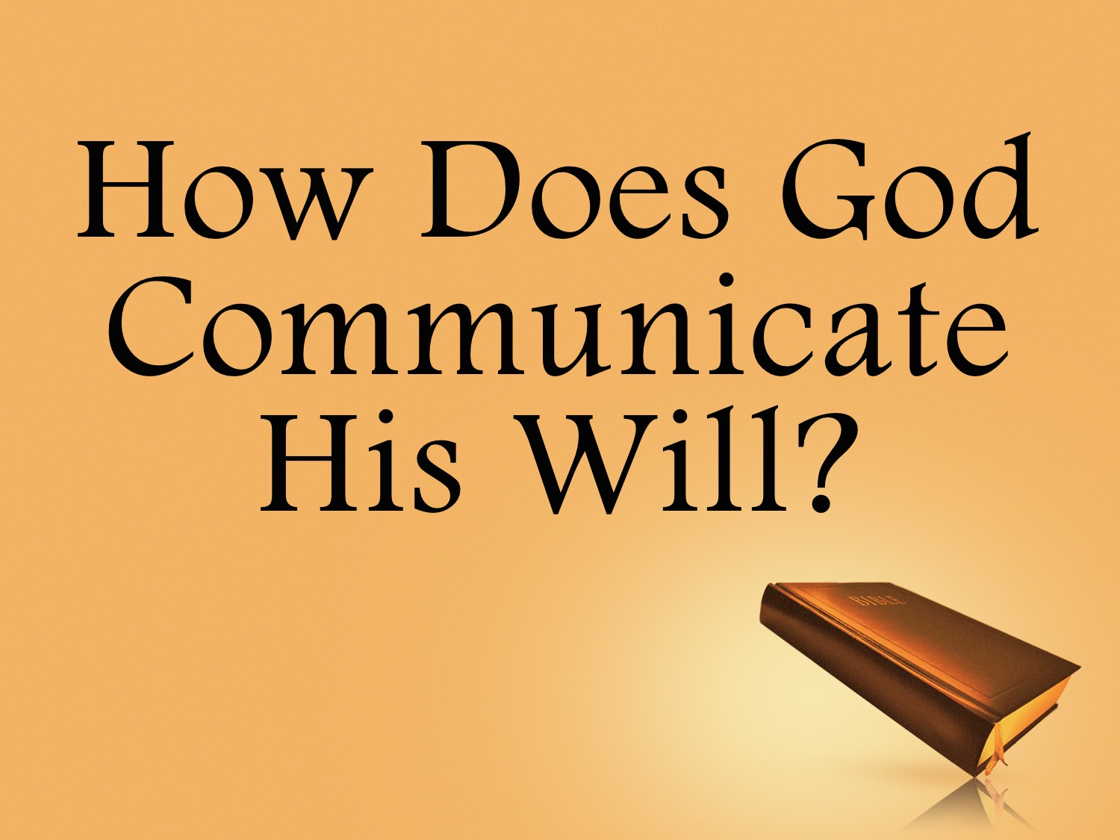

Slide 6
God Chose To Communicate His Will With WORDS
Men were expected to UNDERSTAND and obey the words of God: Exo. 20.1ff, cf. Acts 7.38; Deut. 4.4-5, 10; Jer. 1.9-10
Have you not READ? Matt. 19.4-6; Gen. 2.18-25

Slide 7
God Chose To Communicate His Will With WORDS
Apostles and prophets WROTE down what the H. S. said so that future generations would know the Lord’s will: John 14.25-26; 16.13; 1 Cor. 14.37; Col. 4.16; 1 Thess. 5.27; 2 Thess. 2.15; Eph. 3.3-5

Slide 8
How COMMUNICATION Works
“Then the Lord said to him, ‘Who has made man's mouth?’” Exo. 4.11

Slide 9
How COMMUNICATION Works
God created us with the ABILITY to communicate with each other
  What conversations did you have this morning?
  How did you communicate your thoughts and will to others?

Slide 10
How COMMUNICATION Works
Did you tell something to someone you wanted them to know or do?

Slide 11
How COMMUNICATION Works
Did you show something to someone you wanted them to know or do?

Slide 12
How COMMUNICATION Works
Did you imply something to someone you wanted them to know or do?

Slide 13

How do we teach names, dates & places?

Slide 14
How do we teach writing ABCs or math?

Slide 15
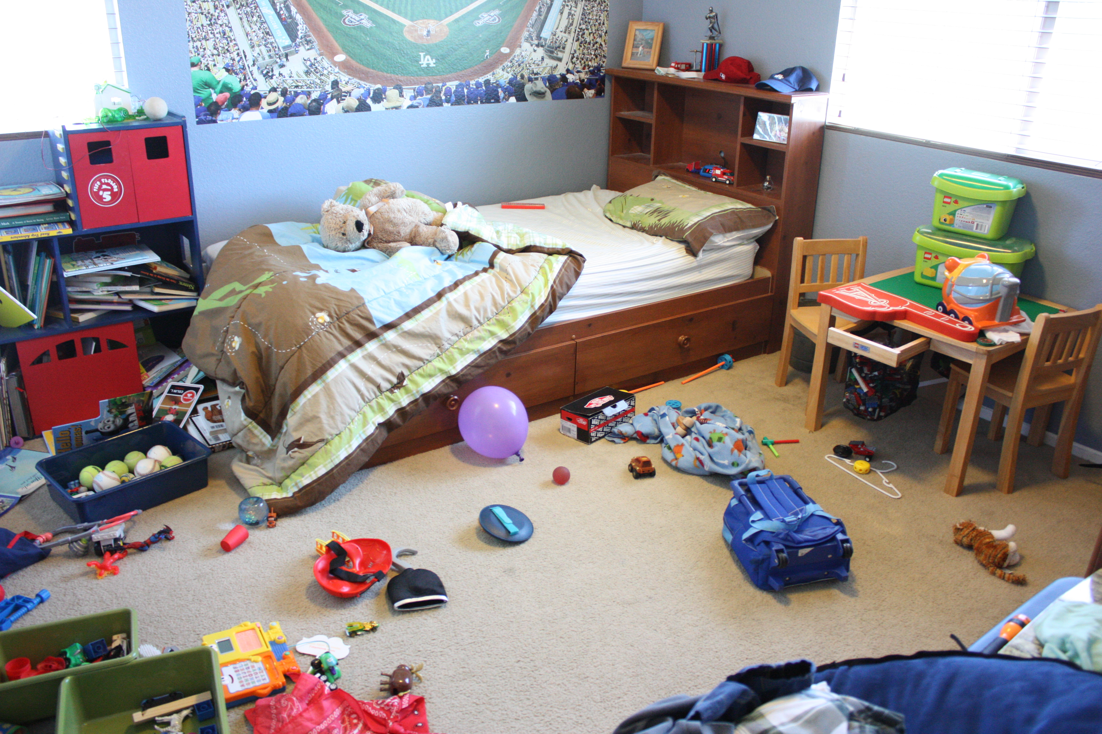
How do we teach kids to clean their room?
Notes:
http://www.desireeeaglin.net/wp-content/uploads/2012/09/9-17-12-007.jpg

Slide 16

How do we teach kids to tie their shoes?
Notes:
http://blog.novakdjokovicfoundation.org/media/2015/03/father-helping-son-to-tie-his-shoe.jpg

Slide 17
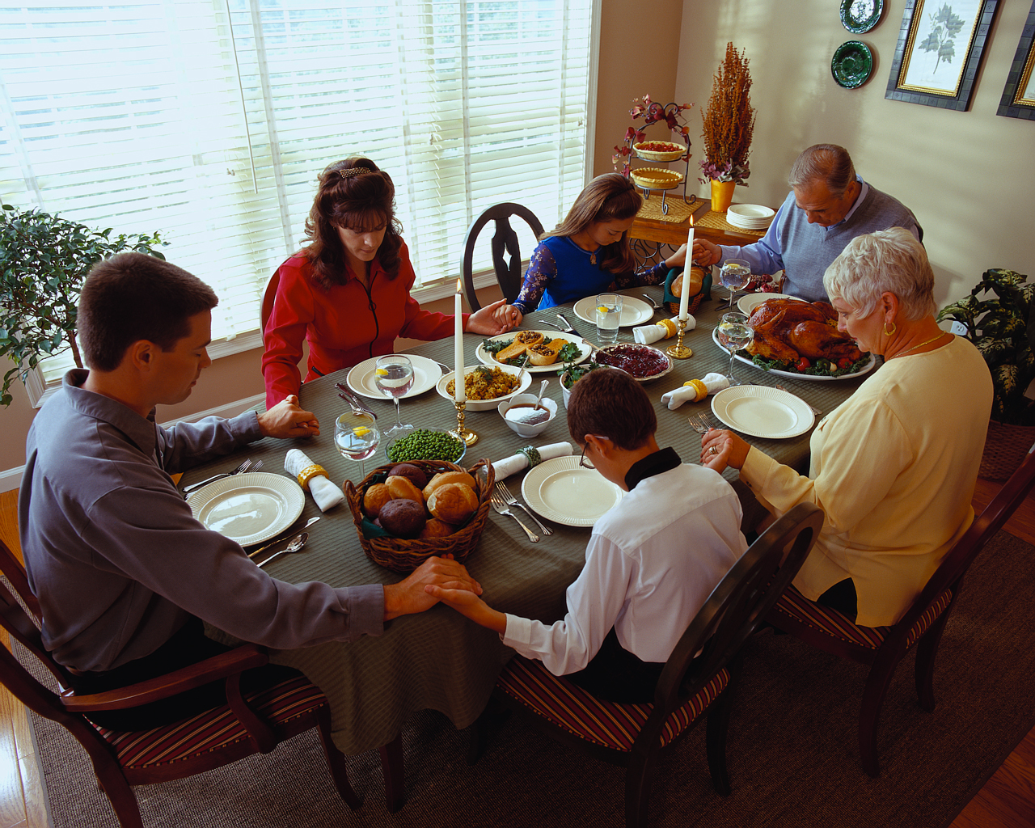
What is meant by, “dinner’s ready!”?
Notes:
http://www.columbuscatholicwomen.com/wp-content/uploads/2012/05/family-praying-dinner2.jpg

Slide 18
Tell
“Do the laundry”
Show
How to separate the whites from the colors, how much detergent to use, bleach, etc.
Imply
Put the detergent in the washing machine, put the clothes in, turn the water on, etc. When done washing, transfer clothes to the dryer. Fold. Put up.

Slide 19
How COMMUNICATION Works
ALL human communication: TELL, SHOW, IMPLY
It is IMPOSSIBLE to communicate anything without one of these methods
Try it. Can you communicate to
me another way without TSI?

Slide 20
How COMMUNICATION Works
If you disagree with what I’m saying do not tell me you disagree, do not show me you disagree and do not imply your disagreement!

Slide 21
How COMMUNICATION Works
This is not special theology
This is not ‘church of Christ’ doctrine
This is not a magic formula
This is communication!
No one INTERPRETS anything that
is not first told, shown or implied.

Slide 22
How COMMUNICATION Works
God communicates to us the SAME WAY we communicate to each other: Deut. 4.5; Jer. 1.9
Because God used words to reveal His will then we must understand that these words will:
  Tell us something
  Show us something
  Imply something

Slide 23
How COMMUNICATION Works
The Bible was not written to you or me.
It was written to specific individuals & churches to deal with specific issues they had in the 1st century.
Nowhere does it command me to
become a Christian: Rom. 3.23;
6.23; 10.34-35; Acts 2.38; 11.26;
26.28; 1 Peter 4.16

Slide 24
Communication In SCRIPTURE
Tell: one can communicate by either a COMMAND or STATEMENT
“…as the Lord commanded him…” Lev. 8.4, 9, 13, 17, 21, 29; 9.10
A statement of fact: Mark 16.16; Acts 9.6 cf. 22.16; Acts 11.13-14 cf. 10.47-48

Slide 25
Communication In SCRIPTURE
Show: one can communicate through EXAMPLES
“For I have given you an example, that you also should do just as I have done to you.” John 13.15

Slide 26
Communication In SCRIPTURE
Show: one can communicate through EXAMPLES
“Be imitators of me, as I am of Christ.” 1 Cor. 11.1

Slide 27
Communication In SCRIPTURE
Show: one can communicate through EXAMPLES
“Brothers, join in imitating me, and keep your eyes on those who walk according to the example you have in us.” Phil. 3.17

Slide 28
Communication In SCRIPTURE
Show: one can communicate through EXAMPLES
“What you have learned and received and heard and seen in me—practice these things, and the God of peace will be with you.” Phil. 4.9

Slide 29
Communication In SCRIPTURE
Show: one can communicate through EXAMPLES
“Follow the pattern of the sound words that you have heard from me, in the faith and love that are in Christ Jesus.” 2 Tim. 1.13

Slide 30
Communication In SCRIPTURE
Show: one can communicate through EXAMPLES
“See that you make everything according to the pattern that was shown you on the mountain.” Heb. 8.5

Slide 31
Communication In SCRIPTURE
Imply: Why do we INFER anything? Because something is NOT directly or expressly stated or shown.
Jesus EXPECTED others to infer from what they knew: Luke 12.54-56; John 10.24-25; 9.32-33; 3.2

Slide 32
Communication In SCRIPTURE
NECESSARY Inferences: Gen. 1.1; Matt. 3.16; Acts 8.35-36
Unnecessary inferences: 2 Peter 3.4-9

Slide 33
Communication In ACTION
TELL
“Come together in the church to eat the Lord’s Supper.” “Do in remembrance of Christ” 1 Cor. 11.23-26
SHOW
Bless the bread and fruit of the vine; use bread and fruit of the vine; partaking on first day of the week; come together for that purpose Luke 22.14-20; Acts 20.7
IMPLY
Lord’s Supper may not be eaten outside the assembly called for that purpose or on another day than the first day of the week. But assembly may occur at any hour on the first day. We are to use bread and fruit of the vine when we partake.

Slide 34
Communication In ACTION
God used TSI to communicate His will: Acts 10.9-16, 19-20, 28; Acts 15.7-20
vv7–11 God implied to Peter: chapter 10
v12 God showed Paul: chapters 13–14
vv14–18 God told his people: Amos 9.11–12
God was silent on the matter!

Slide 35
Coming Up
The silence of God: Does silence give authority?
A common objection: “God did not tell us, show us or imply to us…”
  A church building
  A projector
  A songbook, etc.

