Slide 3
Parables
A parable is "a short, simple story designed to communicate a spiritual truth, religious principle, or moral lesson; a figure of speech in which truth is illustrated by a comparison or example drawn from everyday experiences" (Nelson's New Illustrated Bible Dictionary, [Thomas Nelson Inc. Nashville, TN, 1995] p. 943).
A parable is sometimes defined as "an earthly story with a heavenly meaning" (And Jesus Said, William Barclay, [The Westminster Press, Philadelphia, PA, 1970], p. 12).

Slide 4
The Context
Luke 15.1-2
He claims to be God and He sits with the sinners? Luke 5.29-32
The three parables picture the “joy in heaven” over each “sinner who repents.”

Slide 5
The Context
The lost sheep: Luke 15.3-7
The lost coin: Luke 15.8-10

Slide 6
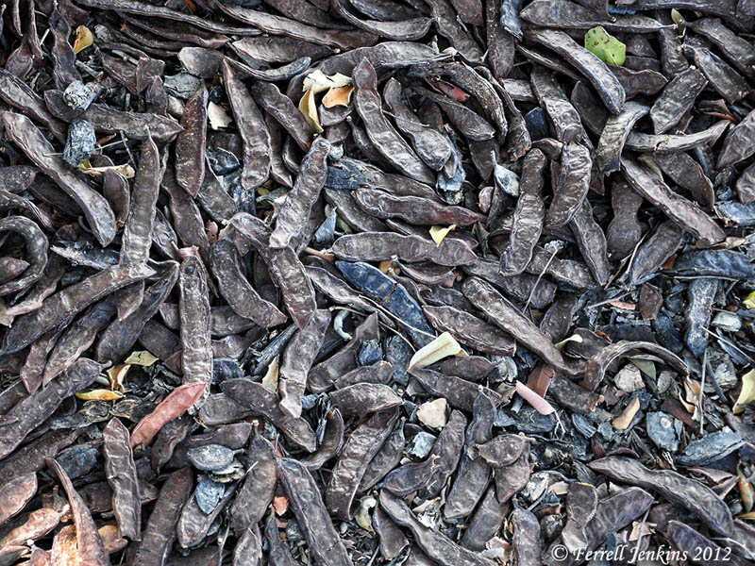
The Lost Boy
The wasteful son represents the sinners who were repenting.
Dissatisfaction
Demand
Departure
Realization: 1 John 2.15-17; Heb. 11.24-26; James 4.4
Repentance: James 4.6-10
Return
Restoration
Rejoicing

Slide 7
The Father
The father represents God: vv.20-24
God will remit and reward: 2 Peter 3.9; 1 John 1.9; John 3.16￼; Rom. 5
God has proven it: I Cor. 6.9-11; 15.9; Gal. 1.13; Phil. 3.6; 1 Tim. 1.12-17

Slide 8
The Older Brother
The older brother represents the Pharisees and scribes: vv. 25-32
The older brother was self-righteous: Luke 18.10-14
The older brother was self-centered: Phil. 2.1-4
The older brother was selfish: 1 John 3.17

