Slide 3
What Do We Mean By Authority?
Authority: "the power of rule or government," the power of one whose will and commands must be obeyed by others
(Vine's Expository Dictionary of New Testament Words)

Slide 4
Consider The Following:
We need God’s authority for all that we do.
We need God’s authority for most of what we do.
We need God’s authority for some of what we do.
We need God’s authority for none of what we do.

Slide 5
Does Authority Really MATTER?
It matters to God, Lev. 10.1-3
It matters to Jesus, Matt. 28.18
It matters to Paul, 1 Thess. 2.13; 2 Tim. 1.13
It matters to Peter, 1 Peter 4.11
It better matter to us!

Slide 6
One SOURCE, One STANDARD
“If anyone hears my words and does not keep them, I do not judge him; for I did not come to judge the world but to save the world. The one who rejects me and does not receive my words has a judge; the word that I have spoken will judge him on the
last day.” John 12.47-48

Slide 7
The WISDOM Of Men
PREACHERS/teachers, 1 Cor. 2.5; 1.21; Jer. 10.23
PARENTS, Gal. 1.13-14; Matt. 10.37

Slide 8
TRADITIONS
Apostolic traditions are BINDING, Acts 2.42; 2 Thess. 2.15
Manmade traditions become sinful when they NULLIFY apostolic traditions, Mark 7.1-1

Slide 9
The SILENCE Of The Scriptures
“The Bible doesn’t say ‘not to’.”
Does silence give us authority to practice certain traditions?
Mechanical instruments? 1 Cor. 4.6; Rom. 14.23; 10.17; 2 Tim. 3.16-17

Slide 10
The MAJORITY
“Surely so many people cannot be wrong.” Matt. 7.13-14; Gen. 6.5-6; 1 Peter 3.20; Deut. 7.7; Num. 14.28-30; John 6.66-68; Matt. 27.25
“Everybody else is doing it.” 1 Sam. 8.4-7, 19-20

Slide 11
EMOTIONS
“If it makes you feel good, it must be right.”

Slide 12
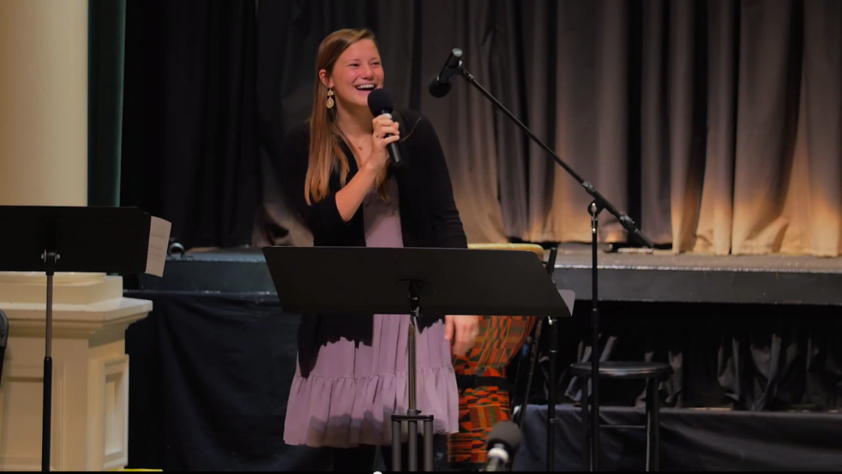
Lauren King, Preacher intern at Fourth Avenue Church of Christ, Franklin, TN

Slide 13
EMOTIONS
“…I went to Lipscomb, not as a Bible major, but a communications major and the Lord made it very clear that He wanted me to do youth ministry. So I starting majoring in Bible with an emphasis in youth ministry and did, I’ve done, three youth internships. The Lord also made it clear, um, through a lot of
discernment, through a lot of
prayer that I was suppose to
pick up a preaching emphasis…

Slide 14
EMOTIONS
…A lot of the ways that I’ve been perceiving the Lord’s voice is through having peace when I walk through open doors. If I haven’t had a peaceful heart then that’s not really were I’m suppose to be, but if I’m in a place where I have peace about where I’m going then that’s that’s the Lord
Telling me, ‘yes’…”

Slide 15
EMOTIONS
For something to SEEM right doesn’t make it RIGHT, Prov. 14.12; 28.26
It MUST be in line with God’s word, 1 Tim. 2.11-12
Emotions LEAD to “Spirit
leading.” To understand God’s
will is to read His word,
Eph. 3.3-4; 5.17

Slide 16
CONSCIENCE
Unless our conscience is properly trained by the word of God, our conscience can be misleading, Acts 8.1-3; 9.1; 23.1; 26.9

Slide 17
The Law Of MOSES
We cannot appeal to the LOM for salvation, Gal. 3.19; 16; Col. 2.14; Rom. 15.4; 1 Cor. 10.11

Slide 18
False Authorities In Religion
Every human source of authority puts greater value on man’s thoughts, desires, emotions, traditions, etc., than on what God says.

Slide 19
False Authorities In Religion
We must have NT authority for every belief, teaching and practice to be right with God, John 12.48; Rom. 2.16

Slide 20
False Authorities In Religion
Must give up everything that is not from NT to be right with God in Christ, 2 John 9

