Slide 2
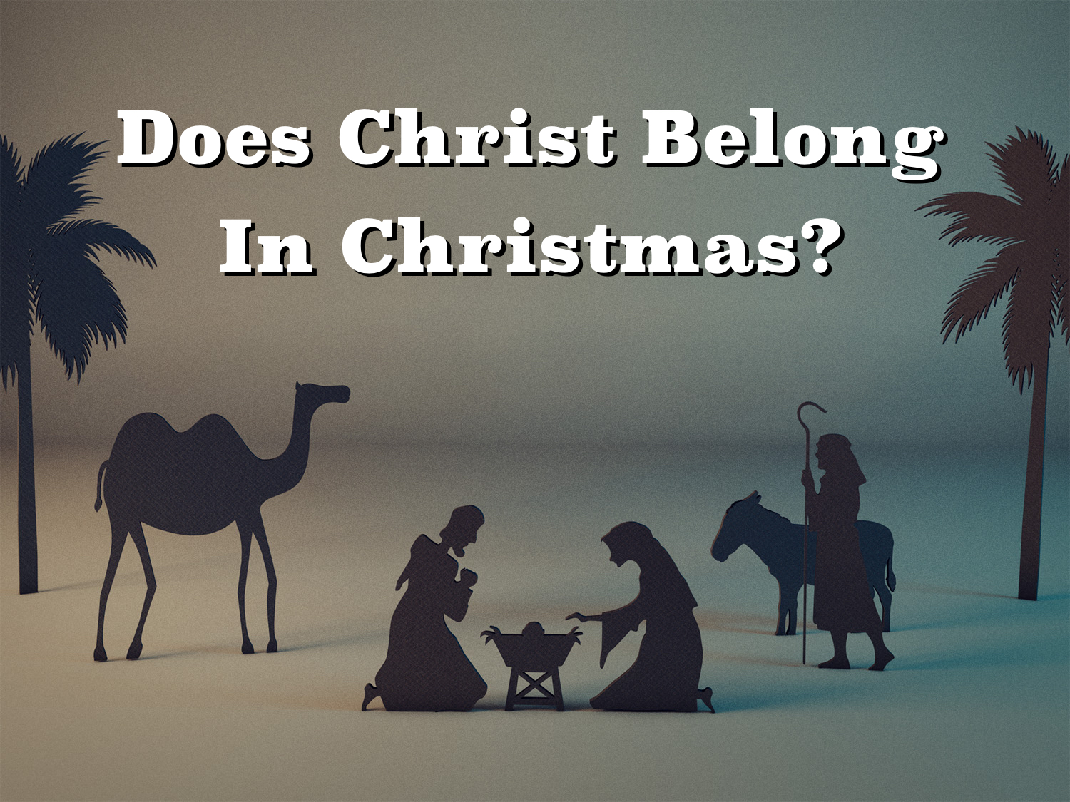

Slide 3
THE BIBLE And Christmas
Bible mentions Jesus’ birth, Matt. 1.18-25, 2.1-23; Luke 2.1-40
Bible does NOT mention “Christmas,”
Christ’s birth date or any
references to special
observances

Slide 4
THE BIBLE And Christmas
Christmas is rooted in FALSE religion (paganism).
“Christmas” (Christ-Mass) and “Santa Claus”
(St. Nicholas) both with origins of
paganism and Catholicism

Slide 5
THE BIBLE And Christmas
Christmas observances DISTORT many Biblical truths:
  “There were three wise men that were present
  when Christ was born.”
  “The wise men went to Bethlehem and
  worshipped Jesus the night of His birth.”
  “The shepherds, wise men
  and all followed the star to
  the manger.”

Slide 6
THE CHURCH And Christmas
The Church is SUBJECT to Christ, Eph. 5.23-24
As a church that belongs to Christ we obey Jesus, Col. 3.17; 1 Cor. 4.6; 2 John 1.9
Since Christ is our head, we may only
engage in religious practices
that he has ordained,
cf. Matt. 15.9

Slide 7
THE CHURCH And Christmas
The Church isn’t AUTHORIZED to observe Christmas / birth of Jesus / any holidays
  If we do any thing Christ hasn't authorized (such as observing man-made holidays), our worship is VAIN, Mark 7.6-9
  We are WARNED against
  presumption in religion,
  2 Sam. 7.1-7; Jer. 10.23;
  2 Pet. 2.10; 2 John 9

Slide 8
THE CHURCH And Christmas
Paul was AFRAID for the churches of Galatia had begun to OBSERVE holy days, Gal. 4.1-11
Nothing in the N.T. authorizes celebrations / masses / special services concerning the
birth of Christ

Slide 9
THE CHURCH And Christmas
The only DIVINELY authorized religious holiday is the first day of the week.
  This day is set aside to HONOR Christ (the Lord’s Day)
  EVERY first day of each week is equally
  Significant.

Slide 10
THE CHURCH And Christmas
The church should remember the DEATH of Jesus
  His death is REMEMBERED during the Lord’s Supper, 1 Cor. 11.24-26
  The birth of Christ means NOTHING if
  Jesus Christ did not die on
  the cross!

Slide 11
THE INDIVIDUAL And Christmas
The individual MAY non-religiously do some things others do religiously.
  The washing of hands before eating, Matt. 15.1-20
  The Pharisees were wrong because they did it religiously.
  Disciples were not forbidden
  to wash at all because
  others did it religiously.

Slide 12
THE INDIVIDUAL And Christmas
Meat offered to IDOLS could be eaten socially, but not “as meat offered to idols” 1 Cor. 8; 10.27-28
We may observe Christmas customs
socially but NOT as a religious holiday;
let us not judge one another,
Rom. 14.5-6, 10, 13

Slide 13
THE INDIVIDUAL And Christmas
We do many things connected with Christmas at any time including December 25 -- Give gifts, express good will, sing seasonal songs, send cards -- not religiously!
Liberty does not give us the right to engage
in Christmas’ religious practices:
participating in religious,
unscriptural Christmas
plays, songs, etc.

Slide 14
“Let’s Put Christ BACK Into Christmas”
Christ was NEVER in Christmas!! He can’t be put back into something He was NEVER in!!
  The apostles NEVER celebrated Jesus’ birthday or “Christmas”!
  Christ NEVER commanded us to remember
  His birthday as He did His
  death (Matt. 26.26‑29).

Slide 15
God’s Plan For Your Salvation
Hear The Word – Rom. 10.17
Believe The Word – John 8.24
Repent Of Sin – Acts 17.30
Confess Faith In Christ – Rom. 10.9-10
Be Immersed – Acts 22.16
Remain Faithful – Rev. 2.10

