Slide 2
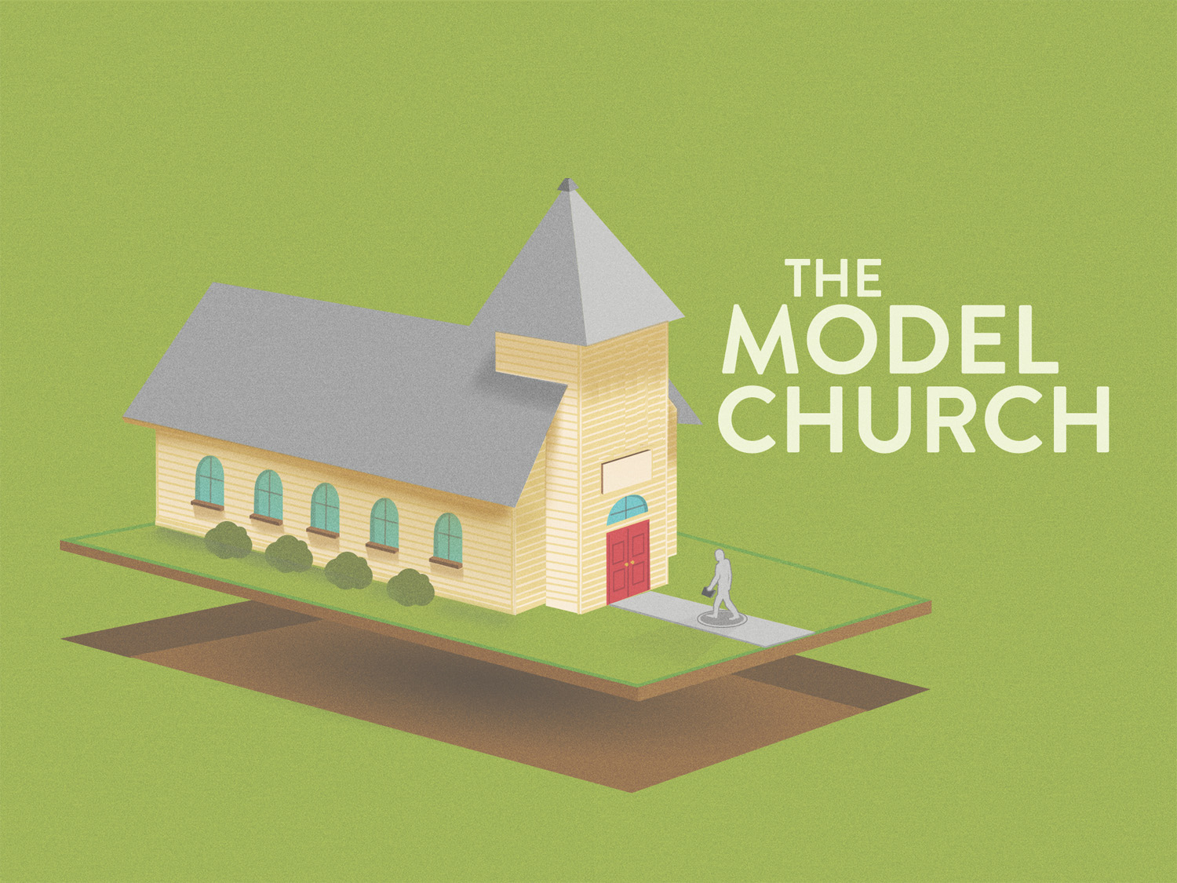

Slide 3
They Were A SEED Planted Church
The church at Antioch started because the seed of God was PLANTED, Luke 8.11; Acts 11.19-21; 7.57-8.4

Slide 4
They Were An UNITED Church
Antioch was COMPOSED of Jew & Gentiles, Acts 11.19-21
United DESPITE different backgrounds, Acts 11.2-3, 18

Slide 5
They Were A GROWING Church
By PREACHING & teaching the Lord Jesus, Acts 11.20, 26; Matt. 28.18; Acts 2.36; 10.36
By EXHORTING with the Word, Acts 11.23; Acts 20.32
FAITHFULNESS to Jesus, Matt. 28.19-20

Slide 6
They Were A GROWING Church
“The HAND of the Lord was with them,” Acts 11.21
  Without DIVINE help, we can never have the right kind of growth
    It is God who opens doors of opportunity, Col. 4.3
    It is God who gives the increase, 1 Cor. 3.5-7
Barnabas SAW the “grace of God,” Acts 11.23
  How do you see someone’s faith? By their works, cf. James 2.14-26
  How do you see the grace of God? By the results of God’s bestowed grace, John 3.16

Slide 7
They Were A GROWING Church
With God's help, we can EXPECT growth
  The 120 disciples grew to over 3000 just in one day, Acts 1.15; 2.41
  Then about 5000 men, Acts 4.4
  The church “multiplied,” Acts 6.7; 9.31
  There were "thousands" of Jews who believed, Acts 21.20

Slide 8
Where there is little or no growth, something is WRONG!

Slide 9
They Were A GROWING Church
The growth was also with the AID of teachers
  Like Barnabas, who encouraged them by word and example, Acts 11.22-24
  Like Saul, who together with Barnabas taught a great many people, Acts 11.25-26
How is the church to grow?

Slide 10
By preaching Jesus as Lord, PRAYING for God's helping hand, UTILIZING those able to teach, and a church will grow!

Slide 11
They Were A GENEROUS Church
The prophet Agabus foretold of a famine to come upon the world
  The disciples gave according to their ABILITY, Acts 11.27-29
  Which is all that God ASKS of any congregation, 2 Cor. 8.12-14

Slide 12
They Were A DETERMINING Church
To send RELIEF to the brethren in Judea, Acts 11.29
“Determined & DID it”

Slide 13
They Were A MATURE Church
"Prophets & TEACHERS,” Acts 13.1
  They were INTERESTED in growth and edification, Eph. 4.11-12
They were FOCUSED on the Word of God, Acts 14.24-27

Slide 14
This is an INDICATOR of a spiritually mature group of Christians!

Slide 15
They Were A DEVOTED Church
The church at Antioch was where disciples of Christ were first called CHRISTIANS, Acts 11.26
  Devoted to CHRIST!
  Great example of a MODEL church, Phil. 3.17

Slide 16
How Are We Doing Northside?

Slide 17
God’s Plan For Man’s Salvation
Hear The Gospel, Matt. 17.5
Believe That Jesus Is The Christ, John 8.24
Repent Of Sins, Acts 17.30
Confess Faith In Christ, Rom. 10.9-10
Be Fully Immersed In Jesus’ Name, 1 Peter 3.21
Be Faithful In All Things, Revelation 2.10
Repent, Confess, Pray, 1 John 1.9

